Slide 1
Year 9 end of year assessment
Revision guidance and material

Slide 2
In science at Pensby we believe in 5 keystone revision activities that support knowledge retrieval and having fun with revision. 1. Mind mapping 2. Flashcards 3. Quizzing 4. Model essay plans 5. Timed Practice For each topic you should try and use the activities above to help recall the information you will need for your exam. Here are some useful things to remember about how to utilise these activities.
 | Helpful Tips | Top things to do
Mind mapping | Use your book and the support sheets enclosed in this booklet to ensure you have all the required information on the map. Single words and pictures on branches. No more than 5 sub sections per section. | Create lots of sub categories. To be effective, you must practice recall- don’t just stick them in your folder or on your wall.
Flashcards | Create 5-10 per week and focus on these. Add them together in the following weeks. Use different colour to separate different subjects. | Mix them up over the weeks. Play pairs, connect 4 in a sentence, odd one out, beat a timer- beat a friend or guess the 5 taken away.
Quizzing | Create the answer sheets. Share and trade them with your friends- the more quizzes the better. | Top 10 key facts. Multiple choice quizzes. Fill in gaps. Crosswords.
Model Essay practice | Create single side cards with a concise introduction, main body bullet points and a conclusion for different topic areas. | Bullet points only- no full sentences- its not a full essay. After created, be quizzed on the content of the card.
Timed Practice. | Set a timer- take away all notes and distractions. This is the last step in any revision- you should have thoroughly studied key content before. | Do the same timed activity as a friend and swap. Always review your answers.

Slide 3
Key information
Biology
Before |  |  | Topics covered… | After
R | A | G | Human skeleton and movement | R | A | G
R | A | G | Gas exchange, breathing and respiration | R | A | G
R | A | G | Cell organisation, types of cells | R | A | G
R | A | G | Variation and adaptations | R | A | G
R | A | G | Plant reproduction and photosynthesis. | R | A | G
Chemistry
Before |  |  | Topics covered… | After
R | A | G | The periodic table | R | A | G
R | A | G | Atoms, elements, compounds and mixtures. | R | A | G
R | A | G | Solids, liquids and gases | R | A | G
R | A | G | Separation techniques | R | A | G
R | A | G | Physical and chemical changes and metal reactions. | R | A | G
Physics
Before |  |  | Topics covered… | After
R | A | G | Energy transfers and resources | R | A | G
R | A | G | Space and gravity. | R | A | G
R | A | G | Electrical circuits and static electricity | R | A | G
R | A | G | Forces and motion | R | A | G
R | A | G | The particle model and pressure. | R | A | G
How to get top marks:
Look back at your previous assessments and at any gaps that you identified and ensure you work to close that gaps in preparation.
When writing an experimental procedure, as yourself ‘”could someone else follow my instructions and do the experiment I want them to do?”
When doing calculations, think “ is my answer sensible in the context of the question?”

Slide 4
Revision QR codes and quiz link.
The link below will take you to some online quizzes to help you revise, following the quiz it will go through all of the answers, this will help you spot any areas that might need a little extra work.
https://www.cgpbooks.co.uk/resources/cgp-s-free-online-10-minute-tests/free-ks3-science-online-10-minute-tests
Biology
Human skeleton and movement | Gas exchange, breathing and respiration | Cell organisation, types of cells | Variation and adaptations | Plant reproduction and photosynthesis.
Chemistry
The periodic table | Atoms, elements, compounds and mixtures. | Solids, liquids and gases | Separation techniques | Physical and chemical changes and metal reactions.
Physics
Energy transfers and resources | Space and gravity. | Electrical circuits and static electricity | Forces and motion | The particle model and pressure.

Slide 5
Biology

Slide 6
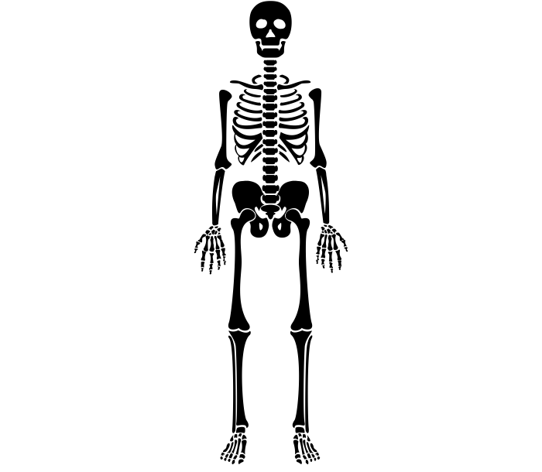
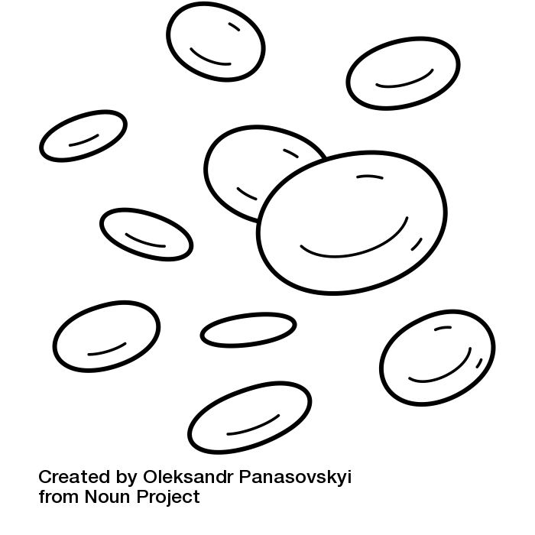
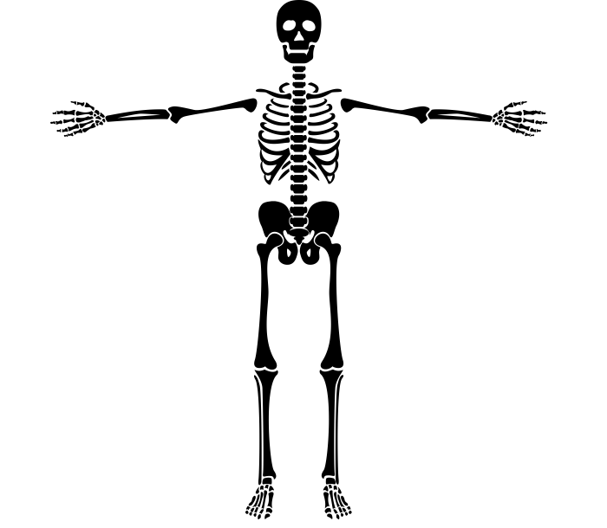
What you need to know about ...
The Skeleton
Bones
Bones are a living tissue, they require a blood supply and can repair themselves
The skeleton
Skull
Vertebrae
Rib cage
Humerus
Radius and Ulna
Pelvis
Femur
Tibia and fibula
Functions of the skeleton
Produce
blood cells
Protect organs
Support of the body
Allows movement

Slide 7
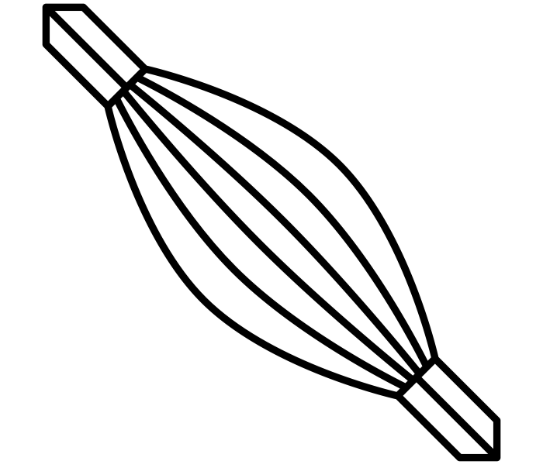
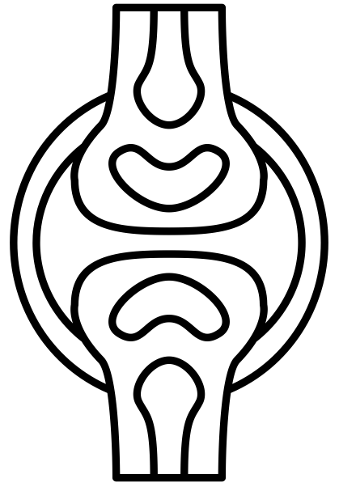
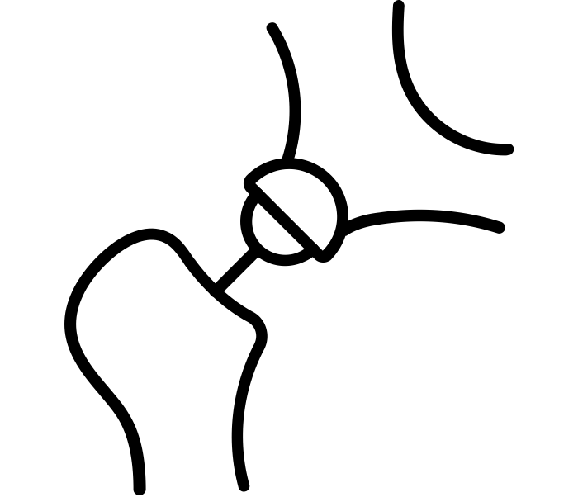
What you need to know about ...
Joints
Joints
A joint is a place in the body at which two bones meet
Tendons
- Connect muscle to bone
- Allow muscles to pull on bones for movement
- Not elastic or stretchy
Ligaments
- Connect bone to bone
- Allow movement in the joint but keeps the bones in line
- Elastic or stretchy
Cartilage
- A soft tissue which covers the end of bones
- Reduces friction of bones rubbing together when moving
- Protects the end of bones
Types of Joints
Ball and Socket
Allows the greatest range of movement
E.g. hip joint
Fixed joint
Allows no movement at all
E.g. top of the skull
Hinge
Allows movement in one direction
E.g. knee

Slide 8
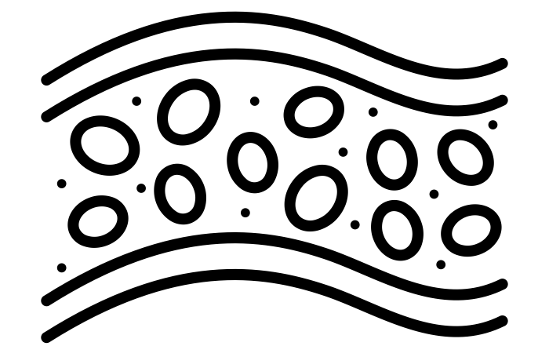
What you need to know about ...
Breathing
Inhalation
Inhalation is the process of breathing in
- Ribcage is pulled upwards and outwards
- Diaphragm contracts and moves downwards
- Volume in the lungs increases
- Air moves into the lungs
Exhalation
Exhalation is the process of breathing out
- Ribcage is pulled downwards and inwards
- Diaphragm relaxes and moves upwards into a dome
- Volume in the lungs decreases
- Air moves out of the lungs
Adaptations of the lungs
Lots of blood vessels to take away oxygenated blood
Thin walls in the alveoli to reduce distance of diffusion
Alveoli create a large surface area
Moist

Slide 9
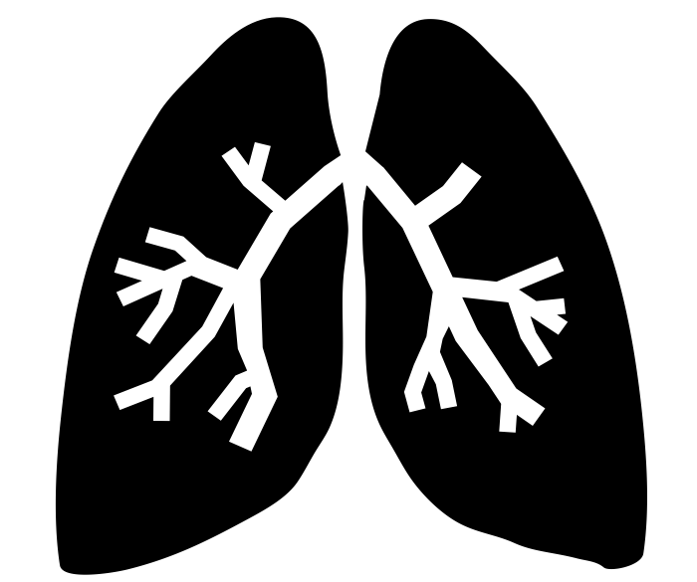
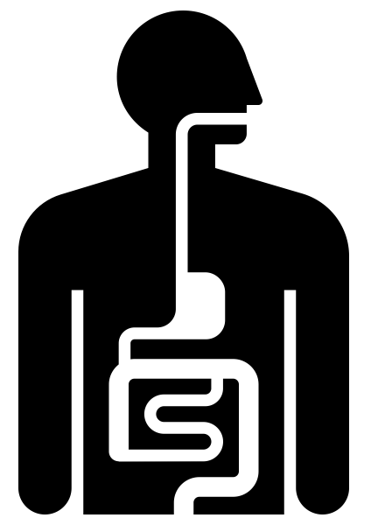
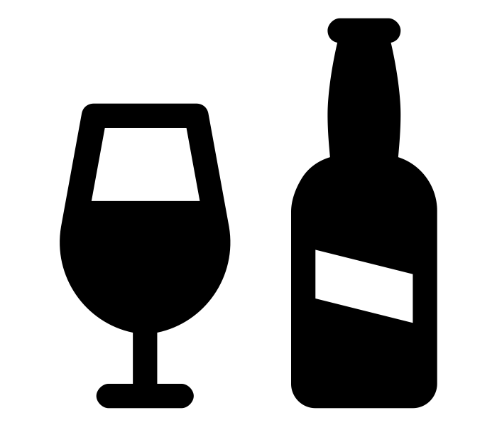
What you need to know about ...
Respiration
Aerobic Respiration
Transported in blood cells from the lungs
More than anaerobic respiration
Glucose + Oxygen → Carbon dioxide + Water + Energy
Comes from food broken down in digestion
Exhaled from the body
Respiration happens in the mitochondria
Anaerobic Respiration
Less than aerobic respiration
Not enough oxygen so glucose can’t be fully broken down
Glucose→Lactic acid + Energy
Builds up in
muscles and
causes cramps, needs extra oxygen to break it down
Cannot be be used for long periods of time because of this
Fermentation Fermentation is a type of anaerobic respiration by yeast in which glucose is broken down and forms ethanol
Glucose→Carbon dioxide + Ethanol
Can be used to make bread and cakes rise
Can be used in alcoholic drinks

Slide 10
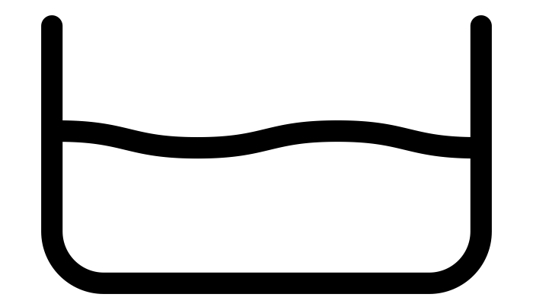
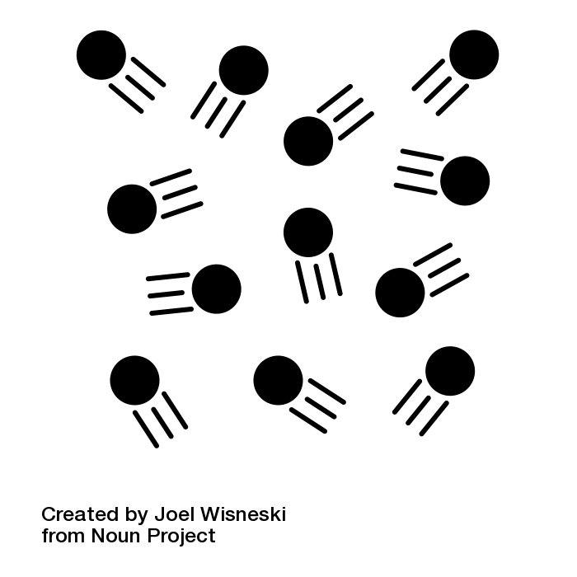
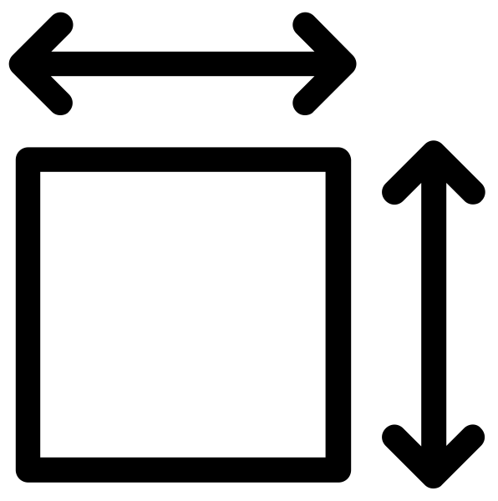
What you need to know about ...
Diffusion In Cells
Diffusion
Diffusion is the random spreading of particles, from an area of high concentration to an area of low concentration.
High concentration
(all close together)
Low concentration
(spread throughout the liquid)
Diffusion in cells
Diffusion occurs across the cell membrane.
Substances which will diffuse into a cell
Substances which will diffuse out of a cell
Oxygen
Carbon DIoxide
Nutrients
Urea
Factors which will speed up diffusion
A higher temperature
A gas rather than a liquid
A larger surface area

Slide 11
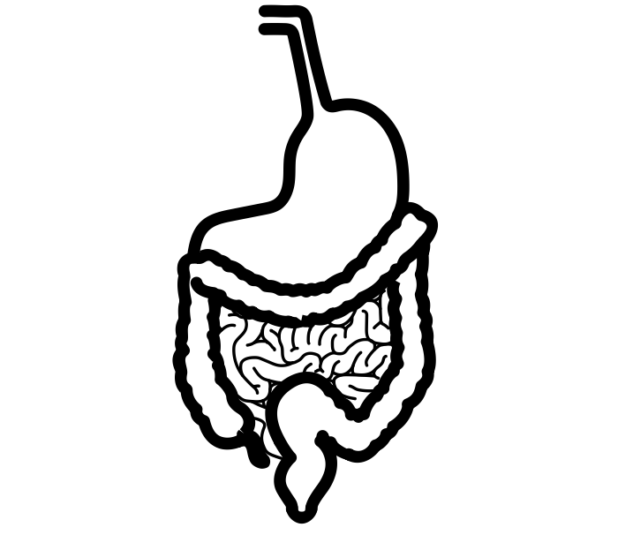
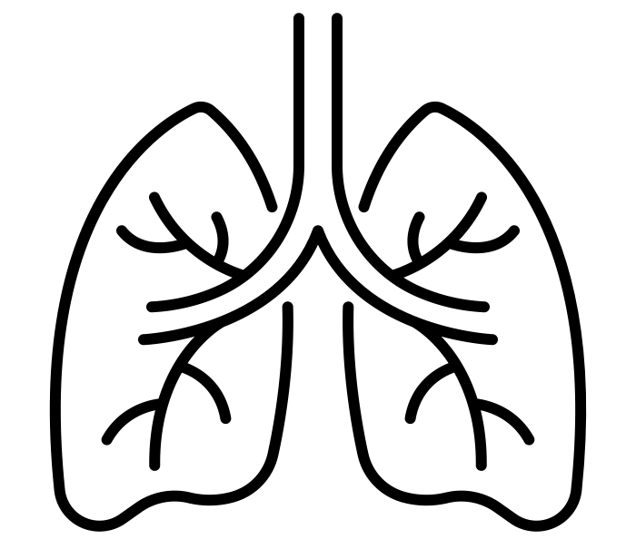
What you need to know about ...
Levels of Organisation
The skeleton
Organism
Made up of several different organ systems which work together to allow a living thing to survive
E.g. a whole human
Organ system
A group of different organs that come together to perform a certain function
E.g. digestive system, respiratory system
Organs
Made up of different types of tissue that work together to perform a particular role
E.g. heart, lungs, stomach, brain
Tissue
A group of similar cells working together to perform a certain function
E.g. muscle tissue, nervous tissue
Cells
The building blocks of life, these can be specialised in order to perform specific roles
E.g. red blood cells, muscle cells

Slide 12
What you need to know about ...
Plant and Animal Cells
Animal Cells
Cytoplasm
A jelly like substance where chemical reactions take place
Cell membrane
Controls what enters and leaves the cell
Nucleus
Controls the cell's activities and DNA is stored here
Mitochondria
Respiration occurs here
Plant Cells
Vacuole
Contains cell sap to keep the cell firm
Cytoplasm
A jelly like substance where chemical reactions take place
Chloroplasts
Photosynthesis occurs here
Nucleus
Controls the cell's activities and DNA is stored here
Mitochondria
Respiration occurs here
Cell Wall
Gives the cell strength and structure
Cell membrane
Controls what enters and leaves the cell

Slide 13
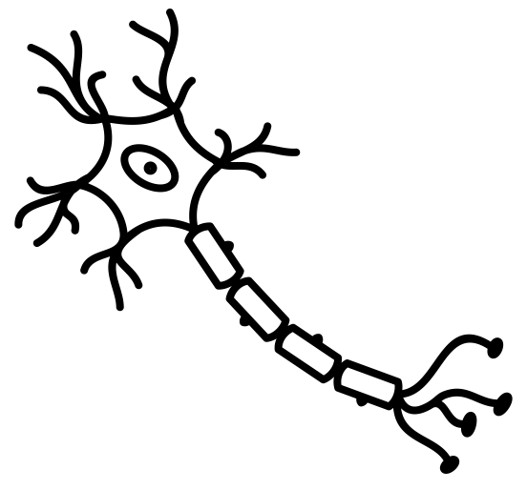
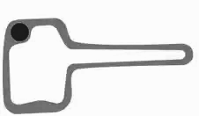
What you need to know about ...
Specialised Cells
Specialised Cells
A specialised cell is a cell which is suited to do a particular job.
Sperm Cells
A sperm cell is adapted so that it can fertilise an egg cell.
Red Blood Cells
A red blood cell is desgined to carry oxygen around the body.
No nucleus so that they can carry more oxygen
Lots of mitochondria to release a lot of energy
A tail to allow the sperm to swim towards the egg cell
A biconcave (donut) shape so they have a larger surface area to absorb oxygen
Nerve Cells
A nerve cell is designed to carry nerve impulses to different parts of the body.
Root Hair Cells
A root hair cell is designed to absorb water and nutrients for a plant.
A large surface area so that they can absorb water and minerals more effectively
Very long to send nerve impulses up and down the body
A thin cell membrane to speed up diffusion
Insulation to increase the speed of a nerve impulse

Slide 14
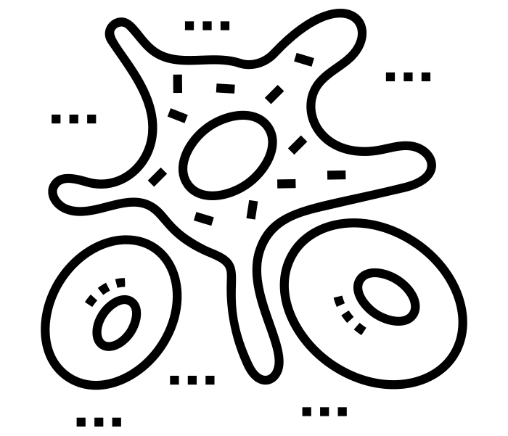
What you need to know about ...
Parts of the Blood
Red Blood Cells
Red blood cells transport oxygen around the body.
Adaptations include:
- Very small to fit through capillaries
- Donut shape for a greater surface
area
- Contain haemoglobin to bind to the oxygen to form oxyhaemoglobin
- No nucleus so more space to carry oxygen
White Blood Cells
White blood cells protect the body from
infection.
Some white blood cells produce
antibodies and some enguld harmful pathogens.
Platelets
Platelets are small fragments of cells
which allow the blood to clot, e.g. scabs.
Plasma
Plasma is a liquid used to carry
other liquids around the body.
Waste products include urea and carbon dioxide.
Useful products include nutrients and water.

Slide 15
What you need to know about ...
Blood Vessels
Arteries
Arteries carry oxygenated blood away from the heart.
- Blood has a high pressure and a pulse
- They have thick walls which are not
permeable
- A small lumen (opening)
- No valves
- Carry oxygenated blood
Veins
Veins carry deoxygenated blood back to the heart.
- Blood has a low pressure
- They have thinner walls which are not
permeable
- A large lumen (opening)
- Have valves to keep blood moving in
the right direction
- Carry deoxygenated blood
Capillaries
Capillaries connect arteries to veins.
- Blood has a low pressure
- They have thin walls (one cell thick) which are permeable
- No valves
- Blood slowly loses its oxygen to surrounding tissue

Slide 16
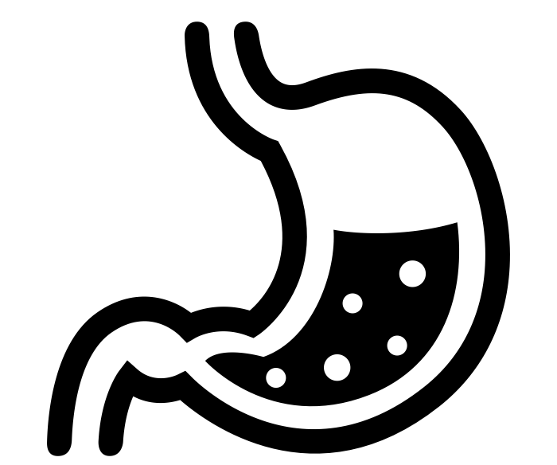
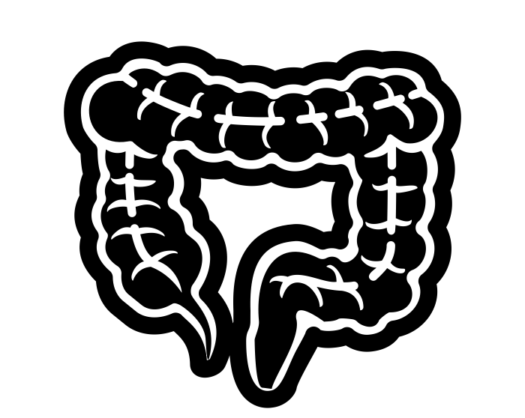
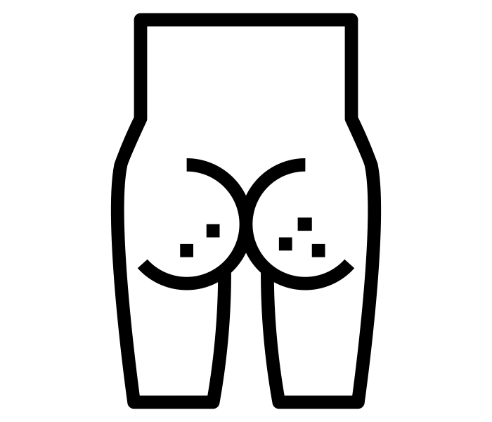
What you need to know about ...
The Digestive System
The Liver
produces bile which is secreted into the small intestine to neutralise stomach acid
The Oesophagus
(food pipe) connects the mouth to the stomach
The Pancreas
is a gland which produces enzymes
The Stomach
mixes food and also contains acid which kills bacteria
The Large Intestine
absorbs excess water
The Small Intestine
is where the majority of enzymes are secreted into and nutrients are absorbed into the blood
The Anus
Is where waste products are passed out of the body
Pathway of food through the digestive system
Mouth
Oesophagus
Stomach
Small Intestine
Large Intestine
Anus

Slide 17
What you need to know about ...
The Heart
Structure of the Heart
The Pulmonary Artery
(To the lungs)
The Aorta
(To the body)
The Vena Cava
(From the body)
The Pulmonary Vein
(From the lungs)
The Right Atrium
(deoxygenated blood)
The Left Atrium
(Oxygenated blood)
The Right Ventricle
(deoxygenated blood)
The Left Ventricle
(Oxygenated blood)
Movement of Blood through the Heart
Lungs
Pulmonary Vein
Pulmonary Artery
Right Ventricle
Left Atrium
Right Atrium
Left Ventricle
Vena Cava
Aorta
Body

Slide 18
Chemistry

Slide 19
What you need to know about ...
Elements, Compounds and Mixtures
Elements
An element is a substance made from only one type of atom, it cannot be broken down chemically.
Compounds
Compounds are made up from more than one type of atom and are chemically bonded
It is hard to separate the atoms within a compound - they need a chemical reaction.
The atoms which make up a compound have different properties to the compound.
The atoms are in a fixed ratio.
Mixtures
Mixtures are made up from more than one type of atom or compound and are not chemically bonded
It is hard to separate the different substances of a mixture - they do not need a chemical reaction.
The substances which make up a compound keep the same properties even when they are in a mixture.
The substances which make up a mixture are not in a fixed ratio.

Slide 20
What you need to know about ...
Solids, Liquids and Gases
Solids
Particles in a solid are very close together
A solid cannot be compressed
Particles in a solid vibrate around a fixed point but cannot flow
A solid will keep its own shape
Liquids
Particles in a liquid have some space between them
A liquid cannot be compressed
Particles in a liquid are able to flow
A liquid will take the shape of the bottom of the container
Gases
Particles in a gas have lots of space between them and are moving very quickly
A gas can be compressed, the space between particles gets smaller
Particles in a gas are able to flow
A gas will take the shape of the whole container
State Changes
Particles gain energy
Melting
Evaporation
Freezing
Condensing
Particles lose energy

Slide 21
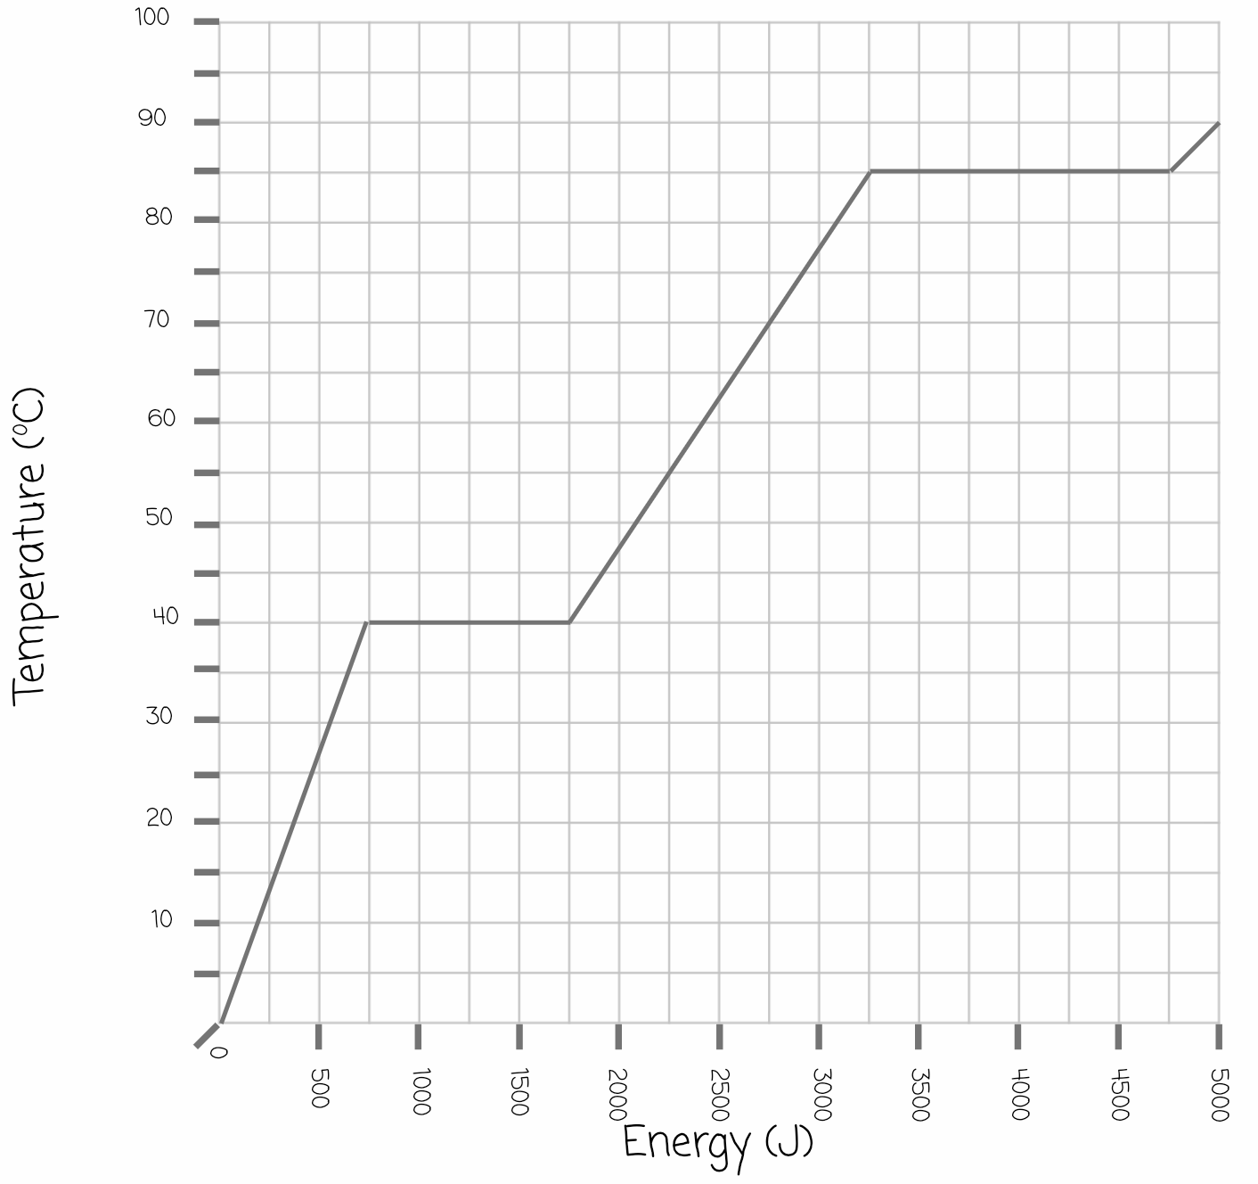
What you need to know about ...
State Change Graphs
State Change Graphs
No change of temperature as it changes from a liquid to a gas
No change of temperature as it changes from a solid to a liquid
Gas
Liquid
Solid

Slide 22
What you need to know about ...
Melting and Boiling Points
Melting points
The melting point of a substance is the temperature at which it changes from a solid to a liquid or a liquid to a solid
Boiling points
The boiling point of a substance is the temperature at which it changes from a liquid to a gas or a gas to a liquid
Working out which state a substance is at a temperature
If a temperature is lower than the melting point it is a solid
If a temperature is between the melting and boiling point it is a liquid
If a temperature is above the boiling point it is a gas
E.g. If the melting point of a substance is -40ºC and the boiling point is 85ºC, which state would it be at room temperature (20ºC)?
Melting Point
Boiling Point
Solid
Liquid
Gas
Melting Point
20ºC is between melting and boiling point therefore a Liquid
Boiling Point

Slide 23
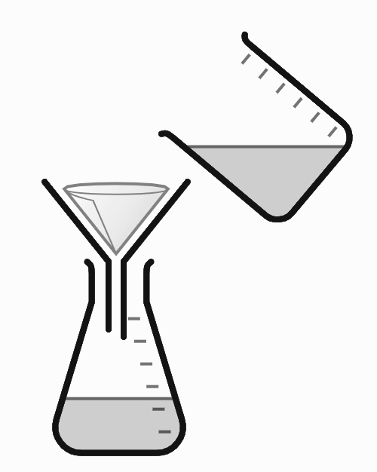
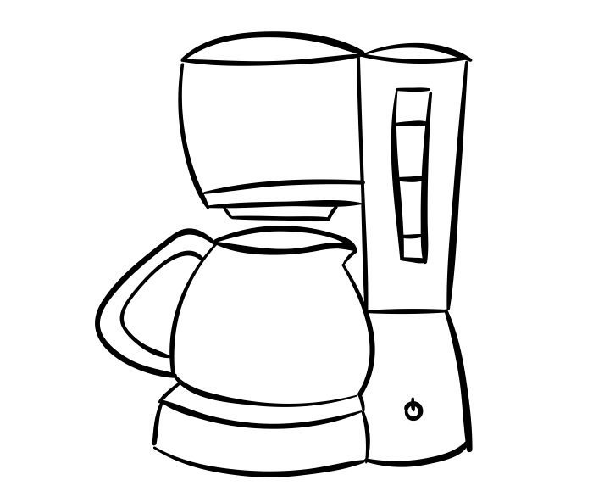
What you need to know about ...
Filtration
Filtration
Filtration is a process by which an insoluble solid is removed from a solvent by passing the mixture through filter paper
The mixture contains both a liquid (solvent) and solid which has not dissolved (insoluble solute)
Filter paper is placed within a funnel, as the mixture passes through the insoluble solid will be collected, this is known as the residue
The filtrate is what is collected in the conical flask
Filtration and mass
The mass of the mixture will be equal to the mass of the filtrate added to the mass of the residue.
Mass of residue + Mass of filtrate = Mass of mixture
E.g. if 12 g of residue are collected in the filter paper, and 100 g of filtrate collected in the conical flask, the total mass of the mixture was 112 g.
Uses of filtration
Removing solids from drinking water
Removing coffee granules

Slide 24
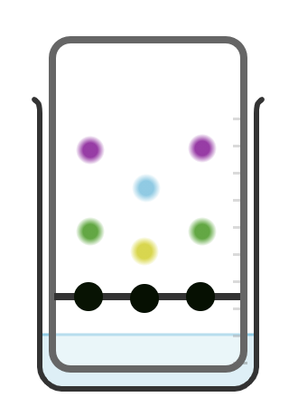
What you need to know about ...
Chromatography
Chromatography
Chromatography is a method by which a mixture of different dissolved substances from one another
A pencil line is drawn on the chromatography paper and spots of the sample being tested (ink) are placed on the line
The water causes the ink to travel up the paper, separating to reveal the different parts of the mixture
The bottom of the beaker is filled with a solvent (water)
Using chromatography
Chromatography can be used to find out what an unknown is. This is done by comparing an unknown mixture to one where you know what it is.
The first mixture matches the third mixture, so they are the same mixture.
Uses of chromatography
Identifying unknown mixtures e.g. ink, paints or food colourings
DNA fingerprinting identifies the DNA of different people

Slide 25
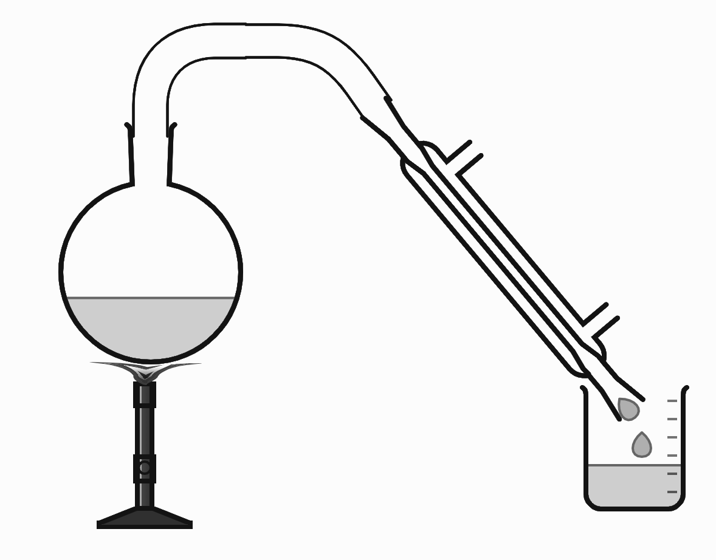
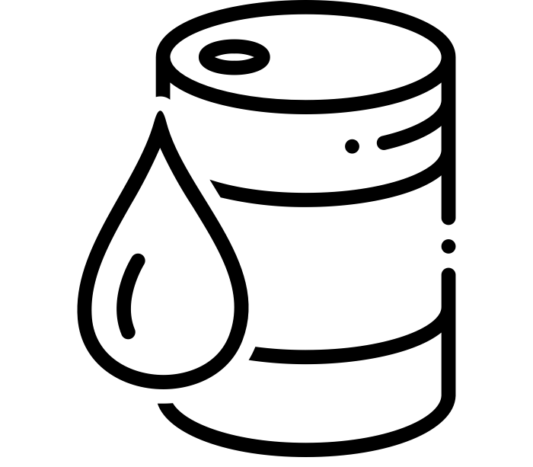
What you need to know about ...
Distillation
Distillation
Distillation is a process in which a mixture of liquids can be separated using their different boiling points.
The gas goes into the condenser, here it is cooled and turns into a liquid through condensation
The mixture is placed in the round bottom flask, it is heated and evaporation of one part occurs
The liquid is collected here, it is known as the distillate
State changes and distillation
In the round bottom flask, the part of the mixture with the lowest boiling point turns from a liquid to a gas in evaporation.
In the condenser the gas turns into a liquid through condensation.
Uses of distillation
Separating oil into different fuels
Separating alcohol from water

Slide 26
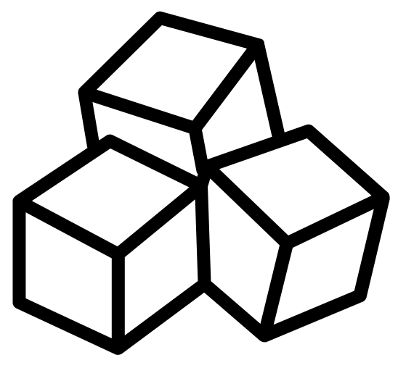
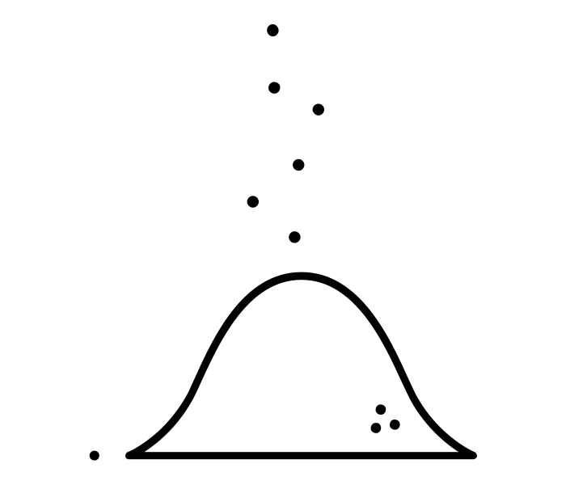
What you need to know about ...
Solutions and Solubility
Solutions
A solution is the end result when a solute dissolves in a solvent, e.g. salt (a solute) dissolving in water (a solvent) to form salt water (a solution)
Solute
(what the does the dissolving)
Solvent
(what the solute dissolves into)
Solution
(the end result)
Solutions and Mass
The mass is conserved in a solution
Mass of solute + mass of solvent → Mass of solution
E.g.
5 g of salt + 50 g of water → 55 g of salt water
Solubility
Solubility is a measure of how much solute will dissolve in a solvent
Not all solutes will dissolve in all solvents
Substances which will dissolve are known as soluble
Substances which will do not dissolve are known as insoluble
Factors affecting solubility
More solute will dissolve in a solution if:
The temperature of the solution is increased
The surface area of the solution is increased, e.g. sugar granules instead of cubes

Slide 27
What you need to know about ...
Reactions of metals
Metals and acids
Metals always react with an acid to form a salt and hydrogen
Three types of acids can be used here:
Hydrochloric acid
Sulphuric acid
Nitric acid
Hydrochloric acid forms chlorides
Sulphuric acids from sulphate
Nitric acids form nitrates
Hydrogen is a gas, we use the squeaky pop test to test for hydrogen
Metal + Acid → Salt + Hydrogen
Zinc + Nitric acid → Zinc Nitrate + Hydrogen
The first part of the salts name comes from the metal, the second from the acid
Metals and water
Metals always react with water to form metal hydroxide and hydrogen
Metal + Water → Metal hydroxide + Hydrogen
Zinc + Water → Zinc hydroxide + Hydrogen
Metals and oxygen
Metals always react with oxygen to form metal oxides
Metal + Oxygen → Metal oxide
Zinc + Oxygen → Zinc oxide
Reactivity series
The higher a metal is in the reactivity series, the more reactive it is
Displacement reactions
In a displacement reaction, a more reactive (higher on reactivity series) metal will take the place of a less reactive (lower on reactivity series) metal
Calcium oxide + Sodium → Sodium oxide + Calcium
Potassium
Sodium
Calcium
Magnesium
Aluminium
Calcium is lower on the reactivity series so sodium takes its place to form sodium oxide

Slide 28
Physics

Slide 29
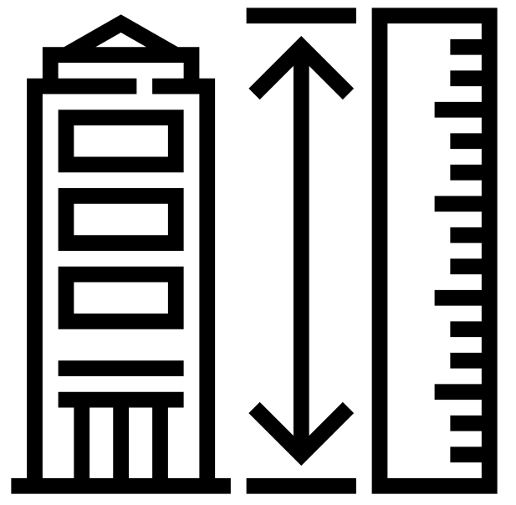
What you need to know about ...
Gravitational Potential Energy
Gravitational Potential Energy
Gravitational potential energy is the energy because of the position of an object, it is measured in joules
Gravitational Potential Energy = Mass x Gravity x Height
(kg) (N/kg) (m)
Example
A book with a mass of 0.25 kg is placed on a shelf with a height of 1.7 m. If the value of gravity on Earth is 9.81 N/kg, what is the gravitational potential energy of the book?
Gravitational potential energy = mass x gravity x height
Gravitational potential energy = 0.25 x 9.81 x 1.7
Gravitational potential energy = 4.17 J
Gravitational Potential energy and mass
The greater the mass, the greater the gravitational potential energy
Gravitational Potential energy and gravity
The value of gravity is different on different planets, the greater the value of gravity, the greater the gravitational potential energy
Gravitational Potential energy and height
The greater the height, the greater the gravitational potential energy

Slide 30
What you need to know about ...
Kinetic Energy
Kinetic Energy
Kinetic energy is the energy of movement, it is measured in joules
Kinetic Energy = 0.5 x mass x speed x speed
(kg) (m/s) (m/s)
Example
A car is moving with a speed of 10 m/s and has a mass of 2500 kg. What is the kinetic energy of the car?
Kinetic energy = 0.5 x mass x speed x speed
Kinetic energy = 0.5 x 2500 x 10 x 10
Kinetic energy = 125 000 J
Kinetic energy and mass
The greater the mass, the greater the kinetic energy
Kinetic energy and mass
The greater the speed, the greater the kinetic energy

Slide 31
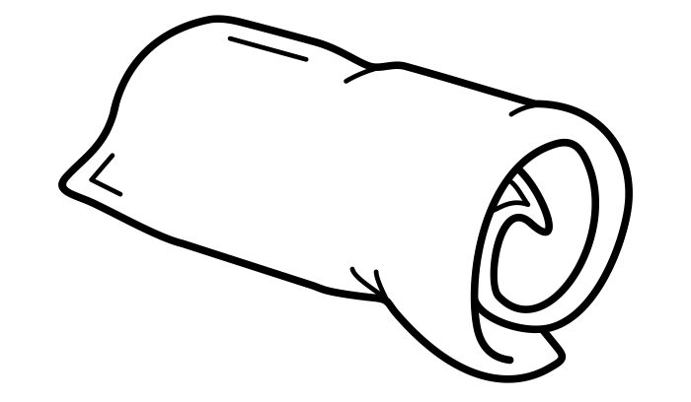
What you need to know about ...
Efficiency
Efficiency is a measure of how much energy is used usefully in a situation, the lower the wasted energy the more efficienct a device is.
Efficiency = (useful energy ÷ total energy) x 100
Example
A light bulb has 500 J of electrical energy provided to it, if 200 J is transferred as light, what is the efficiency of the light bulb?
Efficiency = (useful energy ÷ total energy) x 100
Efficiency = (200 ÷ 500) x 100
Efficiency = 40 %
Increasing efficiency
Efficiency can be increased by reducing wasted energy, examples of how to do this include:
Using lubricants to prevent moving parts rubbing together
For heaters reducing wasted energy to the surroundings by using insulation
Useful and wasted energy
Useful energy is the energy released which is used by the appliance
Wasted energy is any other form of energy given out, usually this can be thermal and sound
Useful:
Light Energy
Wasted:
Thermal Energy
Input: Electrical Energy

Slide 32
What you need to know about ...
Renewable and Non Renewable Energy
Non Renewable energy
Non renewable energy resources will run out, they cannot be replaced within your lifetime
Nuclear power uses radioactive materials to heat water and turn a turbine to generate electricity
Fossil fuels (coal, oil and natural gases) are burned in a power station to heat water and turn a turbine to generate electricity
Renewable energy
Renewable energy resources will not run out, they can be replaced within your lifetime
Wind turbines use the wind to generate electricity
Solar panels convert energy from the sun into electricity
Hydroelectric energy uses falling water to turn turbines and generate electricity
Geothermal uses the heat of rocks to heat water which will turn a turbine to generate electricity

Slide 33
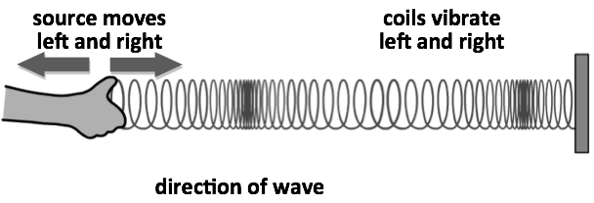
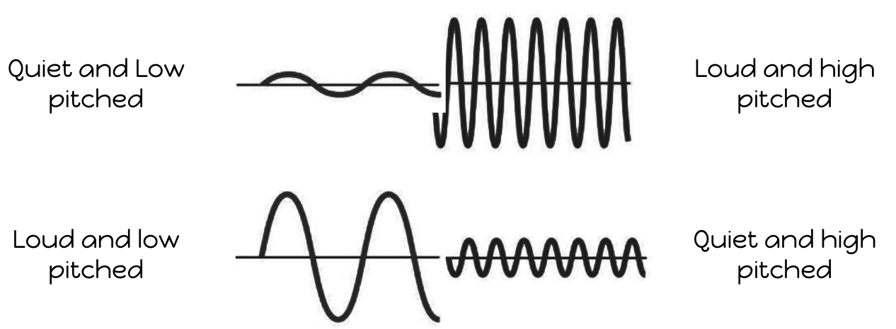
What you need to know about ...
Sound
Waves
A wavelength is the distance between two identical points on a wave
The peak is the top of the wave
The trough is the bottom of the wave
The amplitude is the maximum distance of the wave from the rest position
Sound and energy Sound is caused by particles vibrating
Transverse and Longitudinal Waves
Sound travels most quickly through a solid as the particles are closest together
Sound travels slowest through a gas as the particles are most spread out together
Transverse waves move at 90º to the direction of travel, e.g. Light
Longitudinal waves move at in line with the direction of travel, e.g. Sound
Loudness and Pitch
Ultrasound Ultrasound has a frequency above 20 000 Hz, higher than humans can hear
Ultrasound can be used to form images of objects we can’t see by using echolocation, e.g. a baby scan

Slide 34
What you need to know about ...
Circuit Symbols
Circuit Symbols
Cell
Provides the energy to a circuit to allow a current to flow
Battery
More than one cell connected together
Open Switch
Breaks the circuit so that current cannot flow
Closed Switch
Completes the circuit so that current can flow
Lamp
Emits light like a lightbulb
Fixed resistor
A component which makes the flow of electrons more difficult
Voltmeter
Measures the potential difference, placed in parallel (piggy backed)
Ammeter
Measures the current, placed in series (in the main circuit loop)

Slide 35
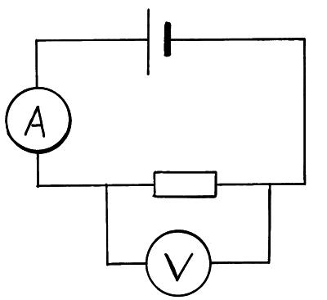
What you need to know about ...
Resistance
Resistance
Resistance is a measure of how hard or easy it is for electrons to flow in a circuit, it is measured in ohms (Ω).
Resistance = Potential Difference ➗ Current
(Ω) (V) (A)
Example
A light bulb has a current passing through of 3 A and a potential difference across it of 12 V, what is the resistance cause by the light bulb?
Resistance = Potential difference ÷ Current
Resistance = 12 ÷ 3
Resistance = 4 Ω
Factors that increase resistance
A higher temperature
A longer wire
A thinner wire
Measuring resistance in a circuit
The current is measure with an ammeter in series.
The potential difference is measured with a voltmeter in parallel (piggy backed).

Slide 36
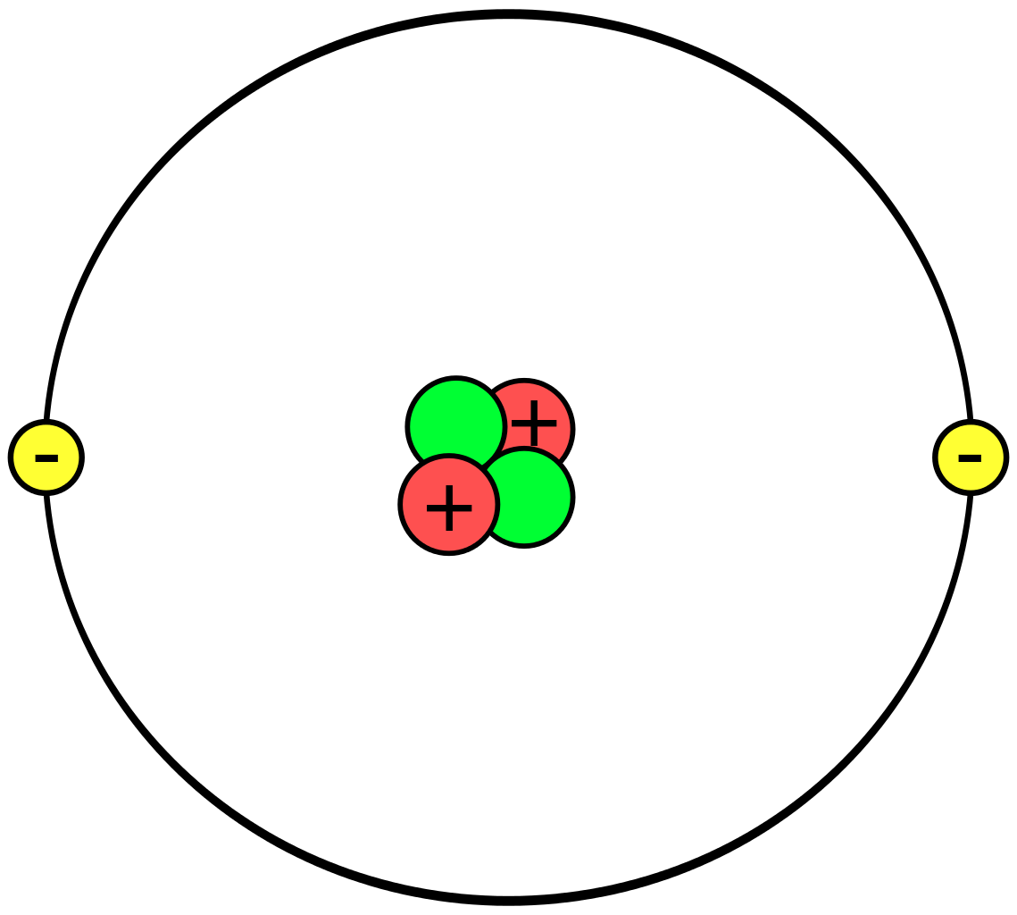
What you need to know about ...
Static Electricity
Atoms and subatomic particles
Protons are in the nucleus of the atom, they are positively charged
Electrons are around the outside of the atom, they are negatively charged
Neutrons are in the nucleus of the atom, they are neutrally charged
Static electricity
Static electricity is the buildup of charge by the transfer of electrons, it is caused by friction between insulators or insulated conductors
Gaining an electron leads to an overall negative charge
Losing an electron leads to an overall positive charge
Attraction and Repulsion
Opposite charges attract
Like charges Repel
Like charges Repel

Slide 37
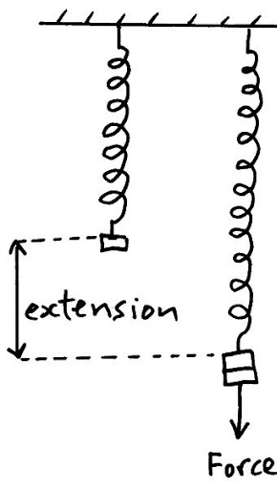
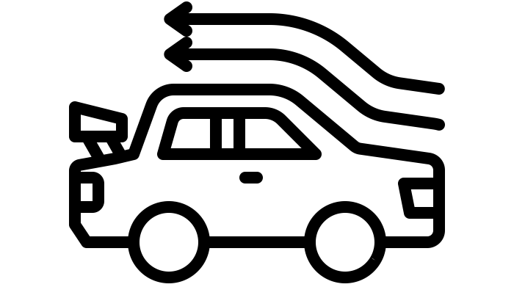
What you need to know about ...
Forces
Forces
A force is a push or a pull from one object to another
Contact forces physically touch
Non Contact forces do not touch
Push / pull
Air Resistance
Friction
Gravitational
Electrostatic
Magnetic
Balanced and Unbalanced Forces
Force arrows are the same size meaning that the forces are balanced, the car will move at a constant speed or not be moving
Force arrows are not the same size meaning that the forces are unbalanced, the car will move be accelerating or decelerating
Weight and Gravity
Hooke’s Law
Measured in Newtons
A type of Force
Different on different planets
Measured in Newtons/kilogram
One object will pull on another
Depends on size of the planet
Extension is the stretched length minus the original length
Weight = mass x gravity
Measured in kilograms
Amount of matter inside an object
Same on all planets
When a spring is stretched, if it obeys Hooke’s law, force and extension will increase by the same amount each time, it will be linear
Streamlining
Streamlined shapes allow air or water particles to pass over them more easily, they go faster and use less fuel
Non-streamlined shapes do not allow air or water particles to pass over them easily, they go slower and use more fuel

Slide 38
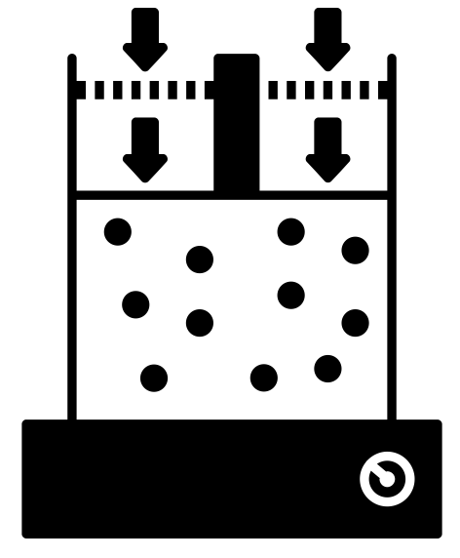
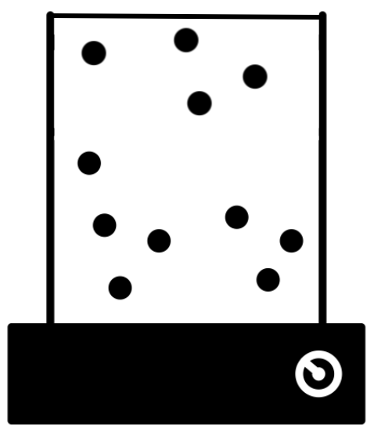
What you need to know about ...
Gas Pressure
Gas Pressure
Gas pressure is caused by gas particles
colliding with the wall of a container.
The more often the particles collide with
the wall of the container, or the greater
the force of the collision, the higher the
gas pressure will be.
Amount of particles
The more particles in a container the more often they will collide with the wall of the container.
More particles in a container means more collisions with the wall and therefore exerting a higher gas pressure
Less particles in a container means less collisions with the wall and therefore exerting a lower gas pressure
Temperature
The higher the temperature, the more energy that particles have. This means they will move faster, collide with the container more often and with a greater force.
A higher temperature means that the particles have more energy and will collide with the wall of the container with a greater force, exerting a higher gas pressure.
A lower temperature means that the particles have less energy and will collide with the wall of the container with a smaller force, exerting a lower gas pressure.
Volume of the container
If the same amount of particles have less space to move, they will collide with the wall of the container more often.
A smaller volume means that the particles have less space to move around, colliding with the container more often and exerting a higher gas pressure.
A larger volume means that the particles have more space to move around, colliding with the container less often and exerting a lower gas pressure.

