Slide 1
Year 9 end of year assessment
Knowledge organisers

Slide 2
Scientific skills

Slide 3
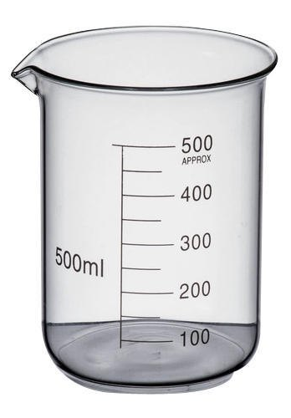
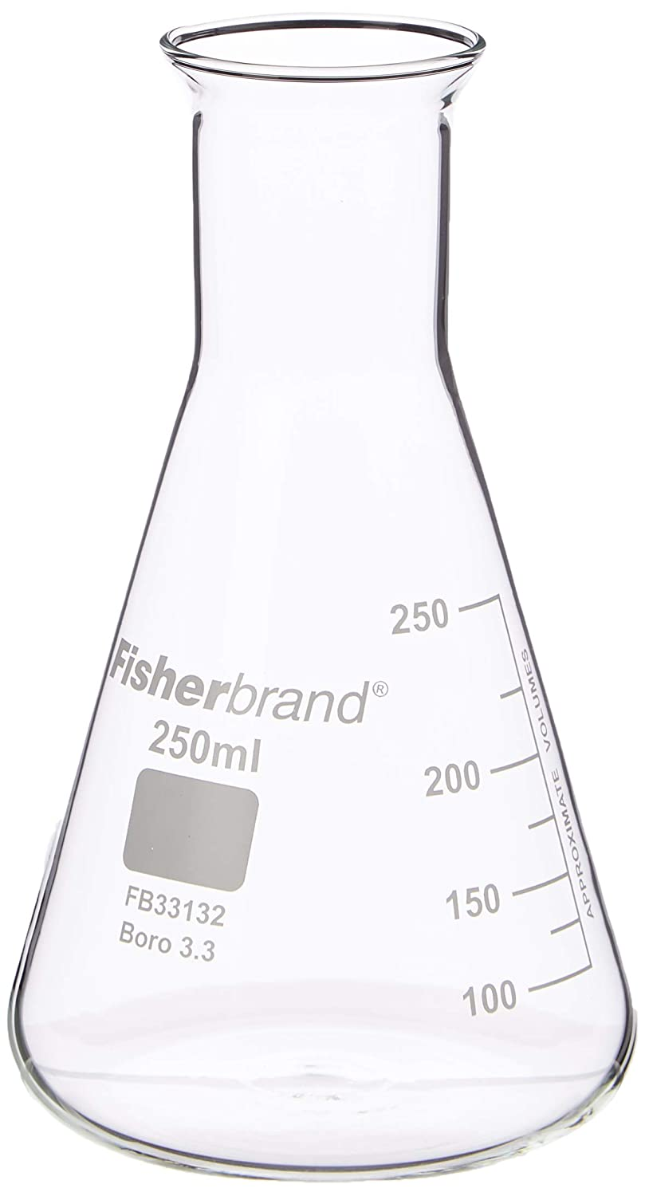
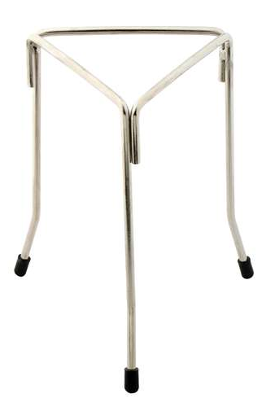
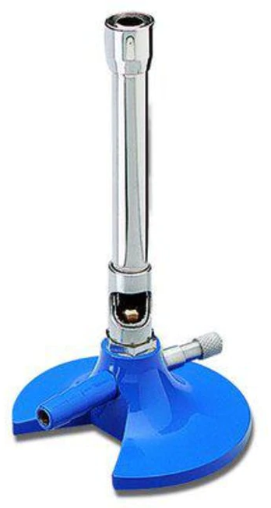
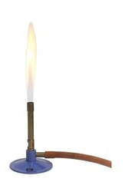
Name each of the pieces of apparatus below by writing the correct name underneath it:
Label each part of the setup of apparatus below:
Define the term corrosive:
…………………………………………………………………………………………………………..
Match the safety symbol to the correct name below:
Irritant
Health Hazard
Toxic
Corrosive
Flammable
Determine whether each statement relies on the air hole being open or closed by circling the correct answer:
A roaring flame Open / Closed
A safety flame Open / Closed
A flame which is more visible Open / Closed
A flame which is hotter Open / Closed
A flame which is cooler Open / Closed
To provide more oxygen Open / Closed
Label all of the parts of the bunsen burner below:
Describe the apparatus which you would use to separate sand which is mixed with water:
……………………………………..
……………………………………..
……………………………………..
Define the term accuracy.
………………………………
………………………………
………………………………
Define the term precision.
……………………………
……………………………
……………………………
Sort the following types of data into categoric or continuous data:
Age Height Favourite food Mass Age Arm length Place of birth Favourite colour
How is categoric data different to continuous data?
……………………………………..
……………………………………..
……………………………………..
Describe the images below with the terms accurate or not accurate and precise or not precise:
Discontinuous Data | Continuous Data
How is accuracy different to precision?
……………………………………..………………………………
……………………………………..………………………………
……………………………………..………………………………
……………………………………..………………………………
Which data type do we plot on a bar graph?
……………………………………..
Which data type do we plot on a line graph?
……………………………………..
How do we calculate a mean?
……………………………………..………………………………

Slide 4
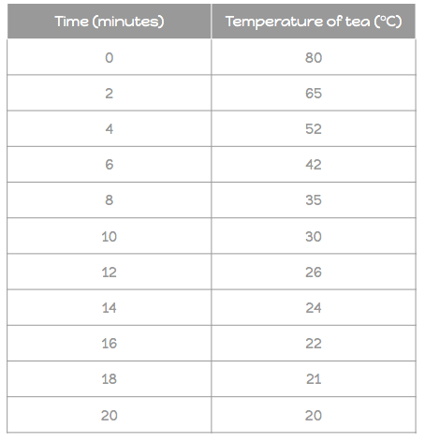
Plot a bar chart using the data below
▢ Titles on both axis from the table
▢ Type of barbie on the X axis
▢ Number owned on the Y axis
▢ Drawn using a pencil and ruler
▢ Even spaces between each bar
▢ Evenly scaled axis
Plot a line graph using the data below
▢ Titles on both axis from the table
▢ Time on the X axis
▢ Temperature of tea on the Y axis
▢ Drawn using a pencil and ruler
▢ Each point is plotted and a smooth line of best fit
▢ Evenly scaled axis
What is meant by an anomaly?
……………………………………..……………………………
……………………………………..……………………………
……………………………………..……………………………
Do we include anomalies in means?
……………………………………..……………………………
Type of Barbie | Number owned
Malibu Barbie | 2
Mermaid Barbie | 10
Fashionista Barbie | 8
Yoga Barbie | 5
Cali Barbie | 1
 | Y Axis
Biggest number
Number of squares
Value for each square (biggest number divided by number of squares)
 | Y Axis | X Axis
Biggest number
Number of squares
Value for each square (biggest number divided by number of squares)
Calculate the means of each set of numbers below, making sure you remove any anomalies (if any) before you do this:
12, 14, 15, 78, 11
……………………………………..…………………………
……………………………………..…………………………
……………………………………..…………………………
92, 96, 150, 90, 94, 95
……………………………………..…………………………
……………………………………..…………………………
……………………………………..…………………………
151, 149, 153, 152
……………………………………..…………………………
……………………………………..…………………………
……………………………………..…………………………

Slide 5
Biology

Slide 6
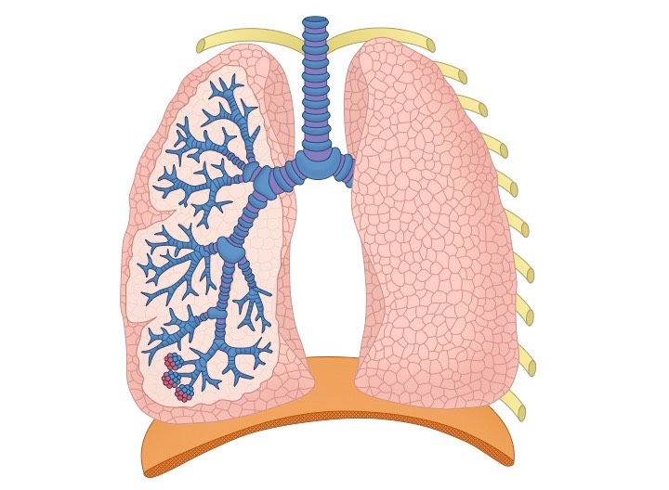
Fill in the blanks to complete the levels of organisation:
____
The building blocks of life, these can be specialised in order to perform specific roles
______
A group of similar cells working together to perform a certain function
______
Made up of different types of tissue that work together to perform a particular role
_____ ______
A group of different organs that come together to perform a certain function
________
Made up of several different organ systems which work together to allow a living thing to survive
Sort the following into tissues, organs or organ systems:
Bones Brain Muscle
Nervous system Ligament
Skin Heart Digestive system
Use the words at the bottom to label the diagram of the lungs:
Word Bank
Diaphragm Bronchus Trachea Bronchiole Rib Alveoli
State four adaptations which allows oxygen to diffuse from the lungs into the blood:
1. …………………………………………….
2. …………………………………………….
3. …………………………………………….
4. …………………………………………….
Tissue | Organ | Organ System
What happens to a muscle when it contracts?
…………………………………………...
…………………………………………...
What happens to a muscle when it relaxes?
…………………………………………...
…………………………………………...
What is an antagonistic pair of muscles?
…………………………………………...
………………………………………...
How is inhalation different to exhalation?
……………………………………………………....
……………………………………………………....
Describe what happens to the ribcage, diaphragm and lung volume during inhalation:
……………………………………………………....
……………………………………………………....
Describe what happens to the ribcage, diaphragm and lung volume during exhalation:
……………………………………………………....
……………………………………………………....
Match the connective tissue to its role below:
Give at least one example of each type of joint below:
Fixed:
……………………………………….
Pivot:
……………………………………….
Ball and socket:
……………………………………….
Hinge:
…………………………………….
Cartilage |  | Connects bone to bone
Tendon |  | Connects bone to muscle
Ligament |  | Cushions the end of bones
State four functions of the skeleton:
1. …………………………………………….
2. …………………………………………….
3. …………………………………………….
4. …………………………………………….

Slide 7
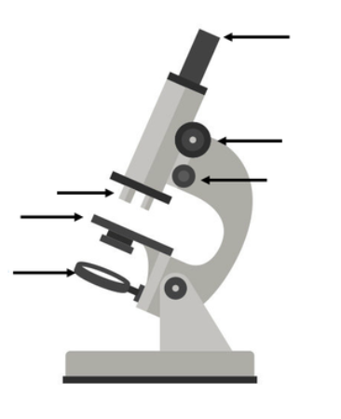
Use the words at the bottom to label the diagram of the microscope:
Word Bank
Objective lens Mirror Coarse Focus
Fine Focus Eyepiece Stage
Why must the sample placed underneath a microscope be thin?
……………………………………..…………………………………………………...
Why can some cells not be seen underneath a microscope?
……………………………………..…………………………………………………...
Why is a plant cell larger than an animal cell?
………………………………………….….
………………………………………….….
Use the words at the bottom to label the images of both cells:
Word Bank
Nucleus Cell wall Cell membrane Chloroplast Mitochondria Vacuole Cytoplasm
Next to each organelle below, state whether it belongs in a plant cell, animal cell or both:
Nucleus
Plant/Animal/Both
Cell wall
Plant/Animal/Both
Cell membrane
Plant/Animal/Both
Chloroplast
Plant/Animal/Both
Mitochondria
Plant/Animal/Both
Vacuole
Plant/Animal/Both
Cytoplasm
Plant/Animal/Both
Which part of the microscope reflects light?
………………………………………………………
Which part of the microscope do we place the sample on?
………………………………………………………
Which two parts of the microscope cause magnification?
………………………………………………………
How are the coarse and fine focuses different?
………………………………………………………
………………………………………………………
Match the organelle to its function below:
Nucleus |  | Gives the cell strength and structure
Cell Wall |  | Controls what enters and leaves the cell through diffusion
Cell Membrane |  | Controls the cell's activities and contains DNA
Chloroplast |  | The site of respiration
Mitochondria |  | The site of photosynthesis
Vacuole |  | A jelly like substance where chemical reactions take place
Cytoplasm |  | Contains cell sap to keep the cell firm
Why do plant cells have chloroplasts but animal cells do not?
………………………………………….…
………………………………………….…
Why do plant cells have a cell wall but animal cells do not?
………………………………………….…
………………………………………….…

Slide 8
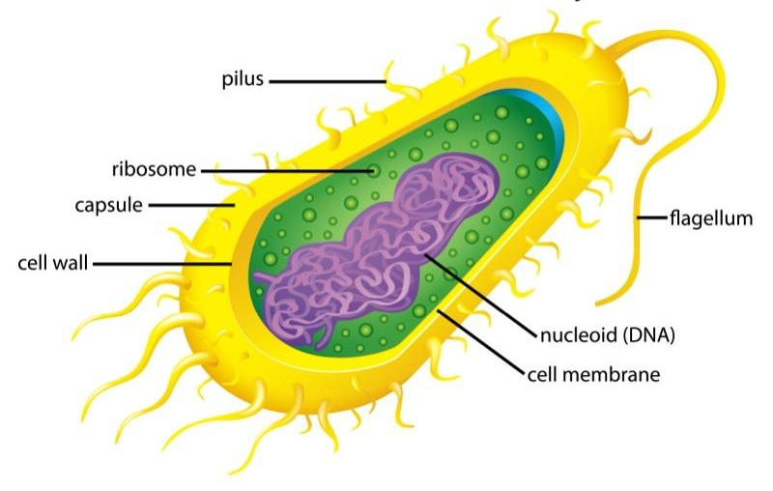
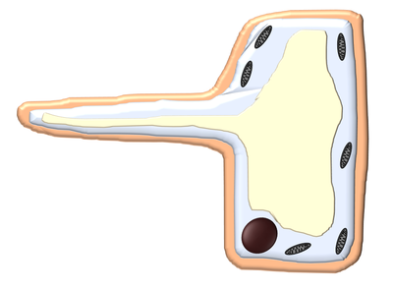
What is a specialised cell?
……………………………………..…………………………………………...
……………………………………..…………………………………………...
What is diffusion?
…………………………………..……....
…………………………………..……....
…………………………………..……....
…………………………………..……....
What is a unicellular organism?
…………………………………..……....………………………
Below is a diagram of a bacterial cell:
Is this a eukaryotic or prokaryotic cell?
…………………………………..……....……………………
State two similarities and two differences between a bacteria and an animal cell:
…………………………………..……....……………………
…………………………………..……....……………………
Match the type of cell below its role:
Sperm cell |  | To absorb minerals and water for a plant
Red blood cell |  | To fertilise an egg cell
Root hair cell |  | To carry oxygen around the body
Palisade cell |  | To carry out photosynthesis
State two substances which will diffuse into a cell:
1. …………………………………..……
2. ………………………………..………
Label the sperm cell below indicating at least two adaptations which helps it to carry out its role:
State two substances which will diffuse out of a cell:
1. …………………………………..……
2. ………………………………..………
Below is a diagram of an amoeba:
Is this a eukaryotic or prokaryotic cell?
…………………………………..……....……………………
State two similarities and two differences between an amoeba and a plant cell:
…………………………………..……....……………………
…………………………………..……....……………………
Label the root hair cell below indicating at least two adaptations which helps it to carry out its role:
How are eukaryotic cells different to prokaryotic cells?
………………...……………………..…
………………...……………………..…
………………...……………………..…
Are animal cells prokaryotic or eukaryotic? Why?
………………...……………………..…
………………...……………………..…
………………...……………………..…
Why would a muscle cell need a lot of mitochondria?
……………………………………..…………………………………………..
Why would a red blood cell need a thin membrane?
……………………………………..…………………………………………..
……………………………………..…………………………………………..

Slide 9
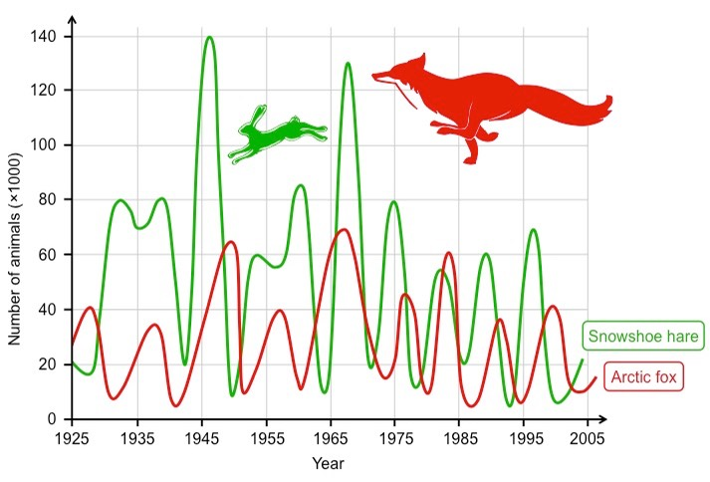
State four factors which animals will compete for:
1. ……………………………..
2. ……………………………..
3. ……………………………..
4. ……………………………..
Describe how each of the changes below will help an animal to adapt to changing seasons:
Camouflage: ……………………………………..……………....………
……………………………………..……………....………………………
Hibernation: ……………………………………..……………....………
……………………………………..……………....………………………
Migration:……………………………………..……………....………
……………………………………..……………....………………………
Winter and summer coats:……………………..……………....………
……………………………………..……………....………………………
In which way do the populations of the fox and the hare depend on one another?
……………………………………..……………....………………………
……………………………………..……………....………………………
Why when the number of foxes decrease, the number of hares increase?
……………………………………..……………....………………………
Why when the number of foxes increase, the number of hares decrease?
……………………………………..……………....………………………
Describe the changing population of the foxes and hares between 1975 and 2005, you must use values from the graph to support your answer:
……………………………………..……………....………………………
……………………………………..……………....………………………
……………………………………..……………....………………………
State four factors which could cause extinction:
1. ……………………………..
2. ……………………………..
3. ……………………………..
4. ……………………………..
Complete the word fill below to describe interdependence:
Interdependence means that one species is directly _______ by another. As the population of the ________ increases, the population of the prey will ________.
Describe what causes environmental variation:
…..……………………………..
…..……………………………..
Describe what causes inherited variation:
…..……………………………..
…..……………………………..
Describe why some characteristics can be affected by both types of variation:
…..……………………………..
…..……………………………..
Sort the characteristics below into which type of variation they are affected by:
Hair colour Eye Colour Weight Skin colour Scars Sun tan Fashion Taste Accent Personality
Environmental Variation | Both | Inherited Variation
Use ideas about natural selection to explain why there are no giraffes with short necks:
……………………………………..……………....………………………
……………………………………..……………....………………………
Complete the word fill below to describe natural selection:
Organisms which have _________ suited to their _______ survive for longer. This means they produce more offspring. Offspring are likely to inherit their parents’ advantageous __________. Therefore more offspring with the advantageous characteristics ______, continuing the process.

Slide 10
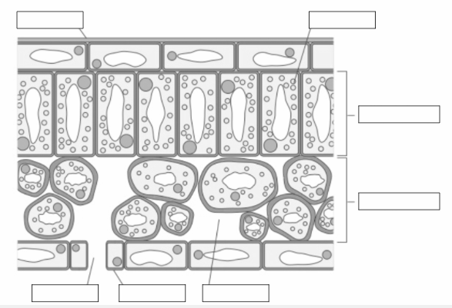
Complete the word equation for photosynthesis:
Carbon dioxide + _____ → _______ + Oxygen
Use the words below in order to label the cross section of the leaf:
Air spaces Chloroplasts Waxy Layer Spongy layer Guard cells Stomata Palisade layer
How is a producer different to a consumer?
………………………………………....…………
……………………………………..…………..…
……………………………………..……………..
In which part of a cell does photosynthesis take place?
……………...……………
…………..…...…………..
Match the part of the leaf to its adaptation:
Spongy layer |  | Prevents water loss
Palisade layer |  | Allows gases to diffuse into and out of the cells
Waxy layer |  | Contains air spaces to allow carbon dioxide to diffuse through the leaf
Stomata |  | Maximises light absorption for photosynthesis
Match the deficiency to the consequence below;
State two possible uses for fermentation:
1. ……………………………………
2. ………………....…………..……
Through which part of the plant is sunlight absorbed?
……………………………………..…………
Through which part of the plant is water taken in?
……………………………………..…………
Through which part of the plant are gases allowed to diffuse into and out of?
……………………………………..…………
Is a plant a consumer or a producer?
……………………………………..…………
What is a fertilser?
…………………………...
…………………………...
…………………………...
What is meant by a plant deficiency?
…………………………...
…………………………...
…………………………...
Magnesium |  | Plants have poor root growth and discoloured leaves
Nitrate |  | Plants have poor growth and yellow leaves
Phosphorous |  | Plants cannot make chlorophyll
Which test is used for carbon dioxide?
…..……………………………………
In which type of organism does fermentation occur?
…..……………………………………
Complete the word equation for fermentation:
Glucose→ ______ _______ + _______

Slide 11
Complete the word equations for aerobic and anaerobic respiration below:
Aerobic:
_______ + Glucose → ______ _______ + _____
Anaerobic:
Glucose → ______ ____
Sort the phrases below as to whether they relate to aerobic or anaerobic respiration:
Release more energy Not sustainable
Long distance running Uses oxygen
Causes cramps Short distance running
Does not use oxygen Releases lactic acid
More energy released Less energy released
Releases carbon dioxide
For which reasons would the body start carrying out anaerobic respiration?
…....……………………………...…………………
…....……………………………...…………………
Where in a cell does respiration occur?
....……………………………...…………………..
…….…………………………..…………………..
Aerobic respiration | Anaerobic respiration
Complete a food chain for each scenario below:
Type of food chain | First organism (Producer) | Second organism (Herbivore / omnivore) | Third organism (Omnivore / carnivore) | Fourth organism (Omnivore / carnivore)
African Savannah | Acacia tree | Goat | Cheetah | Lion
Woodland
Ocean
Jungle
Match the keyword to its correct definition:
Ecosystem |  | Plants and animals that are found in a particular habitat
Community |  | Particular place or role that an organism has in an ecosystem
Habitat |  | Living organisms in a particular area, and the habitat they live in
Niche |  | Place where a plant or animal lives
How is a food chain different to a food web?
…....……………………………...……………………....……………....……………………………...…………
…………………...……………………....……………………………...……………………....…………………

Slide 12
Match the food group to its role in the body:
Fill in the blanks to describe the structure of the digestive system:
Carbohydrates |  | Provides energy
Proteins |  | Provides an energy store and insulation
Fats / Lipids |  | Needed for growth and repair of body tissue
Vitamins |  | Adds bulk to food and prevents constipation
Fibre |  | Makes up the majority of body cells, needs to be replaced from tears, sweating and other waste
Water |  | Are essential to keep you healthy, e.g. for the skin or to help absorb calcium
The _____
produces bile which is secreted into the small intestine to neutralise stomach acid
The __________
(food pipe) connects the mouth to the stomach
The ________
is a gland which produces enzymes
The _______
mixes food and also contains acid which kills bacteria
Match the food test to the method and to the positive result:
The _____ _________
is where the majority of enzymes are secreted into and nutrients are absorbed into the blood
The _____ _________
absorbs excess water
Starch |  | Add a couple of drops of copper sulphate and sodium hydroxide |  | The sample will turn a blue black colour
Proteins |  | Add a couple of drops of iodine solution |  | The solution turns a purple colour
Sugars |  | Add a couple of drops of Benedict's solution and heat in a water bath for five minutes |  | The solution turns an orange colour
The ____
Is where waste products are passed out of the body
What is meant by a balanced diet?
……………………………………..…………
……………………………………..…………
What is meant by a deficiency?
……………………………………..…………
……………………………………..…………
State three possible consequences of being overweight:
1. ……………………………...
2. ………………………..……
3. …………………...………..
State three possible consequences of being underweight:
1. …………………………...
2. ………………………..……
3. …………………...………..
Use the words below to complete the sentences:
Surface area Thin Blood Villi Small Nutrients
_____ are finger like projections which are in the _____ intestine through which _________ are absorbed into the blood. They are adapted by having:
A large _______ ____
A good _____ supply
____ walls

Slide 13
Complete the table below to describe the role of each enzyme:
Use the words below to complete the sentences:
Recreational Medicinal Depressant Stimulants
_________ drugs are used to benefit health, whereas ____________ drugs are used for enjoyment.
__________ drugs will slow down responses whereas __________ wil speed them up.
Enzyme | Substrate (what it breaks down) | Product (What is produced) | Where it is made | Where it is works
Carbohydrase
Protease
Lipase
Sort the drugs below as to whether they are stimulants or depressants:
Alcohol Cannabis Caffeine Amphetamines
State two factors which will affect how an enzyme will work:
1. ……………………………...…………………..
2. ……………………………..…………………..
What is meant by when an enzyme ‘denatures’?
....……………………………...…………………..
…….…………………………..…………………..
Stimulants | Depressants
Decide whether the statements below about enzymes are true or false:
Enzymes can be used up
True/False
The same enzyme will work anywhere in the digestive system
True/False
Enzymes are specific to one substrate
True/False
Enzymes slow down the digestion of food
True/False
State three possible short term effects of alcohol on the body:
1. ………………………………………………...
2. ……………………………....…………..……
3. ………………………….…………...………..
Describe two possible health consequences of smoking on the body:
1. …………………………………………...………………………………………...
…..…………………………………………...………………………………………...
2. …………………………………………...…………………………………………
…..…………………………………………...………………………………………...
State three possible long term effects of alcohol on the body:
1. ………………………………………………...
2. ……………………………....…………..……
3. ………………………….…………...………..
State three possible consequences of foetal alcohol syndrome:
1. …………………………………………...
2. …………………………….………..……
3. ………………………….……...………..
What is meant by addiction?
…………………………………
…………………………….……
………………………….……....

Slide 14
Chemistry

Slide 15
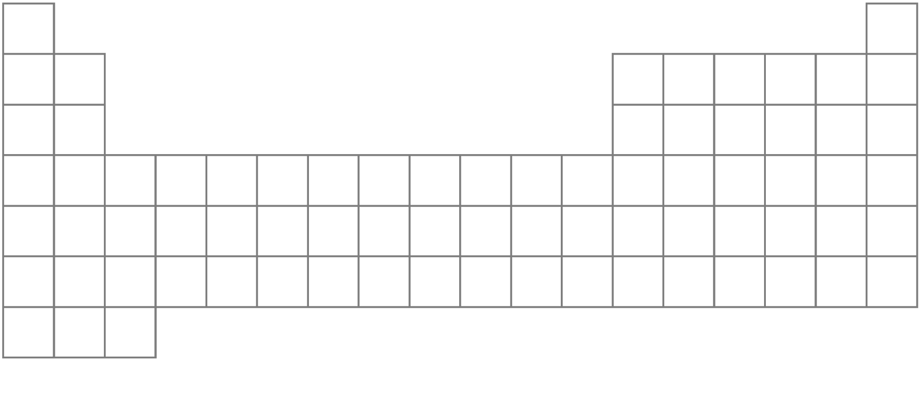
Colour code the periodic table below to show all of the groups of elements below:
Alkali Metals ▢ Transition Metals ▢ Halogens ▢ Noble Gases ▢
Which is the ‘odd one out’ in group 1, why?
……………………………………………………....
……………………………………………………....
How are groups different to periods?
……………………………………………………....
……………………………………………………....
Which is the most unreactive group in the periodic table?
……………………………………………………....
Where is the least reactive element in group 1?
…….…………………………………….
Where is the most reactive element in group 1?
…….…………………………………….
What is formed when an alkali metal reacts with water?
…….…………………………………….
…….…………………………………….
How do we test for hydrogen gas?
…….…………………………………….
…….…………………………………….
Which properties make alkali metals different to other metals?
…….…………………………………….
…….…………………………………….
What observations would we see in a reaction between alkali metals and water?
…….…………………………………….
…….…………………………………….
Sort the properties below as to whether they belong to metals or nonmetals:
On the left hand side On the right hand side Sonorous Dull Shiny Good thermal conductor
Good electrical conductor Poor thermal conductor
Poor electrical conductor Ductile Soft Hard
Malleable High density Low density
Match the keyword to its correct definition:
Ductile |  | The mass of a material in a certain volume.
Sonorous |  | Easily breakable
Brittle |  | The temperature at which a material changes from solid to liquid
Density |  | Capable of producing a deep ringing sound when hit
Melting point |  | Can be drawn into wires
Metals | Nonmetals
Complete the reactions below to show the reactions between alkali metals and water:
Lithium + Water → Lithium _________ + hydrogen
Sodium + Water → ______ hydroxide + ________
Potassium + Water → _________ _________ + ________
________ + Water → Rubidium _________ + ________

Slide 16
Are group 7 elements metals or nonmetals?
……………………………………..……………………………………
Where is the most reactive element in group 7?
……………………………………..……………………………………
Where is the least reactive element in group 7?
……………………………………..……………………………………
When do the elements of group 7 appear colourless?
……………………………………..……………………………………
When do the elements of group 7 have a colour?
……………………………………..……………………………………
What is the common name for group 7 elements?
……………………………………..……………………………………
How does the melting and boiling point change in group 7?
……………………………………..……………………………………
……………………………………..……………………………………
……………………………………..……………………………………
Use the words below in order to fill in the blanks about displacement reactions:
Colourless Colour ine ide less compound more
A displacement reaction will occur when a ____ reactive element will take the place of a ____ reactive element in a ________.
The element in the compound will end in -___ and the element on its own will end in -___.
The element on its own will have a ______, whereas the element in the compound will appear __________.
Are the group 0 elements metals or nonmetals?
……………………………………..…………………………
What are the group 0 elements commonly known as?
……………………………………..…………………………
What are two common properties of group 0 elements?
1.……………………………………..………………………
2.……………………………………..………………………
Why can we refer to the group 0 elements as monatomic?
……………………………………..…………………………
……………………………………..…………………………
Apply your knowledge of group 7 elements in order to predict the products of the displacement reactions below:
Sodium chloride + fluorine → Sodium Fluoride + ________
Lithium iodide + Chlorine → Lithium ________ + Iodine
Potassium chloride + Iodine → _________ chloride + ______
Lithium bromide + chlorine → Lithium ________ + _______
Lithium chloride + bromine → _______ ________ + _______
Calcium Iodide + bromine → _______ _______ + ______
Zinc chloride + ________ → ____ fluoride + ________
Sodium Iodide + ________ → ______ chloride + ______
Look at the pairs of group 7 elements below and circle the one which is most reactive:
Chlorine or Fluorine
Astatine or Bromine
Bromine or Iodine
Fluorine or Astatine
Chlorine or Iodine

Slide 17
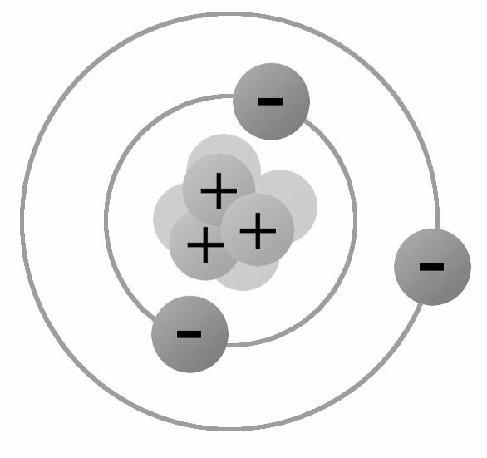
Label the different particles on the diagram of the atom below:
Place a tick in the box below to indicate whether the statement best applies to a element or a compound:
State four ways in which compounds can differ from the elements that make them up:
1. ……………………………………….….
2………………………………………….
3……………………………………….….
4……………………………………….….
 | Element | Compound
Made of one type of atom | ▢ | ▢
Made of more than one type of atom chemically bonded | ▢ | ▢
Made in a chemical reaction | ▢ | ▢
Found on the periodic table | ▢ | ▢
State how many of each elements are in the compounds below:
Match the symbols for each element to their name below:
Match the element to the atomic number below:
H₂O
H = | O =
Complete the label below in order to summarise the different subatomic particles:
Iron |  | Na
Sodium |  | Fe
Lithium |  | H
Helium |  | He
Hydrogen |  | Li
Gold |  | O
Calcium |  | Au
Oxygen |  | Ca
Iron |  | 11
Sodium |  | 26
Lithium |  | 2
Helium |  | 3
Hydrogen |  | 1
Gold |  | 20
Calcium |  | 8
Oxygen |  | 79
NaCl
Na = | Cl =
Particle | Charge | Mass | Where is it found?
Proton
Electron
Neutron
C₂H₆
C = | H =
H₂SO₄
H = | S = | O =
C₆H₁₂O₆
C = | H = | O =
How do we calculate the number of protons in an atom?
…………………………………………………………..
How do we calculate the number of neutrons in an atom?
…………………………………………………………
State the number of protons, electrons and neutrons in each of the elements below:
9
Be
4
Protons =
Electrons =
Neutrons =
1
H
1
Protons =
Electrons =
Neutrons =
40
Ar
18
Protons =
Electrons =
Neutrons =
79
Se
34
Protons =
Electrons =
Neutrons =
24
Mg
12
Protons =
Electrons =
Neutrons =
14
N
7
Protons =
Electrons =
Neutrons =
51
V
23
Protons =
Electrons =
Neutrons =
45
Sc
21
Protons =
Electrons =
Neutrons =

Slide 18
Firstly draw the particle models for each state in the boxes below.
Secondly label the arrows with the names of each of the state changes.
Solid
Liquid
Gas
Complete the table below to summarise the properties of solids, liquids and gases:
What happens to a gas when it is compressed?
………………………………………….….
………………………………………….….
………………………………………….….
State | Can it be compressed? | Does the substance flow? | Which shape will it take in a container?
Solid
Liquid
Gas
Do the particles in a solid move? If so, how?
………………………………………….….
………………………………………….….
What is meant by a boiling point?
……………………………………..…………………………………………………...
……………………………………..…………………………………………………...
Which state changes can be seen at the boiling point?
……………………………………..…………………………………………………...
Which state of matter has the most energy? Why?
………………………………………….….
………………………………………….….
………………………………………….….
What is meant by a melting point?
……………………………………..…………………………………………………...
……………………………………..…………………………………………………...
Which state changes can be seen at the melting point?
……………………………………..…………………………………………………...
When a substance melts, do the particles gain or lose energy? Why?
………………………………………….….
………………………………………….….
On the scale below, write where the substance will be a solid, liquid and gas.
What do we call the state change of solid to gas?
…………………………………………………………….
Melting Point
Boiling Point
What do we call the state change of gas to solid?
…………………………………………………………….

Slide 19
Look at the number line below
Which state will the substance be at 30ºC?
……………………………………..……………………………………
Which state will the substance be at 72ºC?
……………………………………..……………………………………
Which state will the substance be at -60ºC?
……………………………………..……………………………………
Which state will the substance be at 0ºC?
……………………………………..……………………………………
At which temperature will the substance change from a liquid to a gas?
……………………………………..……………………………………
At which temperature will the substance change from a liquid to a solid?
……………………………………..……………………………………
What is diffusion?
…………………………………..……....
…………………………………..……....
…………………………………..……....
…………………………………..……....
State three ways in which gas pressure can be increased:
1. …………………………………..……………………………
2. …………………………………..……………………………
3. …………………………………..……………………………
Melting Point
Boiling Point
Describe how particles will behave when they are heated up:
…………………………………..……....…………………………
…………………………………..……....…………………………
…………………………………..……....…………………………
Identify the statements about diffusion as true or false:
Diffusion is a random process
True / False
Diffusion moves from an area of low concentration to an area of high concentration
True / False
The higher the temperature, the lower the rate of diffusion
True / False
Diffusion cannot occur in a solid
True / False
Describe why if you keep blowing into a balloon it will burst:
…………………………………..……....………………………
…………………………………..……....………………………
…………………………………..……....………………………
…………………………………..……....………………………
For each of the scenarios below identify which state change is being seen:
Butter turning into liquid when heated in a frying pan:
……………………………………..……………………………………
A puddle turning into gas in the sunshine:
……………………………………..……………………………………
Water turning into ice cubes in a freezer:
……………………………………..……………………………………
In the beakers below, use the particle model to draw a diagram with a high concentration in one beaker and with a low concentration in the other beaker:
High Concentration Low Concentration
What causes gas pressure? (you need to speak about particles and collisions).
…………………………………..……....
…………………………………..……....
…………………………………..……....
…………………………………..……....
…………………………………..……....

Slide 20
Match the correct word to the correct definition below:
Why are mixtures easy to separate?
……………………………………..…………………………………………………...
Why are compounds not easy to separate?
……………………………………..…………………………………………………...
Which two factors can increase the solubility of a substance?
1. ……………………………………….….
2. ……………………………………….….
Element |  | Made from more than one type of element chemically bonded
Compound |  | Made from one type of atom
Mixture |  | Made from more than one type of element/compound and is not chemically bonded
Match the correct word to the correct definition below:
Mark each of the statements below as either true or false
All solutes dissolve in all solvents
True/False
Increasing the temperature means more solute will dissolve
True/False
Mass of solute + mass of solvent = mass of solution
True/False
A solute can only be a solid
True/False
Surface area affects how quickly a solute will dissolve
True/False
Solvent |  | The end result when a solute is dissolved in a solvent
Solute |  | The solid which does the dissolving
Solution |  | The liquid into which the solid dissolves into
Soluble |  | When a solute will not dissolve
Insoluble |  | When a solute will dissolve
For each of the statements below, indicate whether it applies to a compound or a mixture:
Not chemically joined
Compound/Mixture
Needs a chemical reaction to separate
Compound/Mixture
Chemically joined
Compound/Mixture
Can be easily separated
Compound/Mixture
The individual substances keep their own properties
Compound/Mixture
The ratios of each substance will remain fixed
Compound/Mixture
The ratios of each substance can change
Compound/Mixture
The properties of the end result will be different to the substances at the start
Compound/Mixture
What is a soluble solute?
……………………………………..…………………………………………………...
……………………………………..…………………………………………………...
Use the conservation of mass to complete the table below:
What is meant by a saturated solution?
………………………………………….
………………………………………….
………………………………………….
What is meant by an unsaturated solution?
………………………………………….
………………………………………….
Mass of solute (g) | Mass of solvent (g) | Mass of solution (g)
10 | 15
120 | 70
120 |  | 280
178 |  | 92
 | 786 | 987
 | 654 | 987

Slide 21
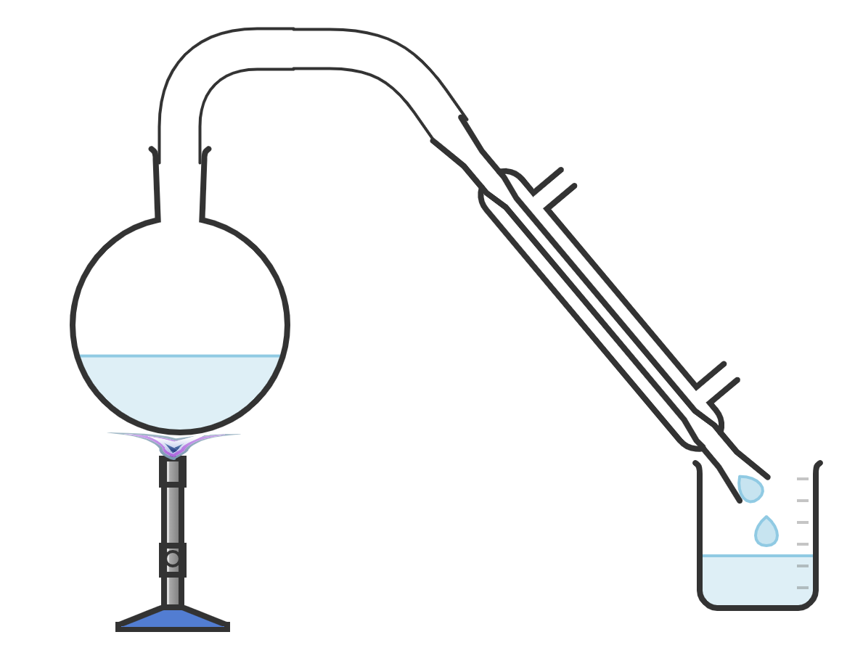
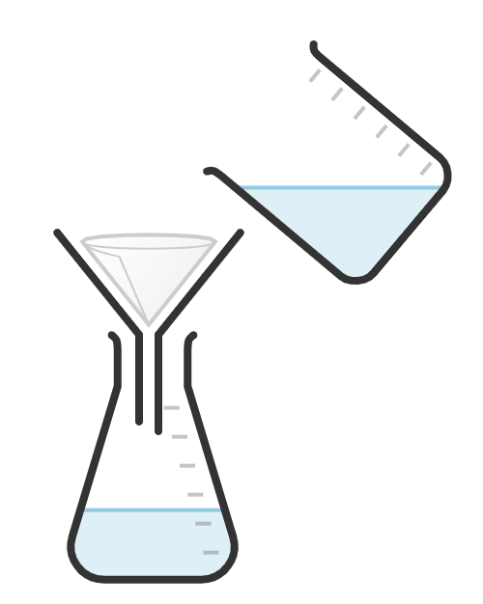
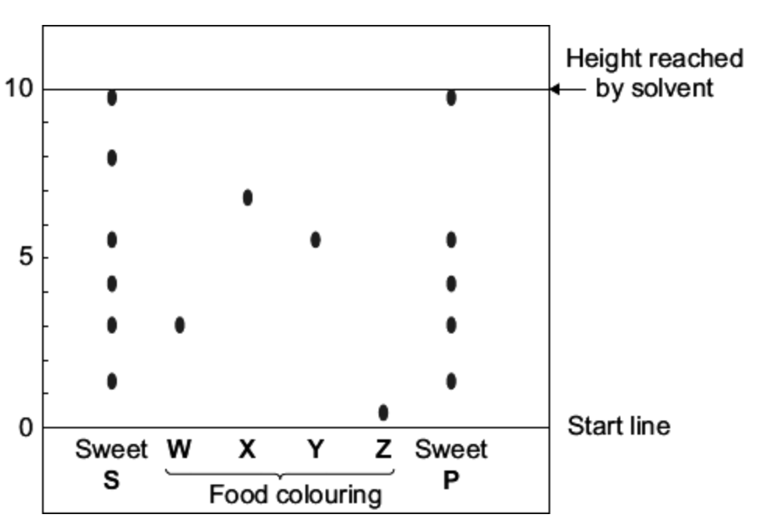
The diagram below shows the apparatus for distillation, label each section of the apparatus using the words from below:
Word Bank
Condenser Round bottom flask Bunsen burner
Water in Water out Solution Distillate
Why do the substances being separated by distillation need different boiling points?
…………………………………..……....
…………………………………..……....
…………………………………..……....
The diagram below shows the apparatus for distillation, label each section of the apparatus using the words from below:
Word Bank
Beaker Conical flask Filter funnel Filtrate
Residue Filter paper
If a solution is filtered, and 100 g of filtrate and 45 g of residue is collected, what was the mass of the solution?
…………………………………..……....
…………………………………..……....
Select the correct method to separate each of the following mixtures:
Sand and water
Distillation/Chromatography/Filtration
Alcohol and water
Distillation/Chromatography/Filtration
A mixture of inks
Distillation/Chromatography/Filtration
A mixture of inks
Distillation/Chromatography/Filtration
An insoluble solid from a liquid
Distillation/Chromatography/Filtration
More than one liquid with different boiling points
Distillation/Chromatography/Filtration
A mixture of inks
Distillation/Chromatography/Filtration
Two or more substances dissolved in one solvent
Distillation/Chromatography/Filtration
Below are the results from a chromatography investigation:
Which colours were in sweet S?
……………………………………..…………………………
Which colours were in sweet P?
……………………………………..…………………………
Why can the start line not be drawn in ink?
……………………………………..…………………………
What is the purpose of the condenser?
……………………………………..……………………………………
Why does the condenser use cold water
……………………………………..……………………………………
Where in the apparatus does evaporation occur?
……………………………………..……………………………………
Where in the apparatus does condensation occur?
……………………………………..……………………………………
What advantage does this method have over simple evaporation?
……………………………………..……………………………………
……………………………………..……………………………………

Slide 22
Complete the word fill below to describe physical and chemical changes:
In a ________ change, the state can change, but the ________ composition is not changed.
In a chemical change, the atoms are __________ to make a ___ substance.
State three uses of chemical reactions:
1 ..…………………….………
2 .……………………………..
3 .……………………………..
Complete the thermal decomposition reactions by filling in the blanks below:
Calcium Carbonate → Calcium _____ + Carbon dioxide
Zinc Carbonate → Zinc oxide + ______ _______
Copper Carbonate → ______ oxide + Carbon dioxide
Sodium Carbonate → ______ _____ + Carbon dioxide
_______ Carbonate → Lithium oxide + ______ _______
Match the type of chemical reaction to the correct definition
State three signs that a chemical reaction has taken place:
1 ..…………………….………
2 .……………………………..
3 .……………………………..
Combustion |  | This reaction releases energy, the surroundings increase in temperature
Thermal decomposition |  | The burning of a fuel in oxygen
Endothermic |  | A substance is broken down into at least two other products using heat
Exothermic |  | This reaction takes in energy, the surroundings decrease in temperature
Complete the reaction below to represent the combustion of methane:
Methane + ______ → ______ _______ + _____
On which side of the equation are the reactants?
……………………………………………………………………………….
On which side of the equation are the products?
……………………………………………………………………………….
State the three factors in the fire triangle:
1 ..…………………….………
2 .……………………………..
3 .……………………………..
Read the statements below to decide whether they describe an endothermic or an exothermic reaction:
The temperature starts at 13ºC and ends at 20ºC
Endothermic/Exothermic
The temperature starts at 23ºC and ends at 20ºC
Endothermic/Exothermic
The burning of a fuel
Endothermic/Exothermic
The frying of an egg
Endothermic/Exothermic
A hand warmer
Endothermic/Exothermic
An instant ice pack
Endothermic/Exothermic
Where the temperature decreases
Endothermic/Exothermic
Use your knowledge of the conservation of mass in order to calculate the missing values below:
Magnesium carbonate → magnesium oxide + carbon dioxide
120 g __ g 19 g
Aluminium carbonate → aluminium oxide + carbon dioxide
__ g 55 g 10 g
Ethane + Oxygen → Carbon dioxide + Water
100 g 50 g __ g 75 g
Ethane + Oxygen → Carbon dioxide + Water
__ g 8 g 12 g 29 g
Which chemical do we use to test for carbon dioxide?
..…………………….……
What happens to the chemical you have answered above when carbon dioxide is present?
..…………………….……
..…………………….……

Slide 23
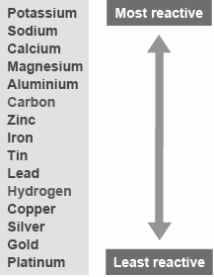
Match the acid to the type of salt that it produces when reacting with a metal:
Which type of gas do we test for with the squeaky pop test?
…………………………………………………
Which type of gas do we know is present when it turns limewater cloudy?
…………………………………………………
Fill in the blanks to complete the reactions between a metal and oxygen:
Magnesium + Oxygen → Magnesium _____
Iron + Oxygen → ____ _____
Copper + Oxygen → ______ _____
_______ + ______ → Lithium oxide
Hydrochloric acid |  | Sulphide
Sulphuric acid |  | Chloride
Nitric acid |  | Nitrate
Fill in the blanks to complete the equations for the metal and acid reactions below:
Hydrochloric acid + Magnesium → Magnesium _______ + Hydrogen
Hydrochloric acid + Zinc → ____ ________ + Hydrogen
Hydrochloric acid + Iron → ____ ________ + ________
Sulphuric acid + Calcium → _______ sulphate + ________
Sulphuric acid + Tin → ___ ________ + ________
Nitric acid + Nickel → ______ _______ + ________
Nitric acid + Beryllium → _________ _______ + ________
________ ____ + ______ → Sodium sulphate + ________
Fill in the blanks to complete the reactions between a metal and water:
Magnesium + Water → _________ hydroxide + Hydrogen
Zinc + Water → ____ hydroxide + _______
Sodium + Water → ____ _________ + _______
_________ + _____ → Potassium hydroxide + _______
Use the reactivity series in order to complete the metal displacement reactions below:
Iron chloride + Zinc → ____ chloride + ____
Calcium chloride + Sodium → ______ chloride + _______
Iron chloride + Tin → ____ chloride + ___
Potassium chloride + Gold → _________ chloride + ____
Lead sulphate + Zinc → ____ sulphate + ____
Silver sulphate + Zinc → ____ sulphate + ______
Which non metal can be used to extract a metal from its ore?
…………………………………………………
Write the equation for the extraction of iron from its ore using this nonmetal:
…………………………………………………
Complete the word fill below:
In a ___________ reaction a ____ reactive metal will take the place of a ____ reactive metal in a compound. If the metal on it’s own is ____ reactive than the metal in the compound __ reaction will take place.

Slide 24
Physics

Slide 25
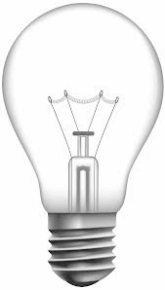
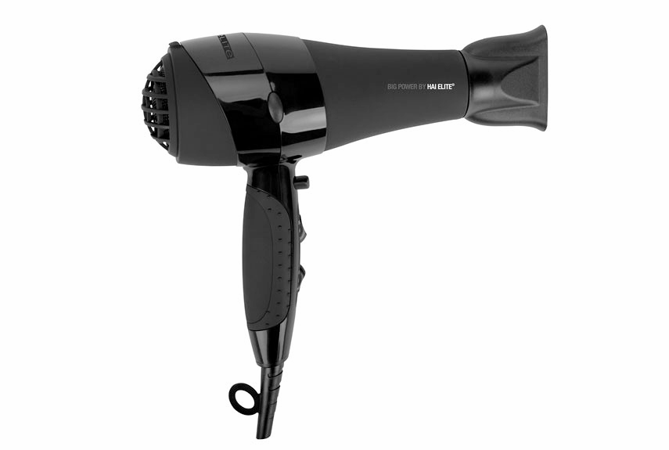
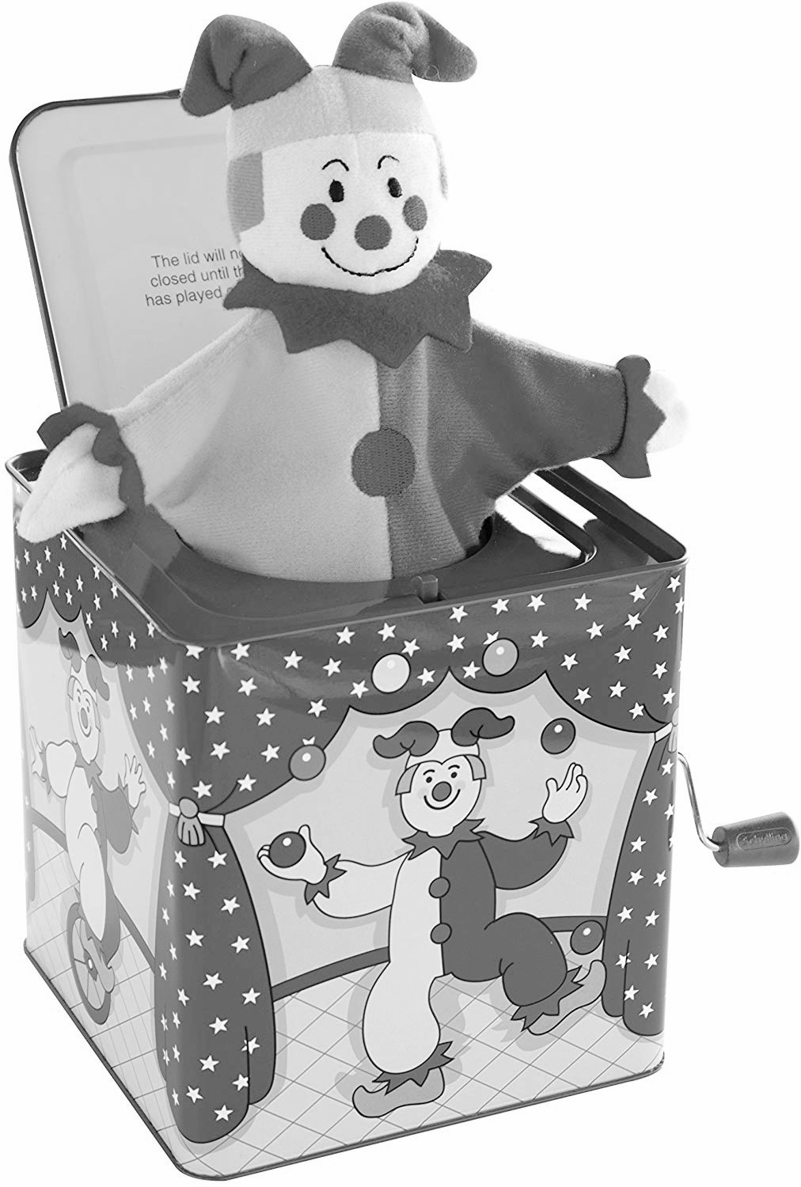
Match the energy store to the correct description:
Which type of energy is in a battery?
……………………………………..…………
Which type of energy is in a battery?
……………………………………..…………
Which energy store decreases as a ball rolls down a hill?
……………………………………..…………
Which energy transfer is seen in a car which has just been filled with petrol?
……………………………………..…………
Which unit is temperature measured in?
…………………………………………......…………
Which unit is thermal energy measured in?
……………………………………..………....………
What is meant by equilibrium?
…………………………………....………..…………
…………………………………....………..…………
Magnetic energy |  | Anything that has been stretched
Elastic potential energy |  | An object or substance from which energy can be released by a chemical reaction
Electrostatic energy |  | Magnets that are attracted or repelling
Thermal energy |  | Two electric charges which attract or repel
Kinetic energy |  | The higher the temperature, the more of this type of energy
Gravitational potential energy |  | Anything that is moving
Chemical energy |  | Anything in a gravitational field (anything that can fall)
Write the name of each energy resource being described below:
…………………………...…………
Uses energy from wind in order to produce electricity
…………………………...…………
Uses energy from the Sun in order to produce electricity
…………………………...…………
Involves a process of pumping water down into hot rocks to produce electricity
…………………………...…………
Uses falling water in order to produce electricity
…………………………...…………
Uses nuclear reactions to produce electricity
…………………………...…………
Relies on remains of organisms which died thousands of years ago to produce electricity
For each of the scenarios below indicate whether conduction, convection or radiation is being described:
Hot air rising
Conduction/Convection/Radiation
Heat being transferred from the Sun to Earth
Conduction/Convection/Radiation
An energy transfer not involving particles
Conduction/Convection/Radiation
An energy transfer in a solid
Conduction/Convection/Radiation
An energy transfer in a fluid
Conduction/Convection/Radiation
Water being heated
Conduction/Convection/Radiation
A metal bar being heated by a fire
Conduction/Convection/Radiation
Use your knowledge of the conservation of energy to complete the sentence below:
Energy cannot be _______ or _________, only ___________ or ___________.
Apply your knowledge of the conservation of energy to calculate the missing values below:
30 J of light energy
50 J of electrical energy
__ J of thermal energy
60 J of kinetic energy
___J of electrical energy
50 J of
thermal energy
75 J of kinetic energy
150 J of elastic potential energy
__ J of
sound energy

Slide 26
Use the words below in order to complete the sentences below:
nonrenewable lifetime replaced renewable run out
A _________ energy resource is one which can be ________ within your ________.
A _____________ energy resources will eventually ___ ___, it cannot be replaced within your lifetime.
Match the correct units to the correct measurement:
Complete the formula to calculate power, energy and time below:
Power = ______ ÷ ____
Energy = _____ x ____
Time = ______ ÷ _____
Power |  | Watts (W)
Energy |  | Seconds (s)
Time |  | Joules (J)
State three renewable energy resources:
1. ……………………………...…………………..
2. ……………………………..…………………..
3. ………………………………………...………..
If 500 J of energy are transferred in 10 seconds, what is the value of power?
……………………………………..……………....…………………………
……………………………………..……………....…………………………
……………………………………..……………....…………………………
How long would it take for a device with a power of 8 W to transfer 1600 J of energy?
……………………………………..……………....…………………………
……………………………………..……………....…………………………
……………………………………..……………....…………………………
What would be the value of energy transferred if a device with a power of 15 W is left on for 2 minutes?
……………………………………..……………....…………………………
……………………………………..……………....…………………………
……………………………………..……………....…………………………
What would be the power if a device transfers 800 J of energy in 5 minutes?
……………………………………..……………....…………………………
……………………………………..……………....…………………………
……………………………………..……………....…………………………
State the three fossil fuels:
1. ……………………………...…………………..
2. ……………………………..…………………..
3. ………………………………………...………..
State three nonrenewable energy resources:
1. ……………………………...…………………..
2. ……………………………..…………………..
3. ………………………………………...………..
Annotate the diagram below to describe how a power station will generate electricity:

Slide 27
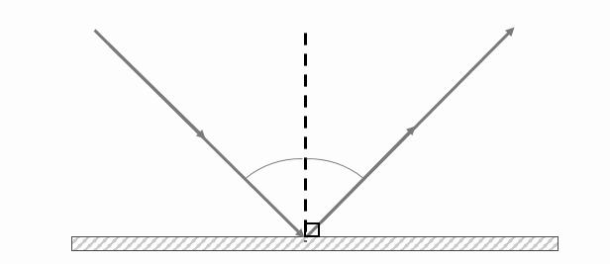
Use the words below in order to complete the sentences about light:
faster straight luminous non-luminous emits
Light travels in ________ lines and at a ______ speed than sound. An object which _____ light is known as ________, and an object which does not emit light is known as ___-________.
Sort the objects as to whether they are transparent, translucent or opaque:
Glass Tracing paper Cardboard Stained glass Brick Wood
Air Sunglasses Vegetable oil Water
Transparent | Translucent | Opaque
Match the term to the correct definition:
Transparent |  | Objects which do not allow light to pass through
Translucent |  | Objects that allow all light to pass through
Opaque |  | Objects which allow light to pass through but will scatter this light
Use the words below in order to label the diagram below:
Normal Incident ray Reflected ray Angle of incidence Angle of reflection
What is the law of reflection?
..……………....……….……..……………....……….……..……………....……….…
..……………....……….……..……………....……….……..……………....……….…
..……………....……….……..……………....……….……..……………....……….…
..……………....……….……..……………....……….……..……………....……….…
In the space below sketch a diagram to represent diffuse and specular reflection:
Diffuse reflection Specular reflection
State three characteristics of diffuse reflection:
1. ………………………………………………
2. ………………………………………………
3. ………………………………………………
State three characteristics of specular reflection:
1. ………………………………………………
2. ………………………………………………
3. ………………………………………………

Slide 28
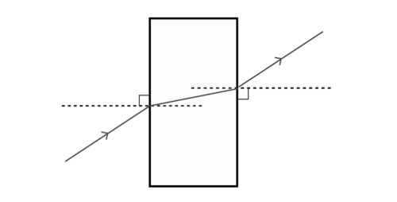
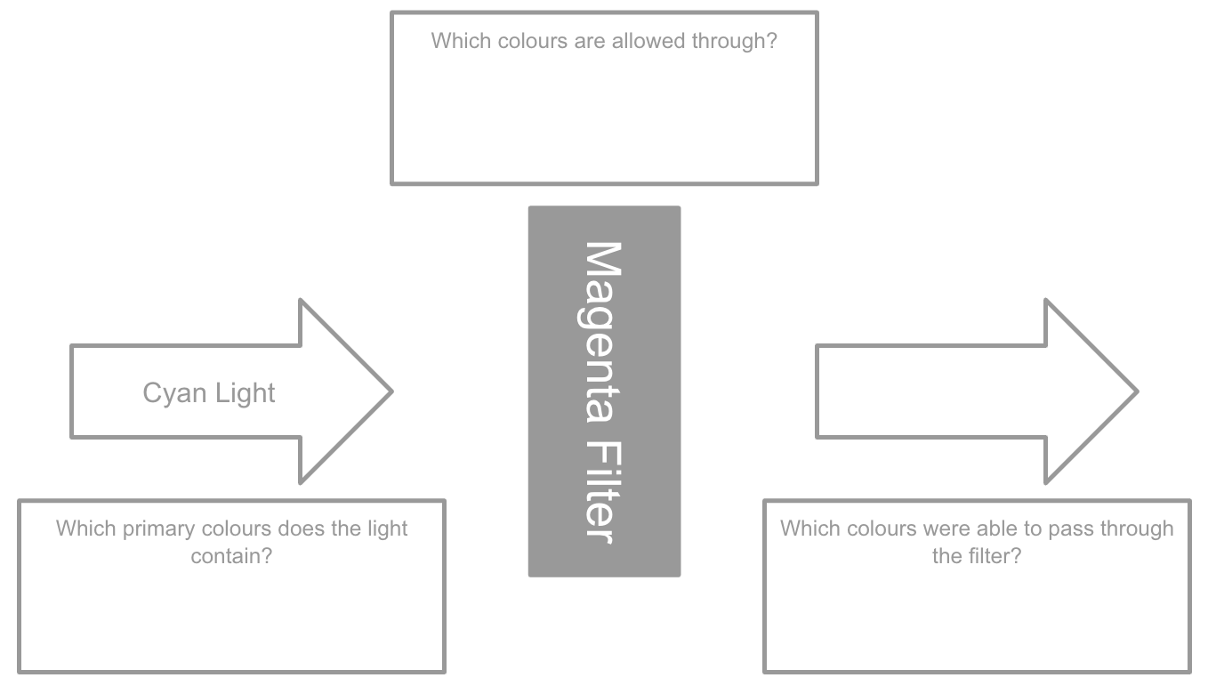
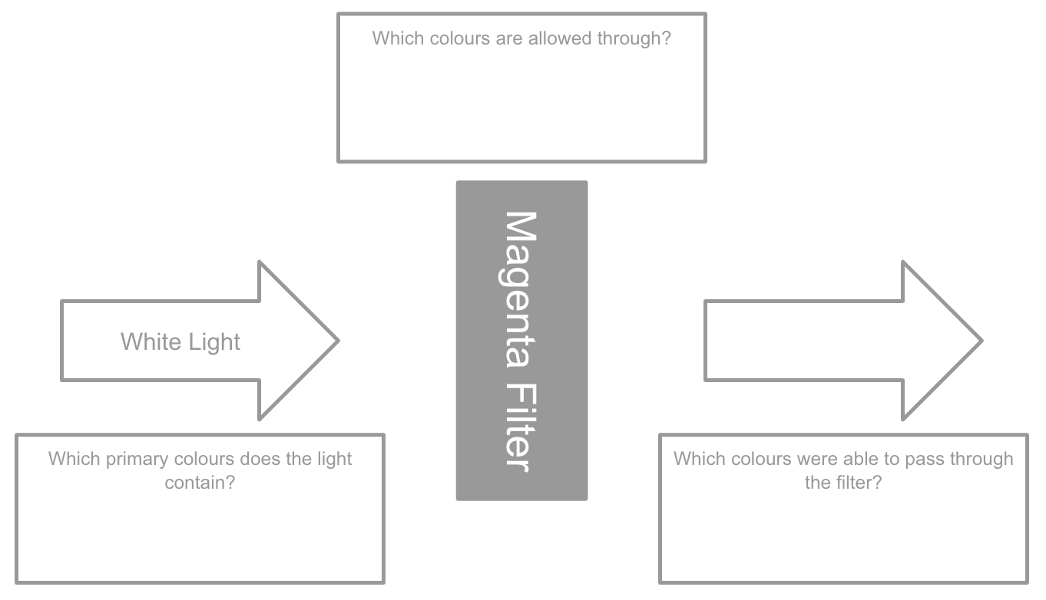
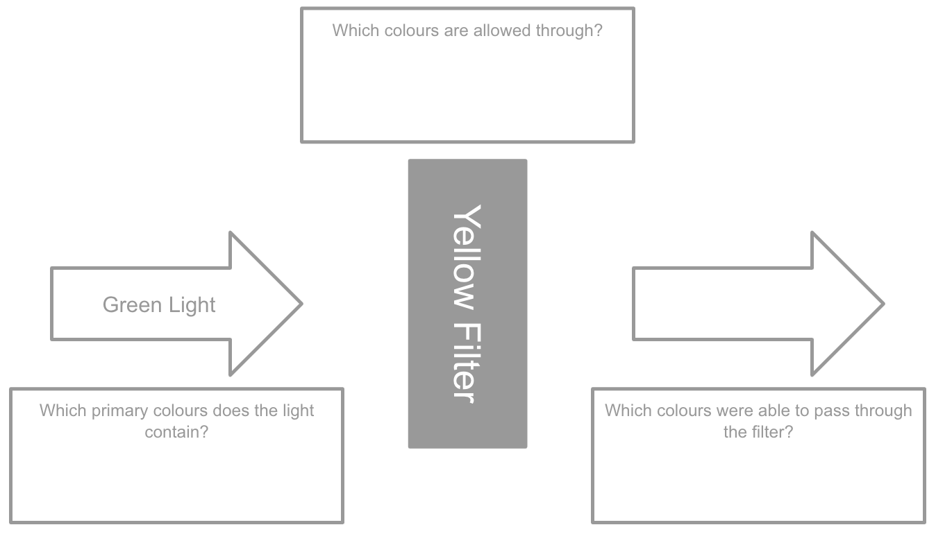
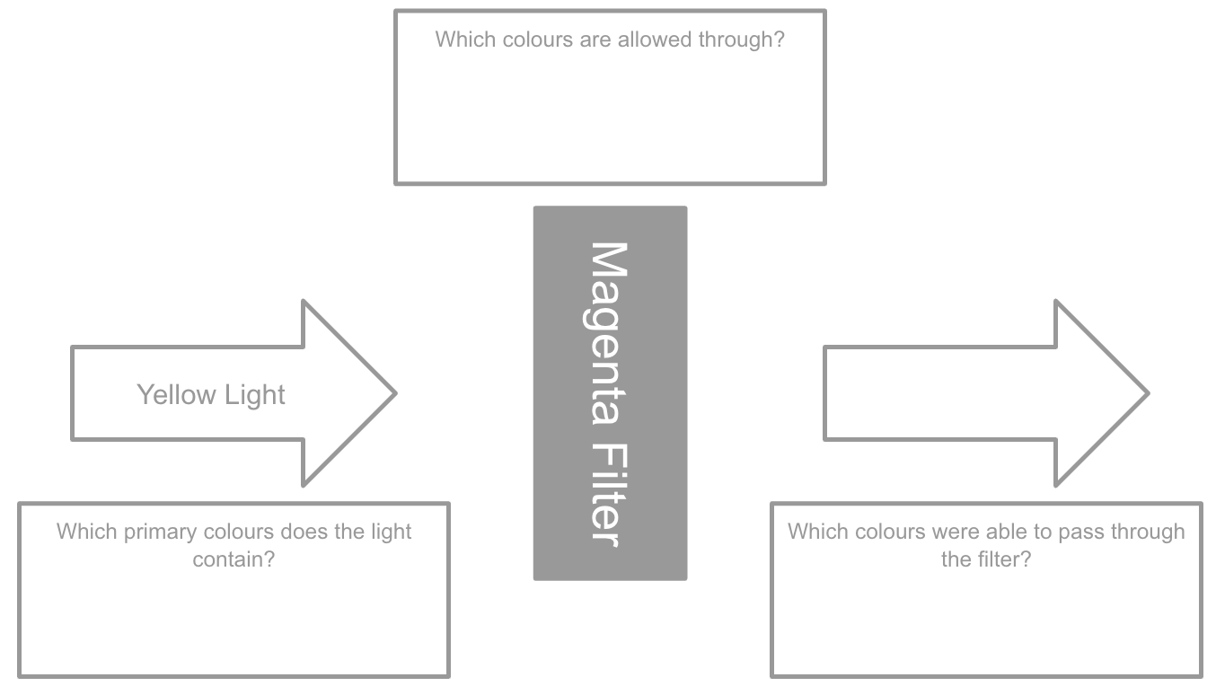
Use the words below in order to complete the sentences about refraction:
away normal normal towards boundary Light
Refraction occurs when a ray of _____ moves across a _________ between two materials.
If it moves from a less dense to a more dense material it will bend _______ the _______.
If it moves from a more dense to a less dense material it will bend ____ the _______.
Use the words below in order to label the diagram below:
Angle of incidence Normal Emergent angle Angles of refraction Normal
State in each case below whether the ray of light will bend towards or away from the normal by circling the correct answer:
Glass to air | Towards / away from the normal
Air to water | Towards / away from the normal
Water to air | Towards / away from the normal
Air to glass | Towards / away from the normal
Complete the diagrams below to describe what happens to light passing through a filter:
What are the three primary colours?
………………………………………………………………………………………….
Which two colours make magenta?
………………………………………………………………………………………….
Which two colours make cyan?
………………………………………………………………………………………….
Which two colours make yellow?
………………………………………………………………………………………….
How does a colour filter work?
………………………………………………………………………………………….
………………………………………………………………………………………….

Slide 29
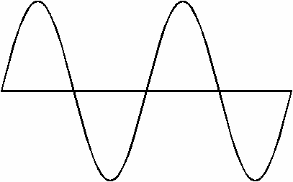
In the boxes below draw the particle models for each state in the boxes below:
Solid
Liquid
Gas
Use the words at the bottom to label the diagram of a wave:
Word Bank
Amplitude Wavelength Peak Trough
Fill in the blanks below to complete the sentences:
A __________ wave is one that will move at 90º to the direction of travel. An example of a __________ wave is _____. Transverse waves do not need _________.
A __________ wave is one that moves along the direction of travel. An example of a __________ wave is _____. Longitudinal waves need _________.
What causes a soundwave?
………………………………………….…...
…………………………………………....….
Match the feature of a wave to its definition:
Match the diagram of the wave to the correct description:
Wavelength |  | The top of a wave
Amplitude |  | The distance between two consecutive points on a wave
Frequency |  | The bottom of a wave
Peak |  | The displacement between the resting position and highest point on a wave
Trough |  | How many waves pass a fixed point per second
 | High pitch and loud
 | Low pitch and loud
 | High pitch and quiet
 | Low pitch and quiet
Through which state of matter does sound travel quickest?
…………………………………………………………
How does the space between particles affect the speed of sound?
…………………………………………………………
………………………………………………………
In which unit do we measure frequency?
………………………………………….……………....

Slide 30
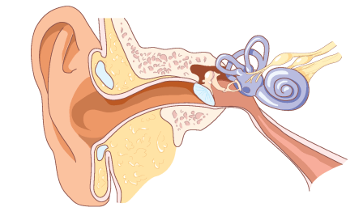
Use the words at the bottom to label the diagram of the ear:
Word Bank
Ossicles Pinna Eardrum Cochlea Ear canal
Complete the formula to calculate speed, distance and time below:
Speed = ________ ÷ ____
Distance = _____ x ____
Time = ________ x _____
A person is in a sports hall and shouts, after 3 seconds he hears the echo of the sound. If the speed of sound is 340 m/s in air, how far away is the person from the wall?
……………………………………..……………....…………………………
……………………………………..……………....…………………………
……………………………………..……………....…………………………
……………………………………..……………....…………………………
A boat is using sonar to find out how deep the ocean is, if it emits a sound and then receives the echo 6 seconds later, how deep is the ocean? The speed of sound in water is 1500 m/s.
……………………………………..……………....…………………………
……………………………………..……………....…………………………
……………………………………..……………....…………………………
……………………………………..……………....…………………………
A bat is at the front of a cave which is 250 m long. If the bat emits ultrasound which has a speed of 240 m/s in air, how long will it take to hear the echo of the ultrasound?
……………………………………..……………....…………………………
……………………………………..……………....…………………………
……………………………………..……………....…………………………
……………………………………..……………....…………………………
Fill in the blanks below to show the process of hearing:
Sound is received enters through the outer ear and travel down the ___ _____
The _______ vibrates which also causes the _________ to vibrate
The vibrations of the ossicles are amplified and passed to the fluid in the _______
Tiny hairs in the cochlea detect the vibrations, this converts the vibrations to __________ signals which are transmitted to the brain via the ________ nerve
State three factors that could affect hearing:
1. ……………………………………………………..
2. …………………………………………………….
3. …………………………………………………….
What is an echo?
……………………………………..………..……..
How can we reduce echoes?
……………………………………..………..……..
……………………………………..………..……..
What is the human range of hearing?
……………………………………..………..…..……..

Slide 31
Use the words below to correctly name each of the circuit components:
Open switch Battery Cell Bulb Ammeter Resistor Voltmeter Closed switch
Match the correct units to the correct measurement:
Complete the formula to calculate charge, current and time below:
Charge = _______ x ____
Current = _____ ÷ ____
Time = ______ ÷ _______
Charge |  | Amperes (A)
Current |  | Seconds (s)
Time |  | Coulombs (C)
Potential difference |  | Volts (V)
Resistance |  | Ohms (Ω)
If a current of 5 A flows for 30 seconds, what is the value of the charge?
……………………………………..……………....…………………………
……………………………………..……………....…………………………
……………………………………..……………....…………………………
If a charge of 90 C is present for 1 minute, what is the current?
……………………………………..……………....…………………………
……………………………………..……………....…………………………
……………………………………..……………....…………………………
What time period will it take 900 C to flow with a current of 12 A?
……………………………………..……………....…………………………
……………………………………..……………....…………………………
……………………………………..……………....…………………………
What is the charge if a current of 8 A flows for 5 minutes?
……………………………………..……………....…………………………
……………………………………..……………....…………………………
……………………………………..……………....…………………………
Use the words below to complete the sentences:
closed parallel series electrons
A circuit must be a ______ loop so that ________ can flow. A ______ circuit only has one loop, whereas a ________ circuit has more than one loop.
Which two types of materials can have static electricity build up within them?
……………………………………..………………
What happens to a an atom when it loses electrons?
……………………………………..………………
What happens to a an atom when it gains electrons?
……………………………………..………………
What causes electrons to move?
……………………………………..………………
In the space below sketch the circuit described:
A series circuit with two bulbs, a cell and an open switch:
A parallel circuit with two bulbs, a closed switch and a battery:

Slide 32
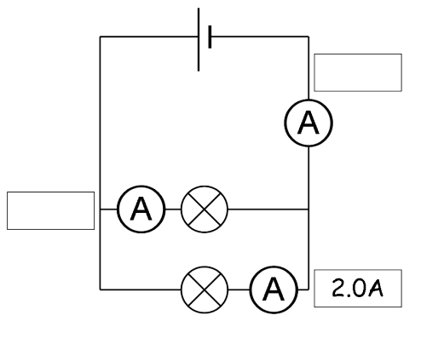
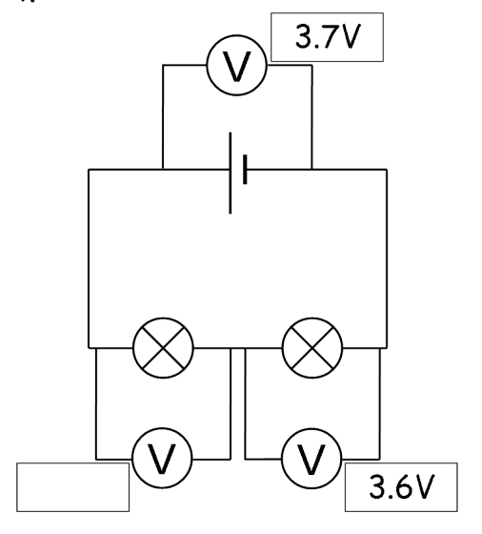
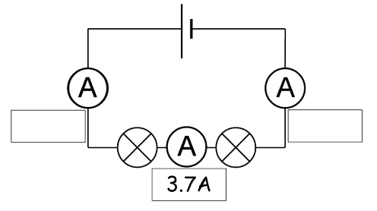
Complete the formula to calculate resistance, potential difference and current below:
Resistance = _________ __________ ÷ _______
Current = __________ ÷ _________ __________
Potential difference = __________ x _______
Where do we place an ammeter in a circuit?
…..……………………………..
Where do we place a voltmeter in a circuit?
…..……………………………..
Complete the table below to describe how potential difference and current are affected by different types of circuit:
 | Series Circuit | Parallel Circuit
Current
Potential difference
If a current of 5 A flows and a potential difference of 12 V is present, what is the value of the resistance?
……………………………………..……………....…………………………
……………………………………..……………....…………………………
……………………………………..……………....…………………………
If a device has a resistance of 12 Ω and a current of 1.5 A is flowing, what is the value of the potential difference?
……………………………………..……………....…………………………
……………………………………..……………....…………………………
……………………………………..……………....…………………………
What is the current if a device has a resistance of 9 Ω and there is a potential difference of 6 V?
……………………………………..……………....…………………………
……………………………………..……………....…………………………
……………………………………..……………....…………………………
What is the resistance if there is a potential difference of 18 V and a current of 3 A?
……………………………………..……………....…………………………
……………………………………..……………....…………………………
……………………………………..……………....…………………………
Apply your knowledge of series and parallel circuits in order to fill in the unknown values:
Sketch the two magnetic fields below:
Attraction Repulsion
State three factors which will affect the strength of an electromagnet:
1. ……………………………..
2. ……………………………..
3. ……………………………..
State three advantages of electromagnets over permanent magnets:
1. ……………………………..
2. ……………………………..
3. ……………………………..
Describe how you could test the strength of an electromagnet:
……………………………….……..
……………………………….……..
……………………………….……..
……………………………….……..

Slide 33
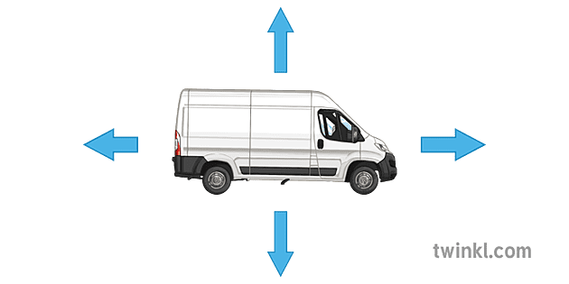
Use the words below in order to complete the sentences about light:
touching separated push newtons pull
A force is a ____ or ____ that is applied by one object on another, it is measured in _______.
Contact forces are physically ________, non contact forces are physically _________.
Sort the forces as to whether they are contact or non contact forces:
Air Resistance Friction Cardboard Electrostatic Magnetic
Gravitational Push / Pull
Contact Forces | Non Contact Forces
In each of the situations below, state if the forces would be balanced or unbalanced:
A car accelerating Balanced / Unbalanced
A plane taking off Balanced / Unbalanced
A car which is stationary Balanced / Unbalanced
A person sitting down Balanced / Unbalanced
An accelerating skydiver Balanced / Unbalanced
A parachute at a constant speed
Balanced / Unbalanced
Use the words below in order to label the diagram below:
Thrust Weight Reaction force Air Resistance
In the space below sketch a car which is streamlined and one which is not, label the key differences:
Streamlined Not Streamlined
State three ways in which air resistance can be increased:
1. ………………………………………………
2. ………………………………………………
3. ………………………………………………
State three advantages of making an object more streamlined:
1. ………………………………………………
2. ………………………………………………
3. ………………………………………………

Slide 34
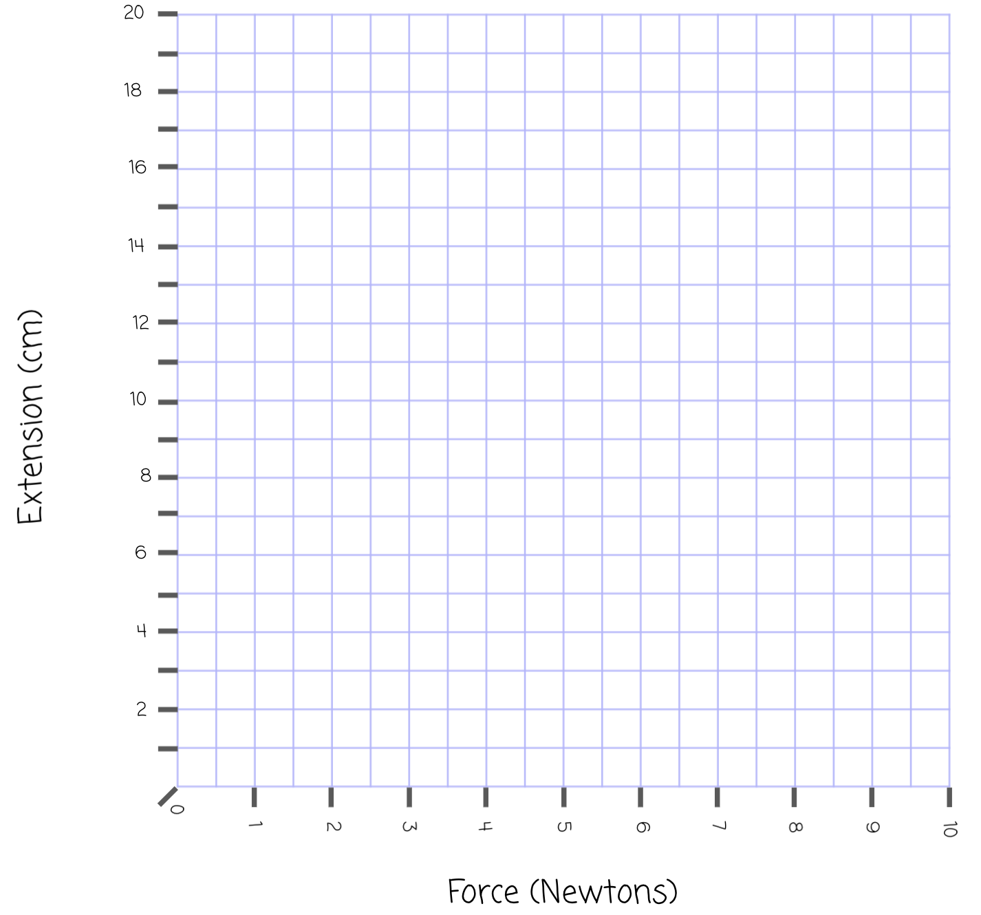
1) Calculate the extension of the spring in the results table below
2) Plot a line graph of the force (X axis) vs the extension (Y axis) on the graph below, draw a line of best fit
3) Label the following terms on your graph:
Directly proportional Limit of proportionality Not directly proportional
Complete the equations to calculate weight, mass and gravitational field strength below:
Weight = ____ x ____________ _____ ________
____________ _____ ________ = ______ ÷ ____
Mass = ______ ÷ ____________ _____ ________
Force (N) | 0 | 2 | 4 | 6 | 8 | 10
Original Length (cm) | 3 | 3 | 3 | 3 | 3 | 3
Stretched length (cm) | 3 | 6 | 9 | 12 | 17 | 23
Extension (cm)
If a person is on the moon where the gravitational field strength is 1.6 N/kg, what will their weight be if they have a mass of 45 kg?
……………………………………..……………....…………………………
……………………………………..……………....…………………………
……………………………………..……………....…………………………
What is a person's mass if they have a weight of 800 N and the gravitational field strength is 10 N/kg?
……………………………………..……………....…………………………
……………………………………..……………....…………………………
……………………………………..……………....…………………………
What is the gravitational field strength on a planet if a person with a mass of 78 kg has a weight of 800 N?
……………………………………..……………....…………………………
……………………………………..……………....…………………………
……………………………………..……………....…………………………
If a person is has a mass of 67 kg, what will their weight be if the gravitational field strength is 10 N/kg?
……………………………………..……………....…………………………
……………………………………..……………....…………………………
……………………………………..……………....…………………………
Complete the sentences below to describe Hooke’s Law:
Hooke’s law states that the __________ of a spring will be ________ proportional to the _____ applied to it. This will be true until the _____ of _______________ has been reached.
Match the correct units to the correct measurement:
Weight | Kilograms (kg)
Mass | Newtons per kilogram (N/kg)
Gravitational field strength | Newtons (N)

Slide 35
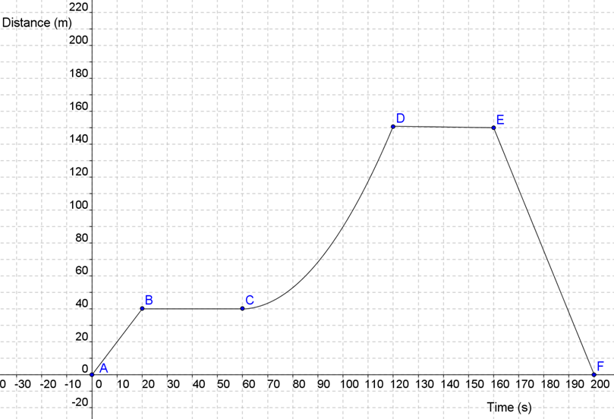
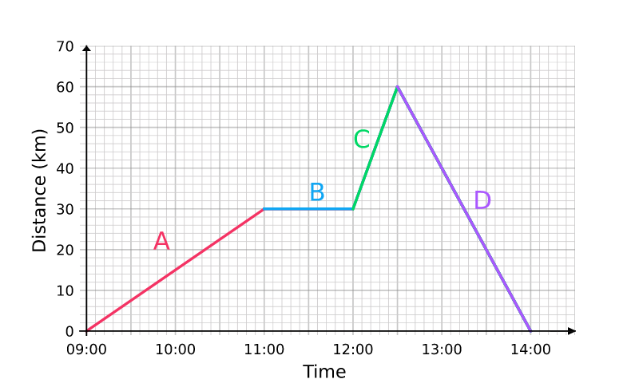
Use the words at the bottom to label the key features of the distance time graph below:
Word Bank
Stationary Constant speed Returning to start Acceleration
Complete the formula to calculate speed, distance and time below:
Speed = ________ ÷ ____
Distance = _____ x ____
Time = ________ ÷ _____
If a person runs 100 m in 15 seconds, what is the speed of the persion?
……………………………………..……………....…………………………
……………………………………..……………....…………………………
……………………………………..……………....…………………………
If a car drives for 300 seconds at 30 m/s, how far will they travel?
……………………………………..……………....…………………………
……………………………………..……………....…………………………
……………………………………..……………....…………………………
If a car covers a distance of 150 meters with an average speed of 2.5 m/s, how long will the journey take them?
……………………………………..……………....…………………………
……………………………………..……………....…………………………
……………………………………..……………....…………………………
If a person travels 50 km in 1 hour and 30 minutes, what is their average speed in m/s?
……………………………………..……………....…………………………
……………………………………..……………....…………………………
……………………………………..……………....…………………………
Describe the motion of each section of the distance time graph below, you need to include time references:
A: ……………………………………..…………….
B: ……………………………………..…………….
C: ……………………………………..…………….
D: ……………………………………..…………….
How does the steepness of a line on a distance time graph relate to speed?
……………………………………..………..…….
What goes on which axis on a distance time graph?
……………………………………..………..…….
……………………………………..………..…….
Match the correct units t the correct measurement:
Speed |  | Meters (m)
Distance |  | Seconds (s)
Time |  | Meters per second (m/s)

Slide 36
Fill in the blanks below in order to complete the definition of gas pressure:
Gas pressure is the _____ exerted by all the _________ inside a container that ______ a unit area of the wall.
Complete the formula to calculate pressure, force and area::
Pressure = _____ ÷ ____
Area = _____ ÷ ________
Force = ________ x ____
Complete the formula to calculate moments, force and distance:
Moment = _____ x ________
Distance = ______ ÷ _____
Force = ______ ÷ ________
A mallet has an area of 0.025 m², if it hits a piece of wood with a force of 50 N, what is the pressure exerted on the wood?
……………………………………..……………....…………………………
……………………………………..……………....…………………………
……………………………………..……………....…………………………
A pressure of 50 Pa is applied to an area of 0.01 m². What is the force applied?
……………………………………..……………....…………………………
……………………………………..……………....…………………………
……………………………………..……………....…………………………
A pressure of 125 Pa is applied with a force of 150 N.. What is the area over which the force is applied?
……………………………………..……………....…………………………
……………………………………..……………....…………………………
……………………………………..……………....…………………………
A hammer has an area of 0.001 m², if it hits a piece of wood with a force of 25 N, what is the pressure exerted on the wood?
……………………………………..……………....…………………………
……………………………………..……………....…………………………
……………………………………..……………....…………………………
A person is using a lever to open a can of paint, if the lever is
0.25 m in length and they apply 5 N of force, what is the moment?
……………………………………..……………....…………………………
……………………………………..……………....…………………………
……………………………………..……………....…………………………
A person is using a crowbar to move a box, if the crowbar has a length of 1.2 m and there is a moment of 10 Nm needed, what is the force applied?
……………………………………..……………....…………………………
……………………………………..……………....…………………………
……………………………………..……………....…………………………
A lever needs a moment of 15 Nm to move, if 5 N of force is applied, what is the length of the lever?
……………………………………..……………....…………………………
……………………………………..……………....…………………………
……………………………………..……………....…………………………
A person is using a lever to open a can of paint, if the lever is
15 cm in length and they apply 1.25 N of force, what is the moment?
……………………………………..……………....…………………………
……………………………………..……………....…………………………
……………………………………..……………....…………………………
State three ways in which gas pressure can be increased:
1. ……………………………..
2. ……………………………..
3. ……………………………..
Describe how atmospheric pressure is changes with altitude.
…..……………………………..
…..……………………………..
…..……………………………..
Describe how water pressure changes with depth.
…..……………………………..
…..……………………………..
…..……………………………..

