Slide 1
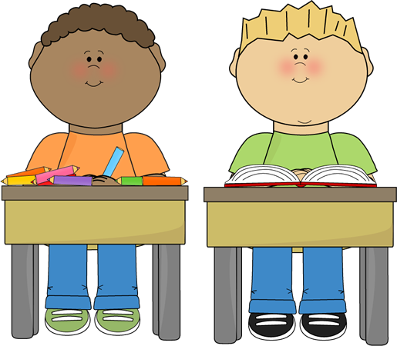
SB1 Revision
SB1a Microscopes
SB1b Plant and Animal Cells
SB1c Specialised Cells
SB1d Inside Bacteria
SB1e Enzymes and Nutrition
SB1f Testing Foods
SB1g Enzyme Action
SB1h Enzyme Activity
SB1i Transporting Substances
LO: Revise the SB1 topic ‘ Key Concepts in Biology’.
Starter:
Complete the SB1 Revision DO NOW starter.

Slide 2
CB1 Revision
CB1a Microscopes
CB1b Plant and Animal Cells
CB1c Specialised Cells
CB1d Inside Bacteria
CB1e Enzymes and Nutrition
CB1f Enzyme Action
CB1g Enzyme Activity
CB1h Transporting Substances
LO: Revise the CB1 topic ‘ Key Concepts in Biology’.
Starter:
Complete the CB1 Revision DO NOW starter.

Slide 3
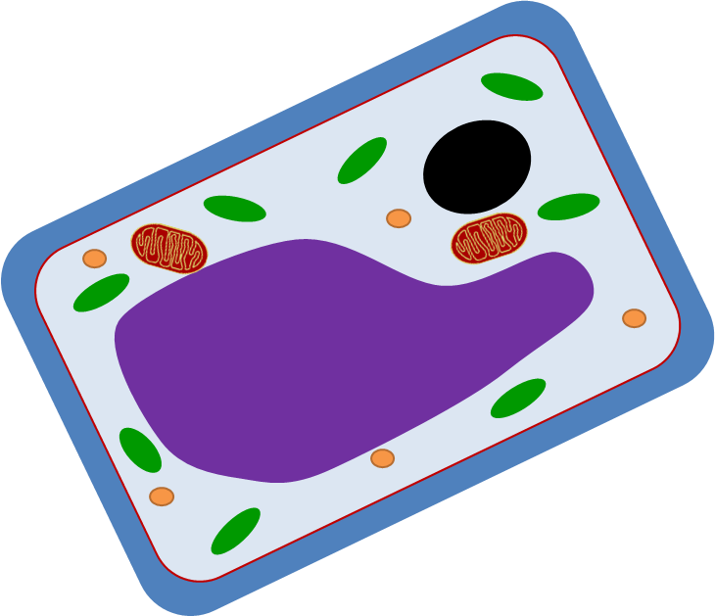
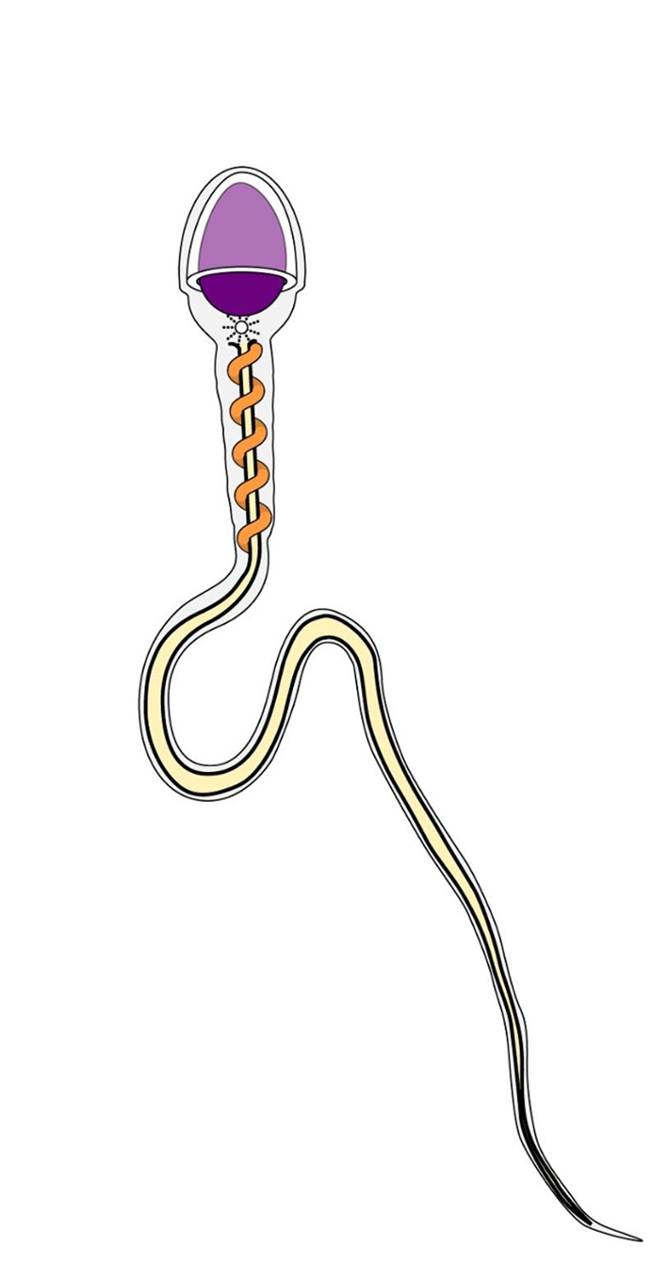
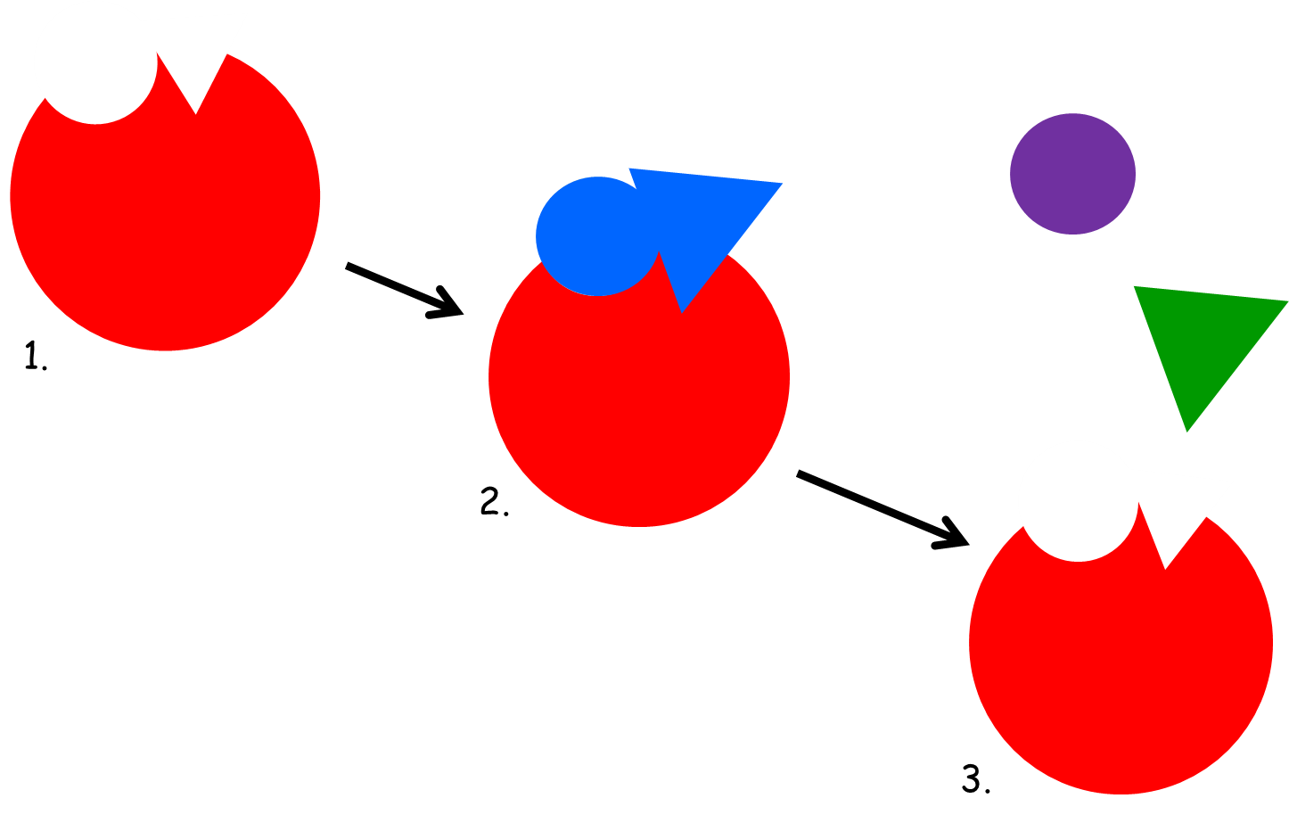
CB1/SB1 Revision: DO NOW starter
Label as much as you can on the key diagrams below.

Slide 4
Magnification & Resolution
Magnification- The process of enlarging the physical appearance / image of something.
Resolution- The ability to distinguish between two points as two separate structures.

Slide 5
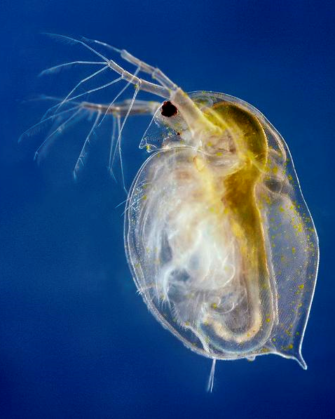
Using Magnification
An image of the water flea is shown at 157mm long.
What is the magnification used?
The actual
size is 1mm.
Magnification
Image size
x157
I
A
M
Actual size

Slide 6
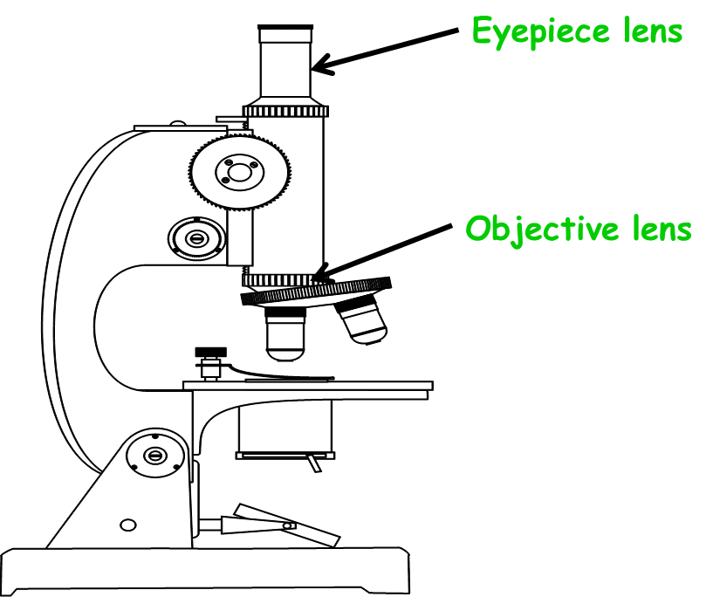
Total Magnification
Calculate the total magnification for the following examples:
Eyepiece Magnification | Objective Magnification | Overall Magnification
X10 | X4
X10 | X10
X10 | X40
X10 | X100
40
100
400
1000
x10 is the most common magnification for the eyepiece lens.

Slide 7
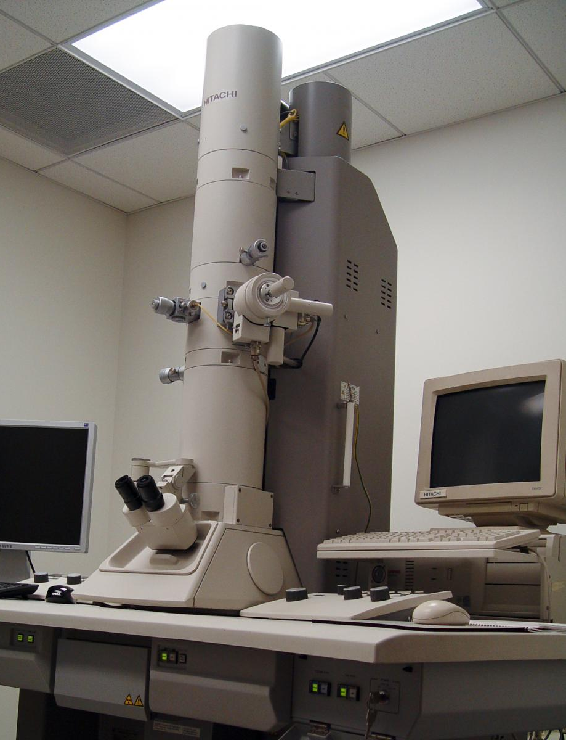
Electron Microscopes
The electron microscope was invented in the 1930s. It uses beams of electrons passing through a specimen to build up an image.
They can magnify up to x2000000 with resolutions down to 0.0000002mm.
They allow us to see cells/microorganisms in greater detail than before.

Slide 8
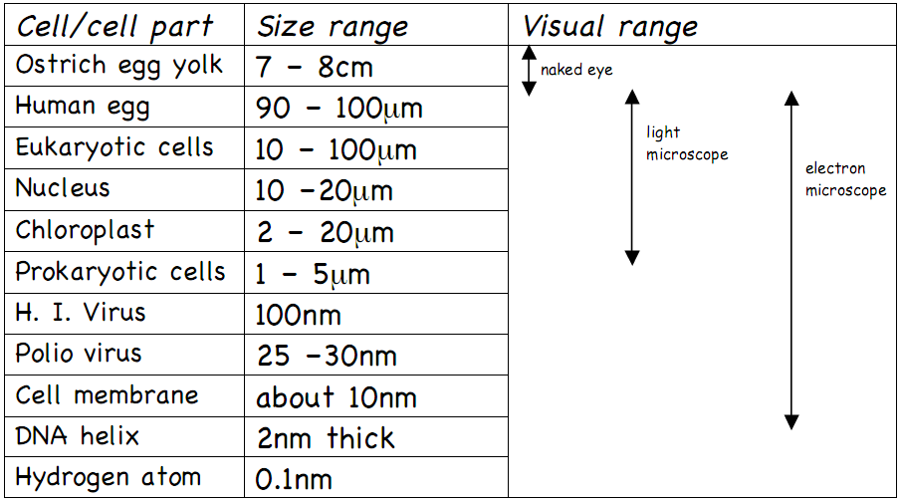
Electron microscopes also allowed us to see things that we previously couldn’t due to its greater magnification power.

Slide 9
Changing Units
÷ 1000
Metre
m
÷ 1000
Millimetre
mm
÷ 1000
x 1000
Micrometre
µm
÷ 1000
x1000
Nanometre
nm
x1000
Picometre
pm
x1000

Slide 10
Decide whether the statements are true or false.
The maximum magnification of a light microscope is x5000
The greater the resolution the sharper the image will appear.
5nm = 0.05µm
Electron microscopes have a greater resolution than light.
Microscopes have had no impact on the study of science.
A millimetre is 1000 micrometres
Image size = magnification x actual size
Eyepiece magnification of x10 and objective of x40, will mean x400 total magnification
Microscopes have one lens that magnifies.
Magnification is reducing the size of an image/ specimen.
Magnification and resolution are the same thing.
A nanometre is smaller than a picometre.

Slide 11
Cells
A cell with a nucleus is described as…
6,15,24,4,22,5,23,20,14,12
EUKARYOTIC

Slide 12
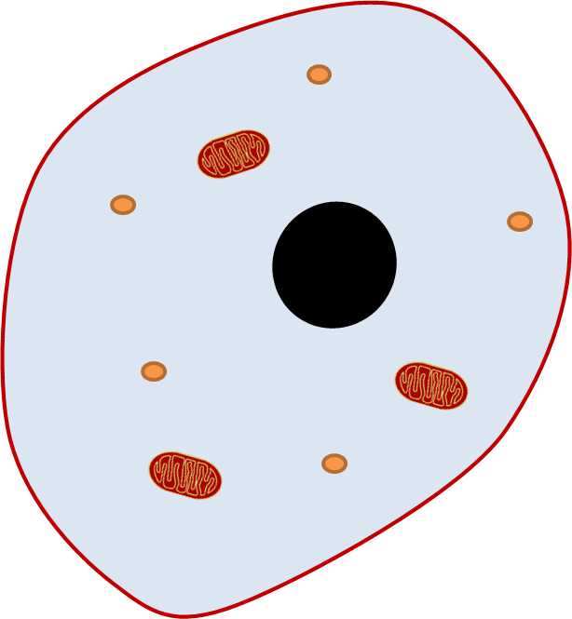
nucleus
Cell membrane
cytoplasm
mitochondria
ribosomes
Cell wall
chloroplasts
vacuole

Slide 13
Nucleus | Controls what happens in the cell and contains the genetic information.
Cytoplasm | Jelly like substance where chemical reactions happen.
Cell membrane | Controls what gets in and out of the cell.
Ribosomes | Where new proteins are made.
Mitochondria | Where respiration occurs generating energy for the organism.
Vacuole | Where cell sap is stored.
Chloroplasts | Where the cell makes its food through photosynthesis.
Cell Wall | Gives the cell structure and support.

Slide 14
Exam Question
Explain the similarities between animal and plant cells.
4 marks
Extending: List four differences between animal and plant cells.

Slide 15
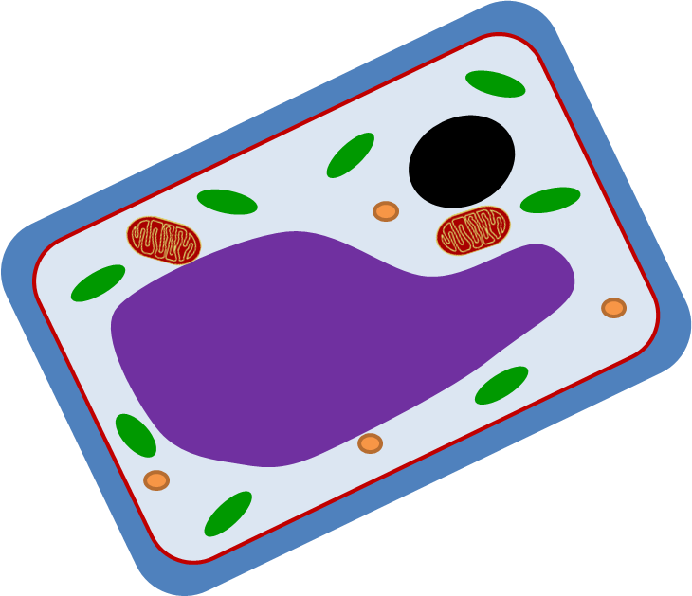
Animal and Plant Cell Similarities
Both have a cell membrane that controls what gets in and out of the cell.
Both have a nucleus that controls the cell and stores the DNA.
Both have mitochondria that make energy through respiration.
Both have cytoplasm where chemical reactions happen in the cell.
Both have ribosomes that make proteins.

Slide 16
Specialised Cells
Humans are MULTICELLULAR organisms.
Most multi cellular organisms have SPECIALISED CELLS.
They work together like a team to support the different processes in an organism.

Slide 17
Specialised Cells
Specialised cells are made through a process called differentiation.
Where an unspecialised cell turns into a very specific cell with a specific function and specific adaptations, it has become specialised.

Slide 18
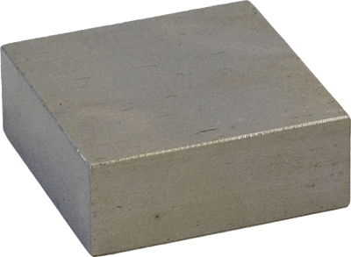
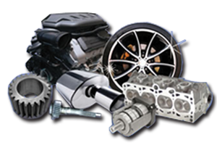
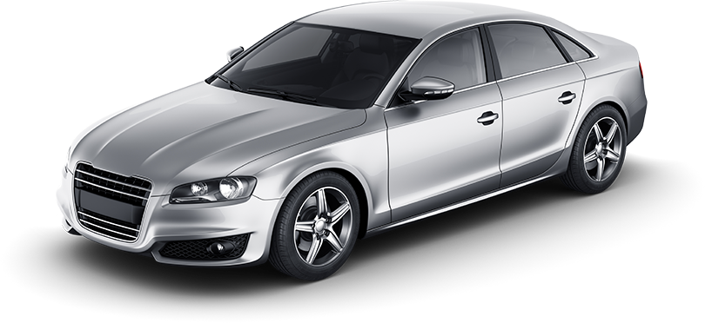
Modelling differentiation:
Block of metal
Unspecialised cell
Car parts
Specialised cell
Car
Body

Slide 19
Digestion
Cells that line the small intestine absorb food molecules produced by digestion.
They have membranes with tiny folds called microvilli, which increases the surface area of the cell.
This allows absorption to happen faster.

Slide 20
Reproduction
Egg cells are the female sex cell (gamete).
They carry half the genetic information of a cell.
They have a jelly coat to protect the cell and ensure only one sperm gets in.
They have lots of nutrients in the cytoplasm for the fertilised egg.

Slide 21
Reproduction
Fertilisation occurs in the oviducts of females. The cells lining this oviduct transport egg cells towards the uterus.
They have hair like structures (cilia) to do this by ‘sweeping’ the egg cells along.
We call them ciliated epithelial cells.

Slide 22
Reproduction
Sperm cells are the male sex cell (gamete).
They have a streamlined shape and tail to easily swim towards the egg.
They have lots of mitochondria to power this tail.
They have enzymes in the acrosome to break through the egg cell’s jelly coat.

Slide 23
Progress Check
Define the term differentiation.
Describe the purpose of microvilli in the digestive system.
Draw and label a diagram to show ciliated epithelial cells.
Explain how human gametes are specialised for their jobs.

Slide 24
Cells
A cell without a nucleus is described as…
6,15,24,4,22,5,23,20,14,12
PROKARYOTIC

Slide 25
New Parts of the Bacteria Cell
Chromosomal DNA- giant loop of DNA containing most of the genetic material
Plasmid DNA- small loops of DNA that carry extra information
Flagella- long whip like structures that allow the bacteria to move themselves along.

Slide 27
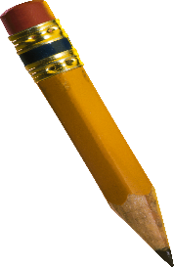
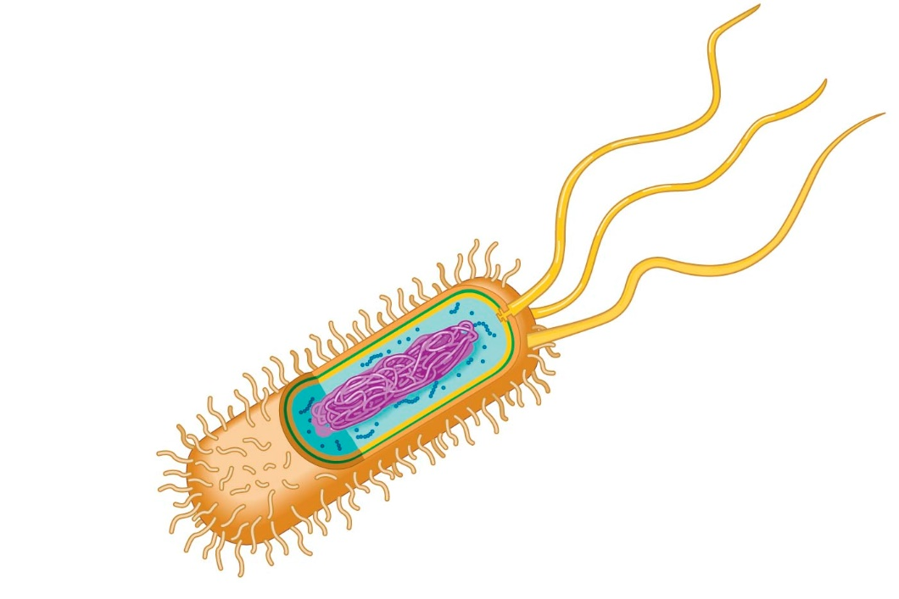
TASK:
Draw a bacterial cell and label it with the following keywords:
KEYWORDS:
Cell Membrane
Cell Wall
Cytoplasm
Chromosomal DNA
Plasmid DNA
Flagellum
Slime Coat
Extending: Explain what each part of the cell does.

Slide 28
Comparing Cells
What are the parts found in each type of cell?
Feature | Animal Cell | Plant Cell | Bacterial Cell
Cell Membrane
Nucleus
Plasmids
Chloroplasts
Cell Wall
Cytoplasm

Slide 29
Standard Form
Higher Only
We show figures as a number between 1 and 10 multiplied by a power of 10:
Index number
A x 10^{n}
The index number tells us how many place values to move the digit.

Slide 30
Higher Only
Standard Form
How to calculate standard form:

Slide 31
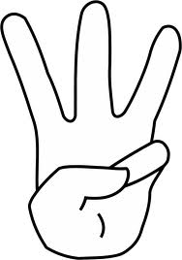
Name 3 things found only in bacterial cells.
Name 2 organelles found in animal, plant and bacterial cells?
Name a difference between plant and bacteria cell walls.

Slide 32
Enzymes
Enzymes are particular types of proteins that help a reaction go faster without being changed in the reaction itself (working as a catalyst).
Some help break down a large substance into smaller molecules (digestion) and other help smaller chemicals join together to make larger ones (synthesis).
We define enzymes as biological catalysts.
They speed up the reactions that occur in the cell (biological processes).

Slide 33
Digestive Enzymes
Protein:
A long chain of amino acids forming a protein molecule.
Synthesis
Broken Down
Individual amino acids.

Slide 34
Digestive Enzymes
Starch:
A long chain of glucose forming a starch molecule.
Synthesis
Broken Down
Individual glucose molecules.

Slide 35
Digestive Enzymes
Lipids:
Lipid molecules
Synthesis
Broken Down
Glycerol and fatty acid chains

Slide 36
Progress Check
Define the term enzyme.
State what chains of amino acids make up.
Describe two things can enzymes do.
Describe a way in which we can model enzyme action.

Slide 37
Specific Enzymes

Slide 38
Exam Style Question
Explain why the role of enzymes as catalysts in digestion is important for life.
3 marks
Extending: Describe the role of three specific enzymes found inside humans.

Slide 39
Exam Style Question
ANSWER
Include the following points:
Digestive enzymes catalyse the breakdown of large food molecules.
So that they are small enough to cross cell membranes.
To supply the body with nutrients and sources of energy.

Slide 40
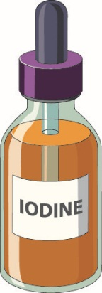
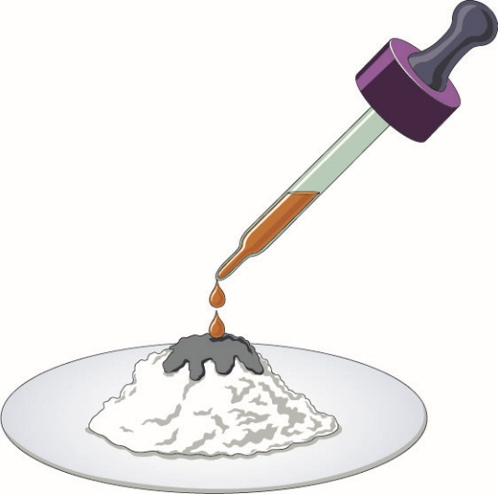
Iodine Test
Triple Only
Safety:
Wear eye protection.
Wash any splashes with water to avoid staining.
Used to identify starch in foods.
Method
Iodine in potassium iodide is yellow-orange.
To test if starch is present, use a pipette to place a few drops of the iodine solution onto some food.
Starch Present: blue-black

Slide 41
Benedict’s Test
Triple Only
Safety:
Wear eye protection.
Avoid scalding from very hot water by handling tubes with heat-resistant gloves or tongs.
Used to identify reducing sugars (i.e. glucose, fructose).
Method
Mix equal volumes of food solution and Benedict's solution in a test tube.
Place into a water bath at 95ºc for a few minutes.
The resulting colour indicates how much reducing sugar is in the food
Benedict’s solution starts out blue.
If the colour does not change the food does not contain any reducing sugar.
Green- food contains a little reducing sugar.
Orange- food contains some reducing sugar.
Red- food contains a lot of reducing sugar.

Slide 42
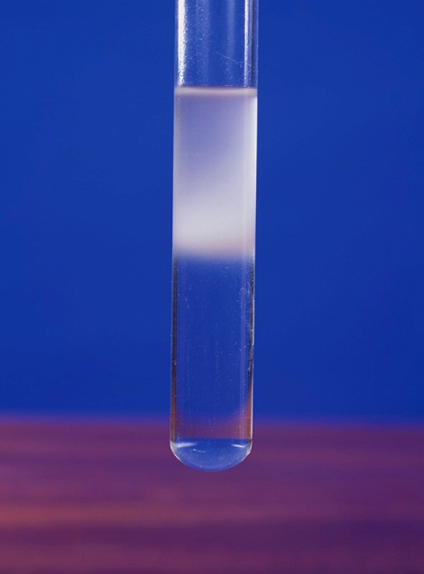
Ethanol Test
Triple Only
Safety:
Wear eye protection.
Ethanol is flammable, do no use near an open flame.
Used to identify fats & oils in foods.
Method
Half fill a tube with ethanol, add the food and mix.
Pour some of the mixture into a tube of water and mix.
Fat Present: cloudy suspension near the top of the tube

Slide 43
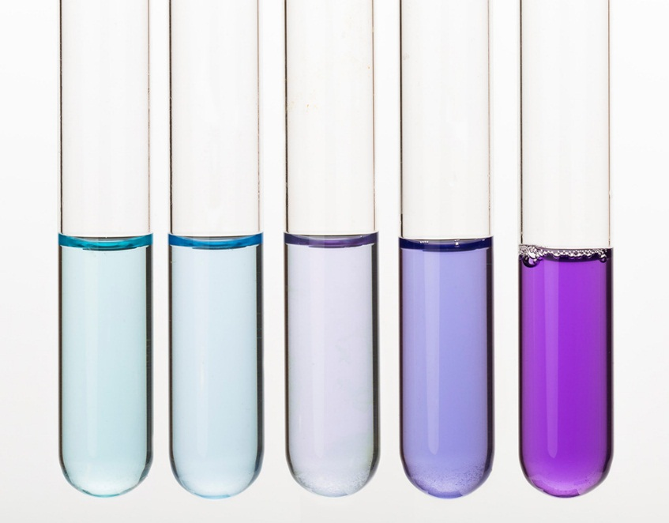
Biuret Test
Triple Only
Safety:
Wear eye protection.
Potassium hydroxide can be harmful to the skin and eyes.
Used to identify protein in foods.
Method
Mix equal volumes of food and dilute potassium hydroxide solution in a test tube.
Add a few drop of copper sulfate solution and mix.
Protein Present: The amount of colour change from blue to lilac indicates the protein level

Slide 44
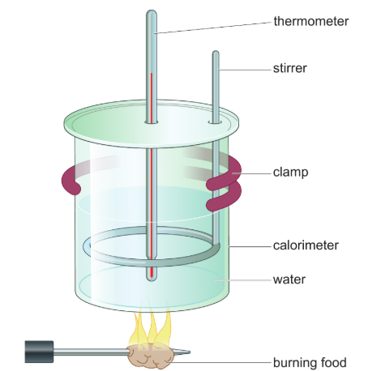
Calorimeter
Triple Only
As the food burns, energy is transferred by heating to the water. The change in temperature of the water is a measure of the amount of energy released form the food.

Slide 45
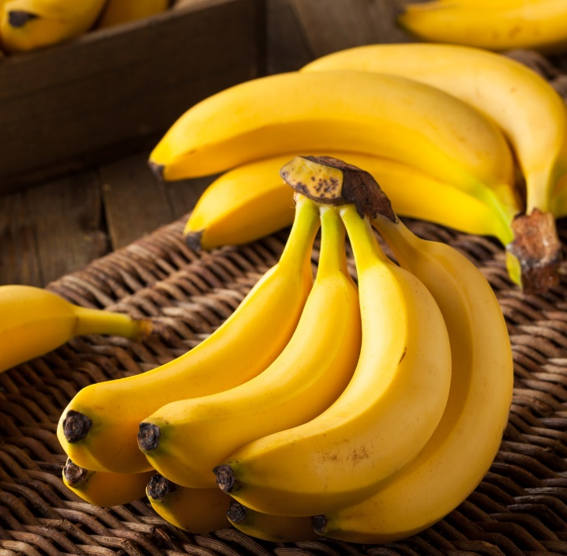
When bananas develop, they mainly contain a complex carbohydrate called starch. As bananas ripen, enzymes break down the starch into smaller carbohydrates, including sugars such as sucrose and glucose.
Triple Only
Describe what you would expect to see if you dropped iodine solution onto the soft part of a ripe banana.
State the chemical reagent you would use to show what is formed as a banana ripens?
Explain how the results of the test might differ if carried out on bananas at different stages of ripening.

Slide 46
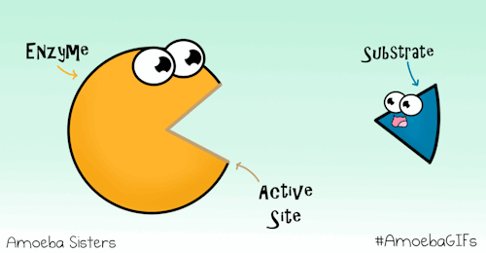
Active Site
The active site of an enzyme will bind to a specific substrate(s) to start the reaction.

Slide 47
Lock and Key Model
Substrates
Active Site
Specific substrates will fit into the active site of the enzyme.
Enzyme

Slide 48
Lock and Key Model
Enzyme Substrate Complex
The substrates bind to the active site.
This forms the enzyme substrate complex.

Slide 49
Lock and Key Model
Product
Active Site
The Enzyme catalyses the reaction and the product is released from the active site.
Enzyme

Slide 50
Lock and Key Model
Similarly enzymes can also be used to break down substrates. This includes the digestive enzymes we looked at last lesson.

Slide 51
Factors that affect Enzymes
Changes in certain conditions will cause the enzyme to denature.
pH
Temperature

Slide 52
What has happened to the active site in the picture?
What does this mean for the substrate and the reaction?

Slide 53
Answer a combination of 3 questions that form a straight line across the grid and MUST include the centre square.
State what enzyme specificity means. | State what the active site is. | Explain why enzymes have a particular shape.
State which type of molecule enzymes are. | Describe what the lock and key model is. | Explain how enzymes become denatured.
State two factors that affect enzyme function. | Describe what denatured means. | Draw a diagram to show a denatured enzyme.

Slide 54
Enzyme
Substrate
Product
Denature
Active Site
Synthesis
Digestion
Destroy the characteristic properties affecting the active site.
A biological catalyst, speeding up reactions in the body.
The initial substance which an enzyme acts on.
Breaking down substances into smaller products.
Producing a substance from more than one substrate.
The substance(s) that are made by the enzyme after the reaction.
The enzyme region that binds to substances during a reaction.

Slide 55
Optimum Conditions
Rearrange the following anagrams to give you a definition for optimum conditions:
The optimum pH or temperature is the level at which the rate of reaction taking place is at its highest.

Slide 56
Graph showing how temperature affects rate of reaction:
Questions:
What was the rate of reaction at 10ºc?
What is the optimum temperature?
What happens after this temperature?
15 g/min
40ºc
Active site denatures

Slide 57
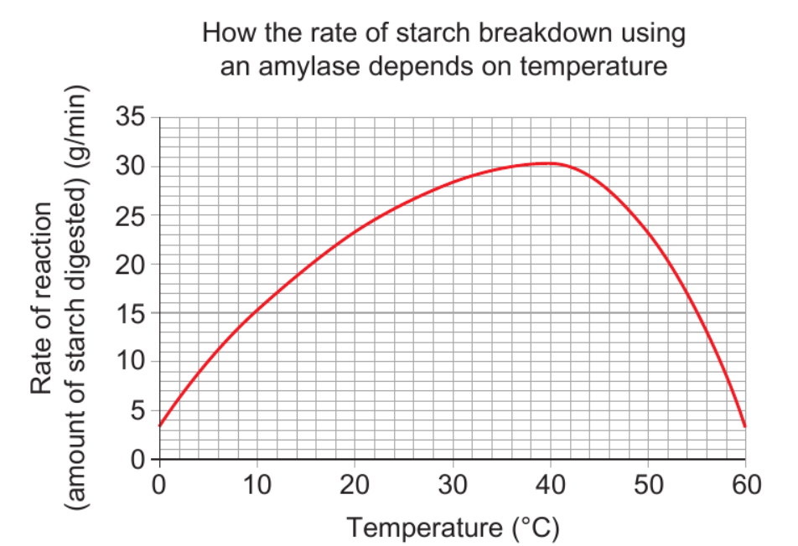
The enzyme denatures meaning the substrate cannot fit into the active site and the reaction is not catalysed.
Molecules move faster, increasing the chance of substrates bumping into the active site.

Slide 58
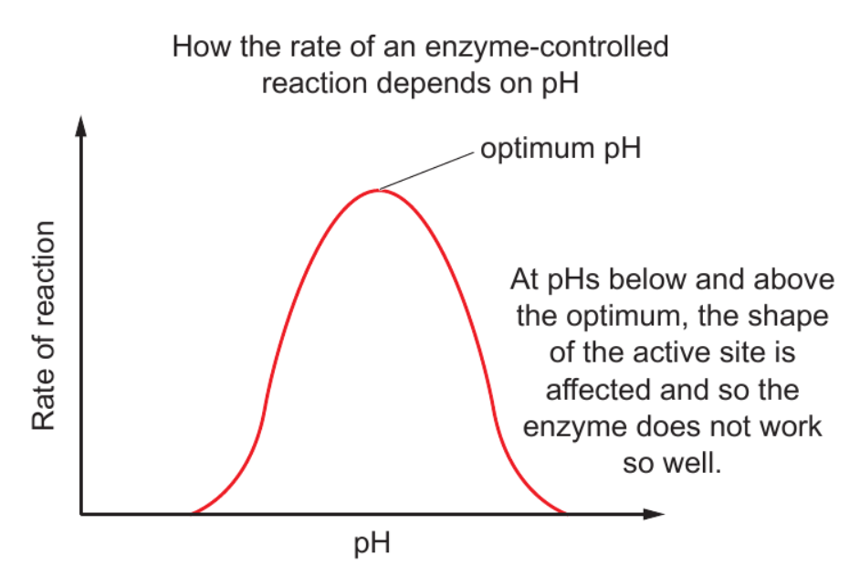

Slide 59
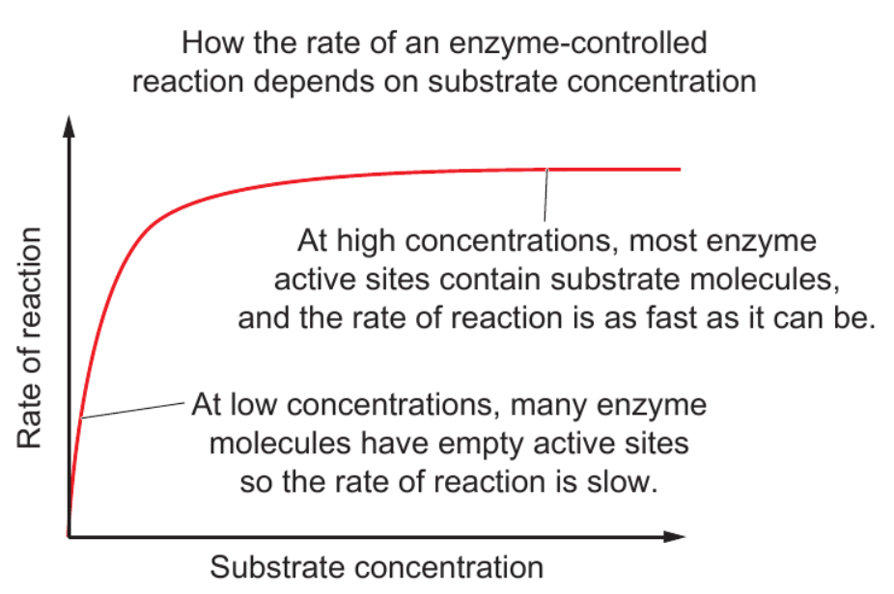

Slide 60
Practice Exam Question
i) Use the table below to draw a graph and a curve of best fit. (2 marks)
ii) Determine the optimum pH for this enzyme. (1 mark)
iii) Describe and explain the effect on enzyme activity of increasing the pH above this optimum level. (3 marks)
pH | 3.6 | 3.8 | 4.0 | 4.4 | 4.8 | 5.0 | 5.2
Rate (cm³s⁻1) | 2.0 | 5.0 | 8.0 | 11.0 | 8.0 | 4.0 | 1.0

Slide 61
Diffusion
Movement from a high concentration to a low concentration until an equilibrium is found.

Slide 62
Osmosis
Water molecule
OSMOSIS
Semi-permeable membrane

Slide 63
Water moves from a concentrated area of solute (less water particles) to a dilute area of solute (more water particles).
Q. Which way will the water flow in the diagram? Explain why.

Slide 64
Active Transport
Both diffusion and osmosis go down the concentration gradient.
Active transport is used to move substances against the concentration gradient.
This requires energy though!

Slide 65
Active Transport
Inside of cell Outside of cell
ENERGY
Transporter Protein
Cell Membrane

Slide 66
Active Transport
WHEN might active transport be used?
To move substances against the concentration gradient.
To move substances that are too large to fit through the semi-permeable membrane.

Slide 67
 | Diffusion | Osmosis | Active Transport
Down / Against concentration gradient?
Requires energy?
Requires a membrane?
Substances move down the concentration gradient.
Water moves down the concentration gradient.
Substances move against the concentration gradient.
NO
NO
YES
Occurs over a partially permeable membrane.
Occurs over a membrane using transport proteins.
No membrane required.
Extending: Compare and contrast the processes of diffusion, osmosis and active transport (6 marks)

