Slide 1
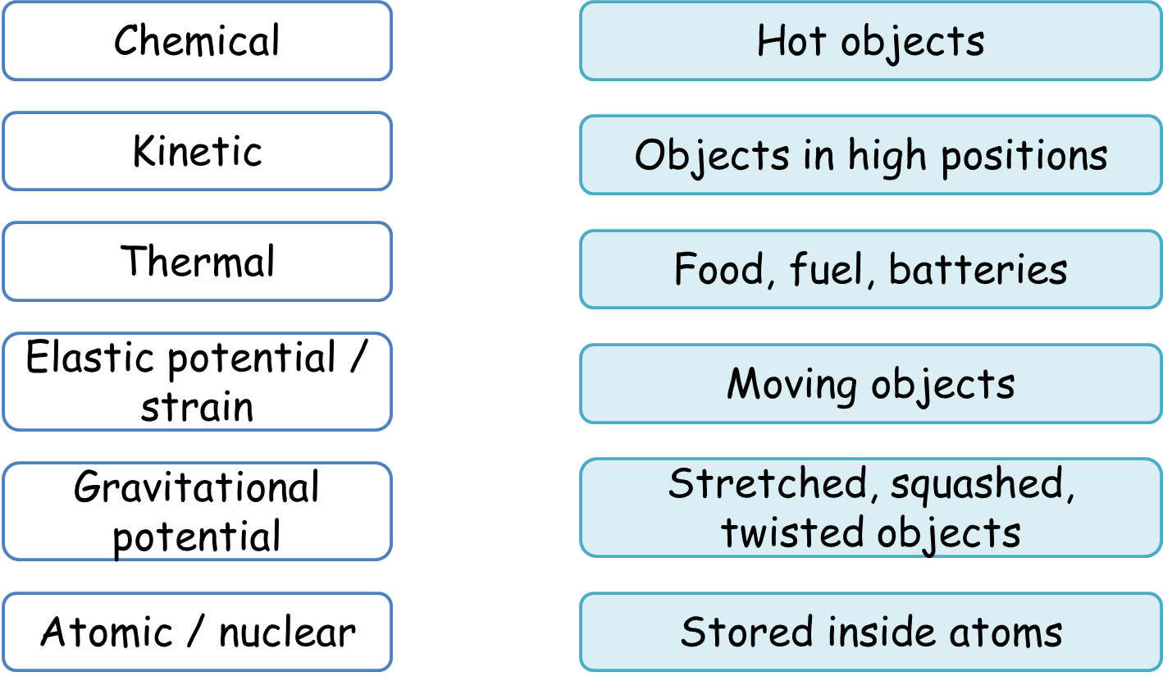
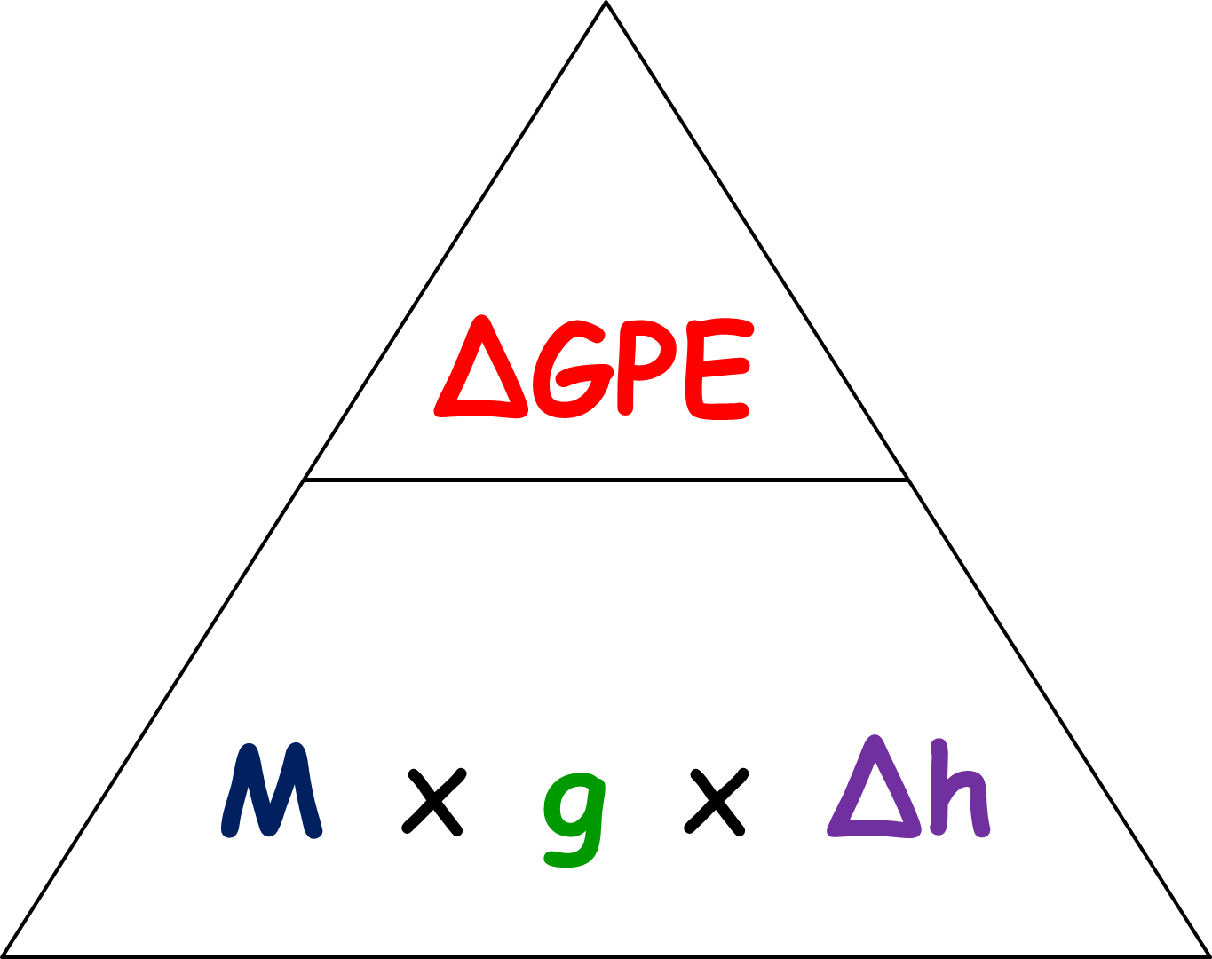
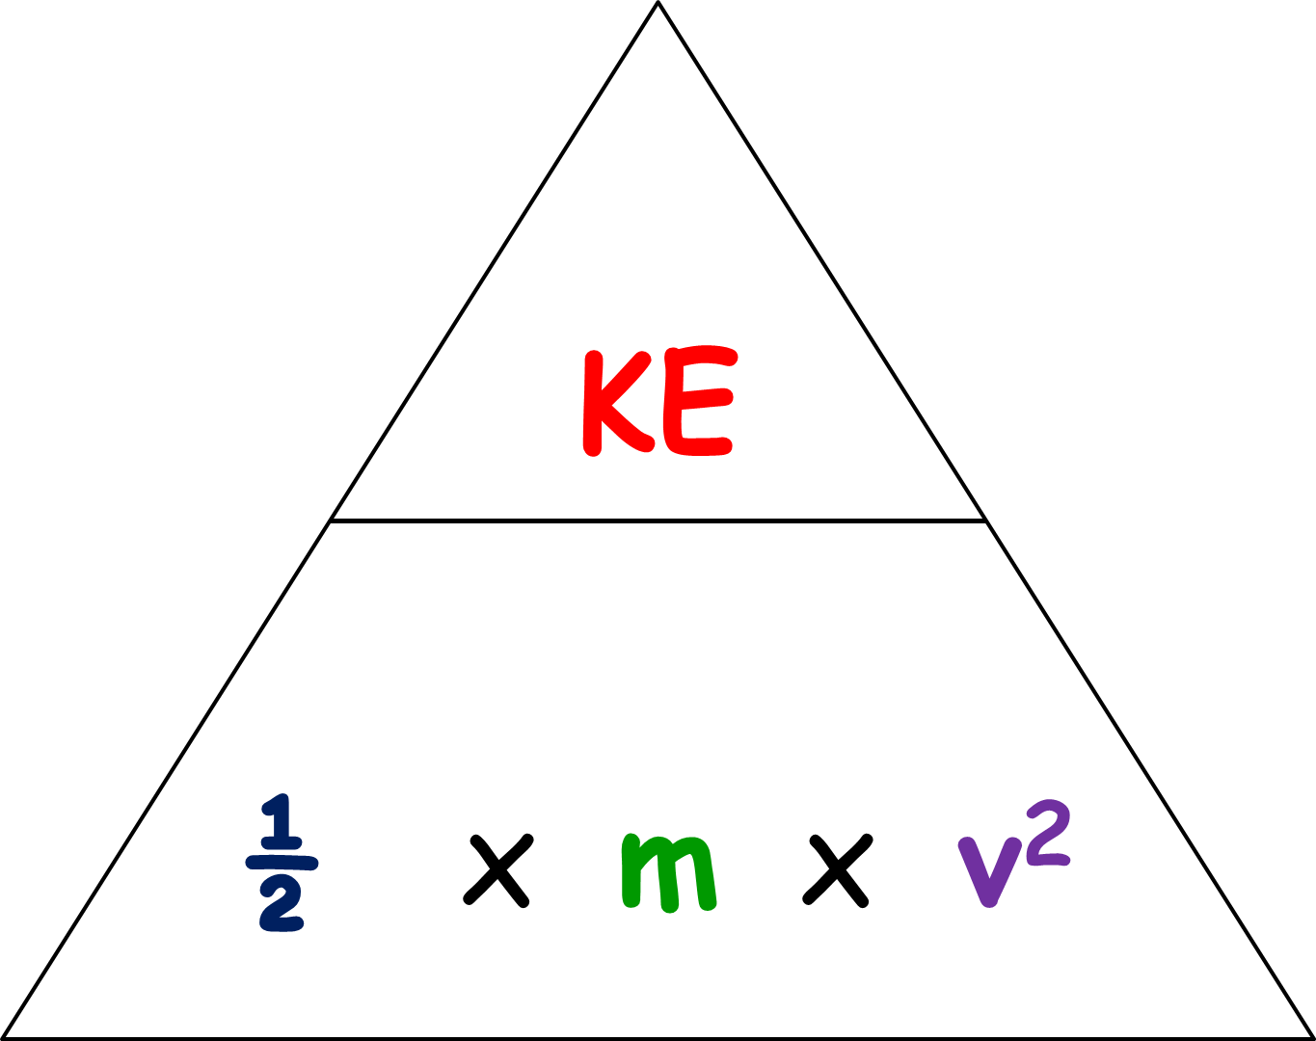
CP3 Revision Worksheet
80J is supplied to a device by electricity. 25J is transferred by sound (the useful energy) and the rest lost to the surroundings by heating.
Draw a Sankey diagram to represent this:
Draw a diagram to explain what convection is?
Match up the energy stores to the examples:
How is radiation different to conduction and convection?
………………………………………………………………
What affects the rate of heat loss through radiation?
………………………………………………………………………………………………………………………………
How is energy transferred to a kettle? ……………………………………………………………………………………………
What energy is stored in the kettle?
……………………………………………………………………………………………
What energy is transferred to the surroundings?
……………………………………………………………………………………………
Using the equation, work out the efficiency for the device in the question above:
efficiency =
In what ways do we ensure houses don’t lose too much heat energy?
………………………………………………………………………………………………………………………………………………………………………………………………………………………………………………………………
Explain what the law of conservation of energy is:
………………………………………………………………………………………………………………………………………………………………………………………………………………………………………………………………………………………
For each of the following systems write the energy input, useful output and wasted output:
TV: Input
Useful Output
Wasted Output
Bulb: Input
Useful Output
Wasted Output
Calculate the GPE of 2kg box which is raised 5m on Earth.
How might we increase efficiency of a device? (HIGHER)
……………………………………………………………………………………………………………………………………………………………………………………………………
Calculate the KE of a 0.4kg ball kicked at a speed of 24m/s.
Describe how conduction takes place in solids:
……………………………………………………………………………………………………………………………………………………………………………………………………
What is thermal conductivity?
……………………………………………………………………………………………………………………………………………………………………………………………………
What does energy efficiency mean?
………………………………………………………………………………………………………………………………………………………………………………………………………………………………………………………………………………………

Slide 2
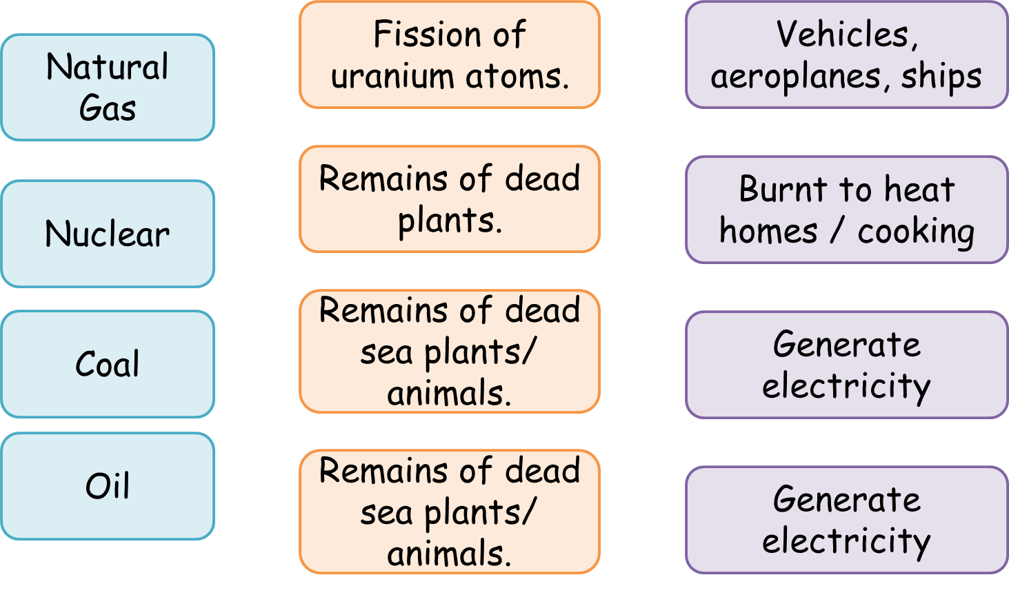
CP3 Revision Worksheet
Rate each of the learning outcomes for how you feel about them:
Define the following words:
Non-renewable
Renewable
Fossil Fuel
CP3.4/ CP3.6 Explain, using examples, that energy is conserved.
CP3.5 Give examples of energy being moved between different stores.
CP3.3 Interpret diagrams that represent energy transfers.
CP3.3 Represent energy transfers using diagrams.
CP3.8 Describe what happens to wasted
energy in energy transfers.
CP3.7 Explain some ways in which energy is transferred wastefully by mechanical processes.
CP3.9 Explain some ways of reducing unwanted energy transfers in mechanical processes.
CP3.11 Define what efficiency means.
CP3.11/CP3.12 Recall and use the equation for calculating energy efficiency.
CP3.12 Explain how efficiency can be increased.(HIGHER)
CP3.9 Describe the ways in which energy can be transferred by heating.
CP3.9 Describe ways of reducing unwanted energy transfers using thermal insulation.
CP3.9 Explain how different ways of reducing energy
transfer by heating work.
CP3.10 Define the meaning of thermal conductivity.
CP3.10 Describe the effects of the thickness and thermal conductivity of the walls of a building on its rate of cooling.
CP3.1 Describe how different factors affect the gravitational potential energy stored in an object.
CP3.1 Recall and use the equation for gravitational potential energy.
CP3.2 Describe how different factors affect the kinetic energy stored in an object.
CP3.2 Recall and use the equation for kinetic energy.
CP3.13 List the non-renewable energy resources in use today.
CP3.13 Describe the advantages and disadvantages of non-renewable energy resources.
CP3.13 Compare the advantages and disadvantages of non-renewable energy resources.
CP3.14 Explain how the use of non-renewable energy resources is changing.
CP3.13 List the renewable energy resources in use today.
CP3.13 Describe the source of energy for different renewable resources.
CP3.13 Describe the ways in which the different energy resources are used.
CP3.13 Explain why we cannot use only renewable resources.
CP3.14 Explain how the uses of renewable energy resources is changing.
Match up the following:
How has the UK’s energy usage changed?
Complete the table about the different energy sources:
 | Advantages | Disadvantages
Fossil Fuels
Nuclear
Solar Power
Wind Power
Hydroelectric

Slide 3
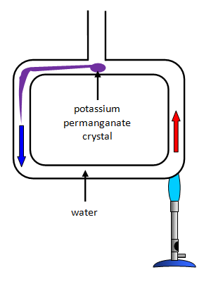
CP3 Revision Worksheet
80J is supplied to a device by electricity. 25J is transferred by sound (the useful energy) and the rest lost to the surroundings by heating.
Draw a Sankey diagram to represent this:
Draw a diagram to explain what convection is?
Match up the energy stores to the examples:
25J useful sound energy
55J wasted energy
How is radiation different to conduction and convection?
Radiation travel in waves and so can travel in a vacuum
What affects the rate of heat loss through radiation?
Surface Area
80J of electrical input energy
How is energy transferred to a kettle?
Electrical Thermal, sound and light What energy is stored in the kettle?
Thermal
What energy is transferred to the surroundings?
Thermal
Using the equation, work out the efficiency for the device in the question above:
25/80 = 0.31
0.31 x 100 = 31%
efficiency = 0.31/ 31%
In what ways do we ensure houses don’t lose too much heat energy?
Insulation
Double glazing
Carpets
Explain what the law of conservation of energy is:
Energy cannot be created or destroyed it can only change from one form to another.
For each of the following systems write the energy input, useful output and wasted output:
TV: Input- Electrical
Useful Output- Light and sound
Wasted Output- Thermal
Bulb: Input- Electrical
Useful Output- Light
Wasted Output- Thermal
Calculate the GPE of 2kg box which is raised 5m on Earth.
2 x 5 x 10=
GPE = 100J
How might we increase efficiency of a device? (HIGHER)
Reduce the thermal energy, reduce friction add lubrication
Calculate the KE of a 0.4kg ball kicked at a speed of 24m/s.
0.5 x 0.4 x 24²
KE = 115.2J
Describe how conduction takes place in solids:
The particles vibrate and pass on the thermal energy through the collisions
What is thermal conductivity?
How easily thermal energy can pass through a material
What does energy efficiency mean?
How well a device converts it energy to useful ways.

Slide 4
CP3 Revision Worksheet
Rate each of the learning outcomes for how you feel about them:
Define the following words:
Non-renewable | Resources that once burnt can’t be used again and will eventually run out as they take millions of years to regenerate
Renewable | Resources that produce less CO² and will not run out.
Fossil Fuel | Coal, Oil and Natural gas. Fuels burnt to generate electricity.
CP3.4/ CP3.6 Explain, using examples, that energy is conserved.
CP3.5 Give examples of energy being moved between different stores.
CP3.3 Interpret diagrams that represent energy transfers.
CP3.3 Represent energy transfers using diagrams.
CP3.8 Describe what happens to wasted
energy in energy transfers.
CP3.7 Explain some ways in which energy is transferred wastefully by mechanical processes.
CP3.9 Explain some ways of reducing unwanted energy transfers in mechanical processes.
CP3.11 Define what efficiency means.
CP3.11/CP3.12 Recall and use the equation for calculating energy efficiency.
CP3.12 Explain how efficiency can be increased.(HIGHER)
CP3.9 Describe the ways in which energy can be transferred by heating.
CP3.9 Describe ways of reducing unwanted energy transfers using thermal insulation.
CP3.9 Explain how different ways of reducing energy
transfer by heating work.
CP3.10 Define the meaning of thermal conductivity.
CP3.10 Describe the effects of the thickness and thermal conductivity of the walls of a building on its rate of cooling.
CP3.1 Describe how different factors affect the gravitational potential energy stored in an object.
CP3.1 Recall and use the equation for gravitational potential energy.
CP3.2 Describe how different factors affect the kinetic energy stored in an object.
CP3.2 Recall and use the equation for kinetic energy.
CP3.13 List the non-renewable energy resources in use today.
CP3.13 Describe the advantages and disadvantages of non-renewable energy resources.
CP3.13 Compare the advantages and disadvantages of non-renewable energy resources.
CP3.14 Explain how the use of non-renewable energy resources is changing.
CP3.13 List the renewable energy resources in use today.
CP3.13 Describe the source of energy for different renewable resources.
CP3.13 Describe the ways in which the different energy resources are used.
CP3.13 Explain why we cannot use only renewable resources.
CP3.14 Explain how the uses of renewable energy resources is changing.
Match up the following:
How has the UK’s energy usage changed?
Over the years the amount of renewable resources used has increased.
Complete the table about the different energy sources:
 | Advantages | Disadvantages
Fossil Fuels | Readily Available | Running out Produce CO2
Nuclear | No CO2 produced Won’t run out | Waste removal is difficult. Hard to control and remain safe.
Solar Power | No CO2 produced Won’t run out | Availability Cost
Wind Power | No CO2 produced Won’t run out | Availability Cost
Hydroelectric | Available all the time | Habitats damaged Space Constraints

