Slide 1
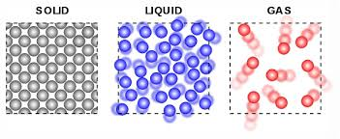
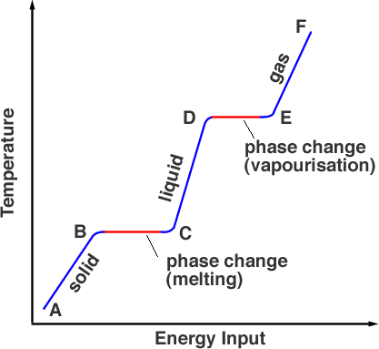
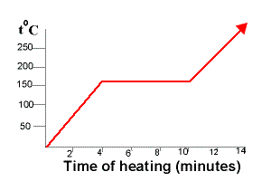
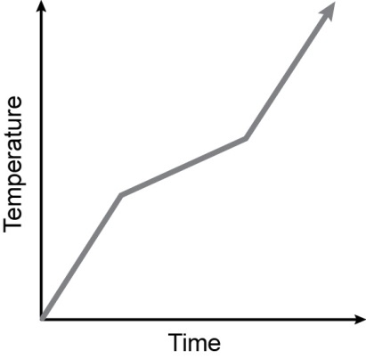
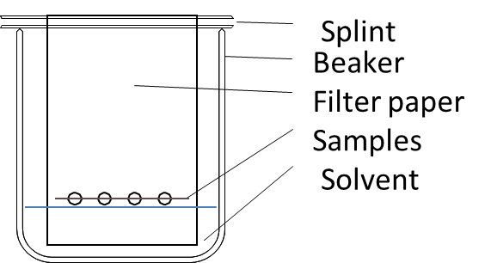
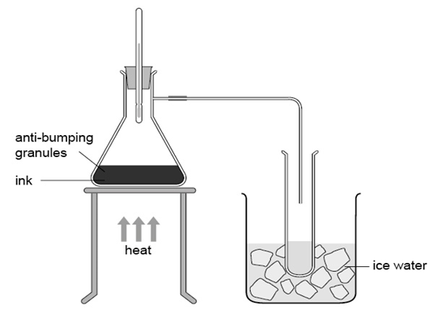
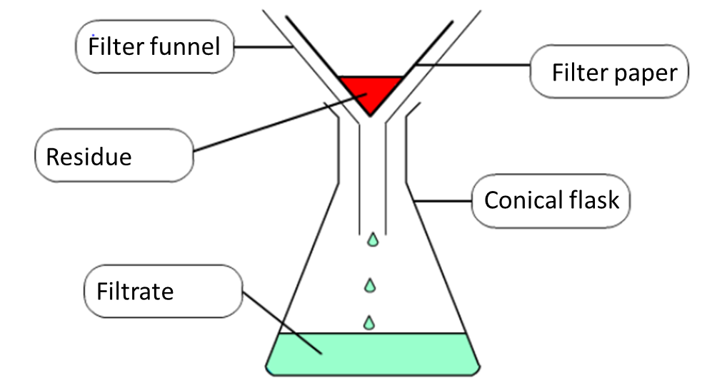
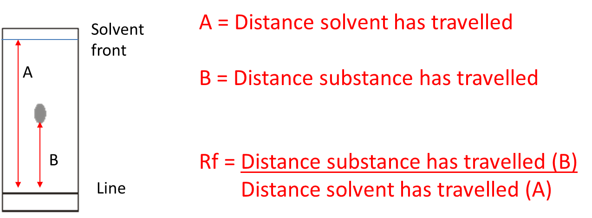
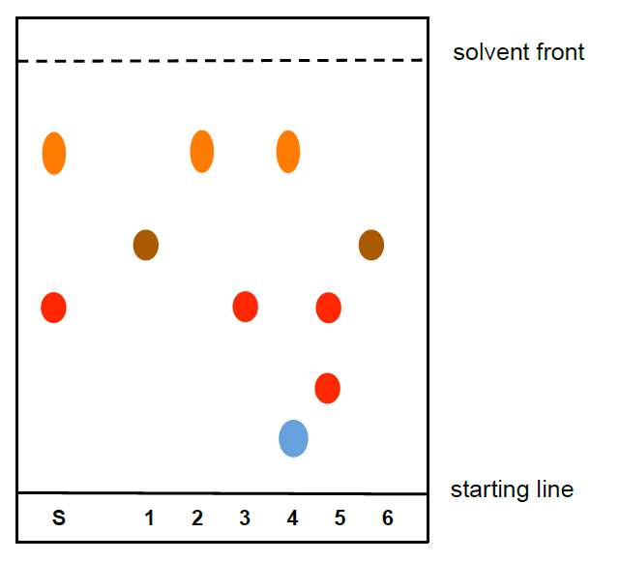
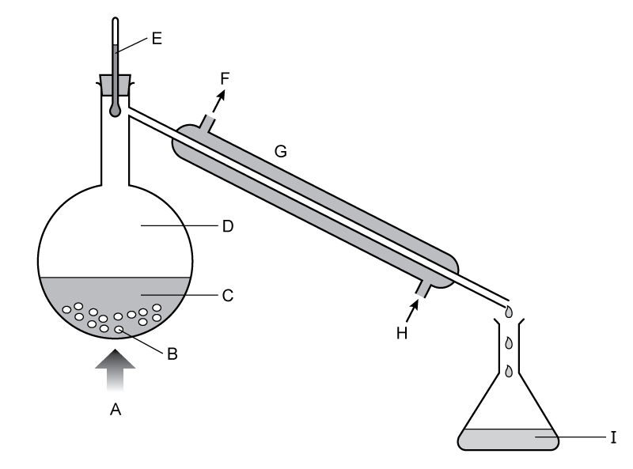
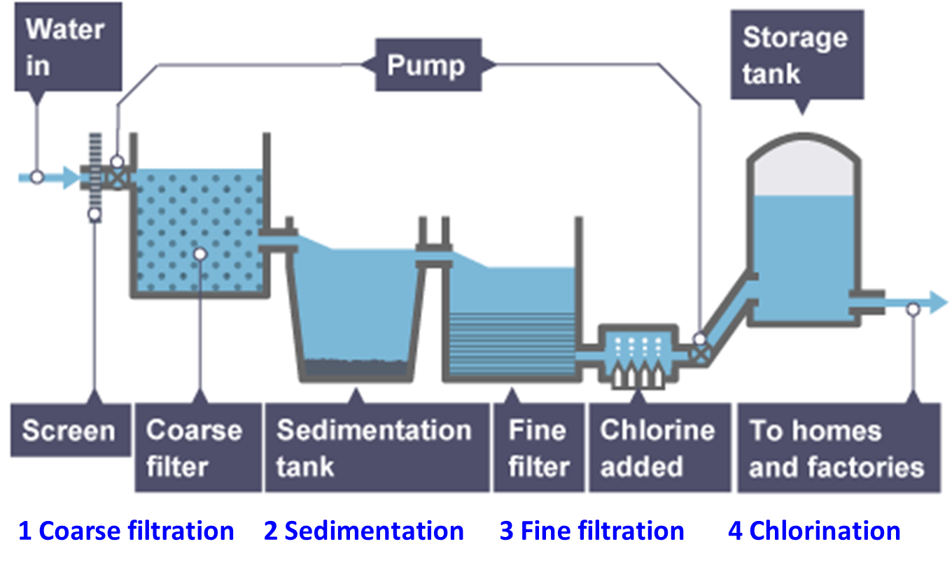
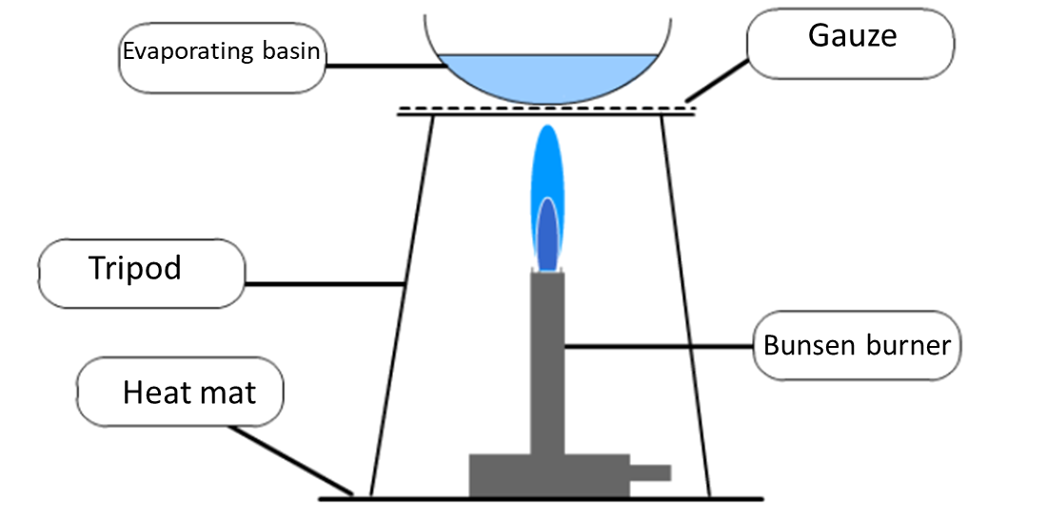
CC1,2: States of matter, separating and purifying knowledge organiser (H)
Lesson 1 States of matter
State Changes
Lesson 2 Heating / Cooling curves
Lesson 3 Mixtures
Mixtures contain substances which are not chemically combined and they can be separated
Pure materials contain only one substance
Impure materials contain a mixture of substances
Pure substances have a sharp melting point
Impure substances have a range of melting points Pure Impure
Condensation
Evaporation
/ boiling
Evaporation
Arrangement of particles
Ordered Random Random
Neat rows Some touch Apart
Movement of particles
Vibrating Rolling over Flying around
about fixed position each other with high energy
Increasing Energy
Freezing
Melting
Time
A heating or cooling curve shows how the temperature changes with time
State changes are shown as horizontal lines
During this time the energy is used to change state and not temperature
Sublimation is going from a solid straight to a gas
Lesson 6 Distillation
Lesson 5 Chromatography
Lesson 4 Filtration and crystallisation
Distillation is used to separate a solvent from a solution or from a mixture of solvent (fractional distillation)
Chromatography is used to separate a mixture of substances. E.g. a mixture of different dyes in an ink.
The mixture separates because some dyes like the solvent more and some like the paper more.
Filtration can be use to separate an insoluble solid from a liquid or from a solution
Simple distillation – can be used to separate water from a water based ink
Calculating Rf values
You can compare how far inks have travelled (Rf values) to analyse the dyes in an unknown mixture
Filtration works because the large particles of the residue can not pass through the small gaps in the filter paper
Distillation with a condenser is better as the condenser cools the gases produced
Lesson 7 Purifying water
Water is used for many things around the home and comes from a variety of sources
Water is purified to remove impurities (silt and mud, chemicals, dissolved salts)
Crystallisation can be used to separate a soluble solid from a solution of that solid
State changes involved in distillation - boiling/evaporation and condensation
Course filtration – filtered to remove twigs etc.
Sedimentation – a chemical is added which makes particles sink to bottom
Fine filtration – filtered through sand
Chlorination – to kill bacteria
Distilled water is pure water and contains no dissolved salts. It is used for laboratory tests.
Sea water contains dissolved sodium chloride
Mineral water contains many dissolved salts
We do not use distillation to make drinking water as it uses a lot of energy and would be expensive
Risk Assessment
Hazard – what is dangerous e.g. Bunsen Burner
Risk – the hard it could do e.g. Hair could catch fire
Control measure – How you make it safe e.g. tie your hair back
In crystallisation of a solution the solvent is evaporated from a solution to leave the solute

Slide 2
CC1,2: States of matter, separating and purifying knowledge organiser (S)
Lesson 1 States of matter
State Changes
Lesson 2 Heating / Cooling curves
Lesson 3 Mixtures
Mixtures contain substances which are not chemically combined and they can be separated
Pure substances have a sharp melting point
Impure substances have a range of melting points
Pure Impure
Condensation
Evaporation
/ boiling
Evaporation
Arrangement of particles
Ordered Random Random
Neat rows Some touch Apart
Movement of particles
Vibrating Rolling over Flying around
In fixed position each other with high energy
Increasing Energy
Freezing
Melting
Time
A heating or cooling curve shows how the temperature changes with time
State changes are shown as horizontal lines
Sublimation is going from a solid straight to a gas
Lesson 6 Distillation
Lesson 5 Chromatography
Lesson 4 Filtration and crystallisation
Distillation is used to separate a solvent from a solution or from a mixture of solvents (fractional distillation)
Chromatography is used to separate a mixture of substances. E.g. a mixture of different dyes in an ink.
Filtration can be use to separate an insoluble solid from a liquid or from a solution
Simple distillation
Calculating Rf values
Each dot represents a dye
The same dye will travel the same distance up the paper
Distillation with a condenser is better
Lesson 7 Purifying water
Crystallisation can be used to separate a soluble solid from a solution of that solid
Water is used for many things around the home
Water is purified by:-
Course filtration – filtered to remove twigs etc.
Sedimentation – a chemical is added which makes particles sink to bottom
Fine filtration – filtered through sand
Chlorination – to kill bacteria
State changes involved in distillation - boiling/evaporation and condensation
Risk Assessment
Hazard – what is dangerous e.g. Bunsen Burner
Risk – the harm it could do e.g. Hair could catch fire
Control measure – How you make it safe e.g. tie your hair back
Distilled water is pure water and contains no dissolved salts.
Sea water contains dissolved sodium chloride
Mineral water contains many dissolved salts
In crystallisation of a solution the solvent is evaporated from a solution to leave the solute

Slide 3
CC1,2: States of matter, separating and purifying knowledge organiser (C)
Lesson 1 States of matter
State Changes
Lesson 2 Heating / Cooling curves
Lesson 3 Mixtures
Mixtures contain substances which are not chemically combined and they can be separated
Mixtures melt over a range of temperatures
Condensation
Evaporation
/ boiling
Evaporation
Increasing Energy
Arrangement of particles
Ordered Random Random
Neat rows Some touch Apart
Freezing
Melting
Time
A heating or cooling curve looks like this
Lesson 6 Distillation
Lesson 5 Chromatography
Lesson 4 Filtration and crystallisation
Distillation is used to separate a solvent from a solution
Chromatography is used to separate a mixture of substances. E.g. a mixture of different dyes in an ink.
Filtration can be use to separate solid from a liquid
Condenser
Each dot represents a dye
The same dye will travel the same distance up the paper
Lesson 7 Purifying water
Heat
In crystallisation the solvent is evaporated off
State changes involved in distillation - boiling/evaporation and condensation
Risk Assessment
Hazard – what is dangerous e.g. Bunsen Burner
Risk – the harm it could do e.g. Hair could catch fire
Control measure – How you make it safe e.g. tie your hair back
filtration – filtered to remove solid
Sedimentation – solid sinks to bottom
Chlorination – to kill bacteria

