Slide 1
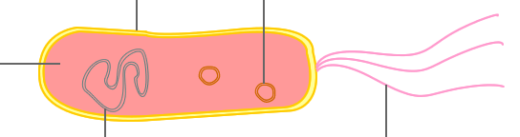
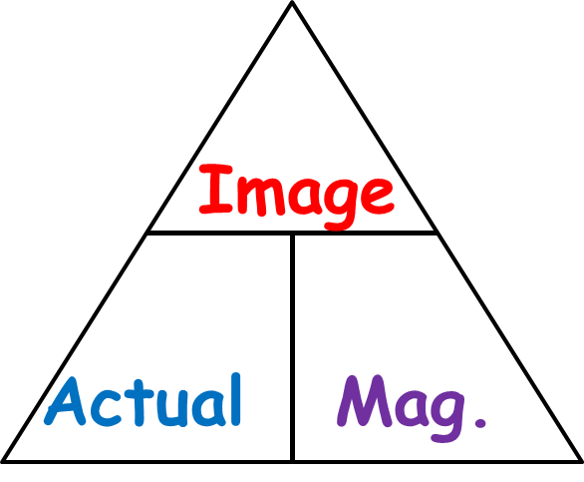
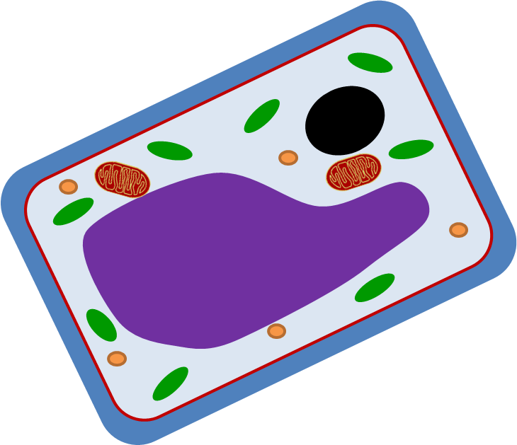
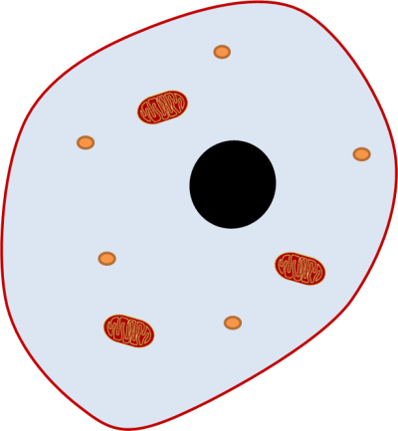
Revision Worksheet
Match up the following organelles to their functions:
Nucleus
Cytoplasm
Cell Membrane
Ribosome
Mitochondria
Vacuole
Chloroplast
Cell Wall
Label the bacteria cell:
State the function of the following components:
Chromosomal DNA- …………………………………………………………
………………………………………………………………………………………………
Plasmid DNA- ……………………………………………………………………
………………………………………………………………………………………………
Flagella- ………………………………………………………………………………
………………………………………………………………………………………………
Define the following words:
Controls what happens in the cell and carries genetic information.
Controls what gets in and out of the cell.
Jelly like substance where chemical reactions happen.
Where respiration occurs to make energy.
Where new proteins are made.
Where the cell makes food through photosynthesis.
Where cell sap is stored
Gives the cell structure and support.
Magnification
Resolution
Using the formula triangle- the size of an organism is 0.003mm and the size of the image is 4.2mm. What magnification was used?
Tick or cross which features are found in which types of cell:
Complete the following:
Total magnification= …………………… x …………………
Feature | Animal Cell | Plant Cell | Bacterial Cell
Cell Membrane
Nucleus
Plasmids
Chloroplasts
Cell Wall
Cytoplasm
Eyepiece Magnification | Objective Magnification | Overall Magnification
X10 | X4
x15 | x400
Draw a specialised cell found in the reproductive or digestive system.
Function:
Adaptations:
Describe three differences between a light microscope and an electron microscope:
……………………………………………………………………………………………………………………………………………………………………………………………………………………………………………………………………………………………………………………………………………………………………………………………………………………………
Define the following words:
Eukaryotic
Prokaryotic
Label all the organelles in the animal and plant cells below:

