Slide 1
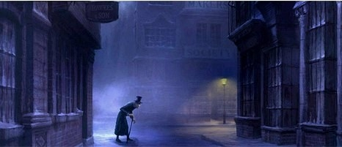
A Christmas Carol Knowledge Recall

Slide 2
Stave One Tasks
Describe Scrooge’s character in this stave using relevant evidence.
Explain how Fred is used as a foil* for Scrooge.
How does Scrooge treat his employee in this stave?
How does Scrooge treat the gentlemen and what does this show about Victorian society?
What is the most shocking thing Scrooge says in this stave and why?
What is the significance of Jacob Marley’s appearance?
What does Dickens’ description of Scrooge’s routine show about his character?
* In literature, a character who is presented as a contrast to a second character so as to point to or show to advantage some aspect of the second character.

Slide 3
Stave Two Tasks
Describe the ghost’s appearance in this stave. What is its significance?
Comment on Scrooge’s reaction to the ghost.
How does Scrooge’s vision of his former school affect him?
What is young Scrooge’s relationship with Fan like? What does this show?
How does the vision of Fezziwig’s Christmas party affect Scrooge?
How does Dickens use Belle’s character in this stave?
How do we see Scrooge’s character start to change in this stave?

Slide 4
Stave Three Tasks
Describe the ghost’s appearance in this stave. What is its significance?
Comment on Scrooge’s reaction to the ghost.
How does Dickens use the setting in this stave?
How do we see Scrooge’s character continue to change in this stave?
How is the Cratchits’ family Christmas presented? What effect does this have?
What other visions of Christmas is Scrooge shown and why?
What is the impact of Ignorance and Want? What do they symbolise?

Slide 5
Stave Four Tasks
Describe the ghost’s appearance in this stave. What is its significance?
What is different about this ghost?
Comment on Scrooge’s reaction to the ghost.
What does the scene in the pawn shop show?
How is Scrooge affected by the death of Tiny Tim?
What does Scrooge learn at the graveyard?
How is the theme of death used in this stave?

Slide 6
Stave Five Tasks
How has Scrooge’s character changed?
What does Scrooge do to show the change in his character?
How does the tone of the final stave contrast with the first?
What does Dickens want the reader to learn? What is the moral of the story?
How does Scrooge spend his Christmas day?
How does Scrooge trick Bob?
What is Scrooge’s lasting reputation?

