Slide 1
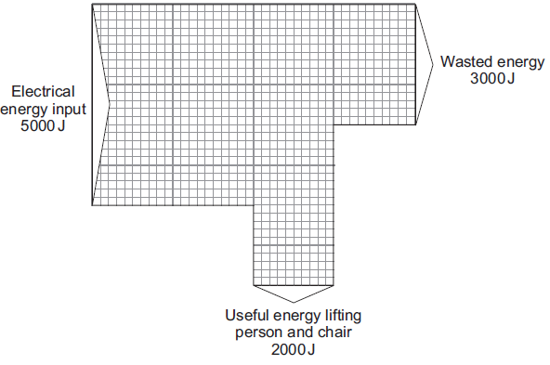
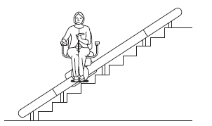
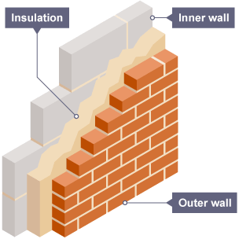
Energy Transfers
10 Minutes on ...
State what happens to the wasted energy from the system.
Describe how to reduce unwanted energy transfers .
Exam question (use Bullet points):
Another student repeated the investigation but doubled the thickness for all three insulating materials. Suggest how using thicker insulation would affect the results of the second student's investigation compared with the first student's results.(2 Marks) ..……………………………………………………………………………………………..
……………………………………………………………………………………………….
……………………………………………………………………………………………….
……………………………………………………………………………………………….
……………………………………………………………………………………………….
……………………………………………………………………………………………….

