Slide 1
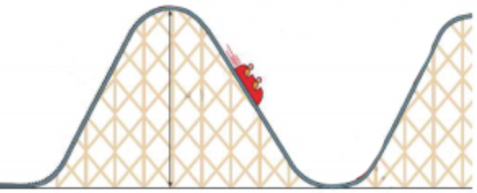
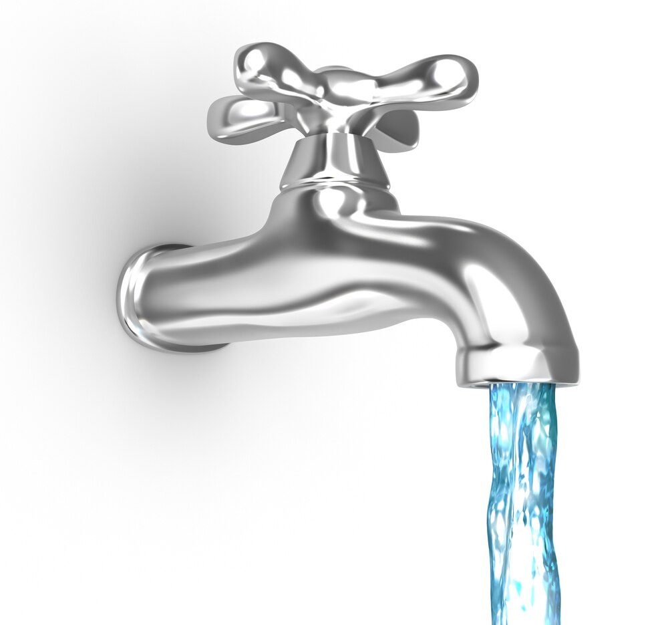
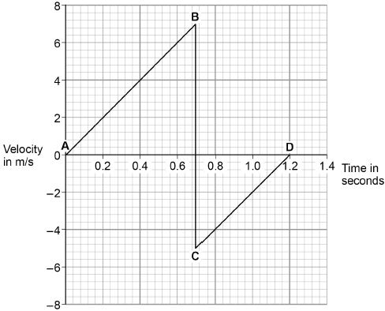
Energy Stores and Changes
10 Minutes on ...
Label the energy stores on the rollercoaster.
Describe the changes in energy as water comes out the end of a tap..
Exam question (use Bullet points):
When the ball hits the ground, energy is transferred from the ball to the Earth.
Explain how the data in the graph above shows this energy transfer. (2 Marks) ..……………………………………………………………………………………………..
……………………………………………………………………………………………….
……………………………………………………………………………………………….
……………………………………………………………………………………………….
……………………………………………………………………………………………….
……………………………………………………………………………………………….
……………………………………………………………………………………………….
……………………………………………………………………………………………….
……………………………………………………………………………………………….

