Slide 1
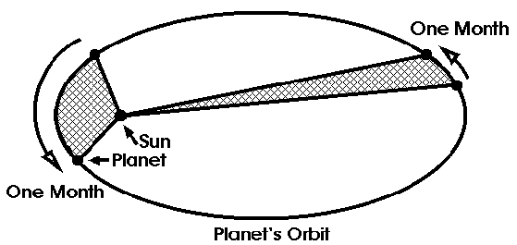
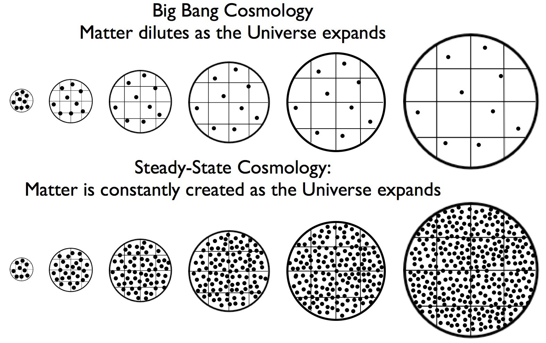
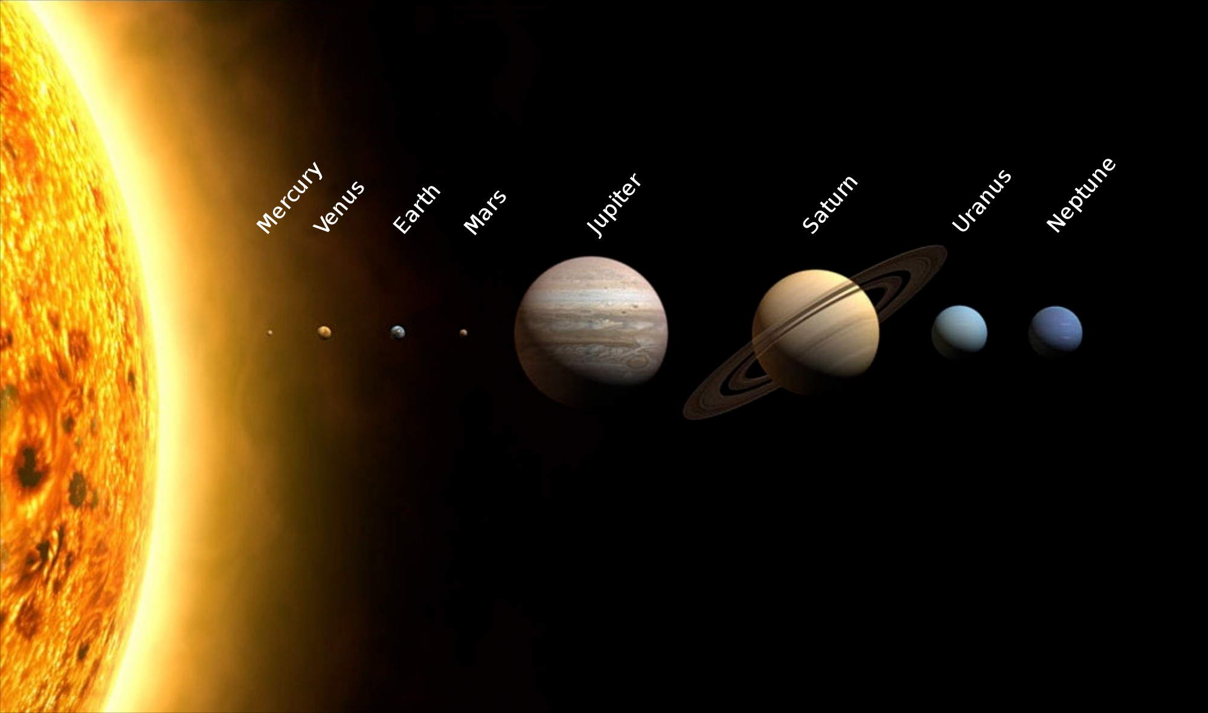
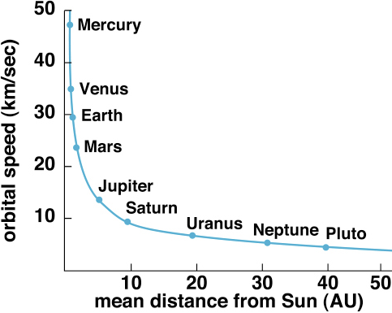
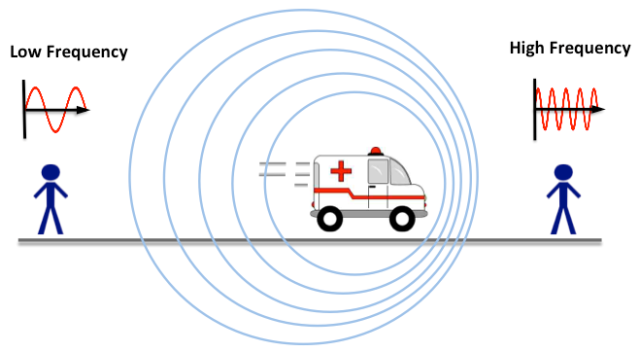
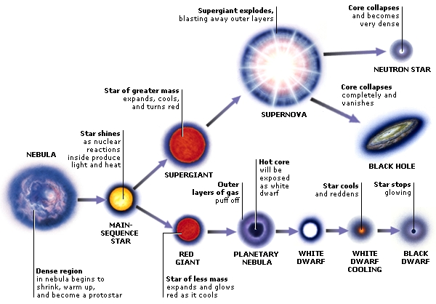
Topic 7: Astronomy (Triple Only)
Orbiting objects have a constantly changing velocity, even though their speed is often unchanged. Remember that velocity is a vector, so a change of direction (curving) means a constantly changing velocity, even though the magnitude (the number part) may not change. This also means that orbiting objects are always accelerating.
The planets are (in order) Mercury, Venus, Earth, Mars, Jupiter, Saturn, Neptune, Uranus. Pluto is now classed as a dwarf planet. My Very Easy Method Just Speeds Up Naming Planets.
There are 2 theories of the universe. The Steady state theory says the universe has always existed, is expanding, and that more matter is created all the time. The big bang theory says the universe began around 14 billion years ago, is expanding, and that all the matter was created at the start.
Orbits are rarely perfect circles, they are usually elliptical (stretched out on one side). Most moons and planets have orbits that are nearly circular. Many smaller objects (e.g. comets) have very elliptical orbits.
Both theories predict red shift (see below) due to the universe expanding. However, Cosmic Microwave Background (CMB) Radiation supports the big bang theory as it is an echo of the bang. The big bang theory is accepted because it is the only theory that can explain the CMB
The diagram above shows the sun and the planets. The sizes are shown to scale, but the space between them is not.
Our solar system is the sun and everything that orbits the sun. As well as planets there are natural satellites (moons), asteroids and comets.
Red shift is a lot like the Doppler effect, which we hear when a vehicle goes past us. The pitch of the sound changes because the wavelength has been squashed or stretched. When light is stretched its wavelength is stretched.
The closer a planet is to the sun the faster it will be orbiting. Imagine a horn-shaped well with a coin rolling in it (see below). The closer the coin is to the centre the faster it will travel. In the ‘wishing well’ below the coin eventually falls in because friction slows it down. In space there is no friction to slow objects and they keep orbiting.
Red light has a longer wavelength than blue. Objects moving away from us very fast have the colour of their light changed as the wavelength is stretched. Objects moving rapidly towards us experience blue-shift.
More distant objects are more red-shifted than nearer objects. This means more distant objects are travelling away faster. Imagine a series of dots on a balloon. As the balloon inflates the dots get further away from each other. The most distant dots at the start move away fastest. This tells us the universe is expanding
Until around the year 1500 people thought that the Earth was the centre of the solar system because they thought if the Earth was moving it would leave the moon behind. This was called the Geocentric model. Galileo disproved the geocentric model and we now know that the sun is the centre of the solar system, which is called the heliocentric model.
CMB radiation is gamma waves that have been red-shifted (stretched) so much they have become microwaves.
Large stars ‘burn’ (fuse) their fuel faster and have shorter lives.
Notes:
Things to add: how our telescopes have improved so we know more; spectral absorption lines confirm red-shift

