Slide 1
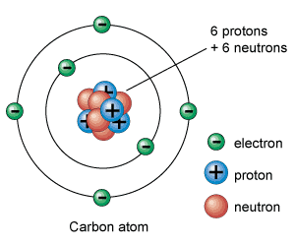
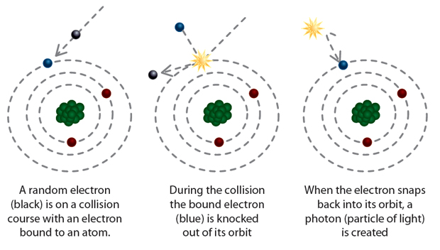
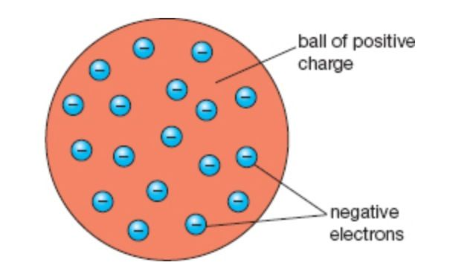
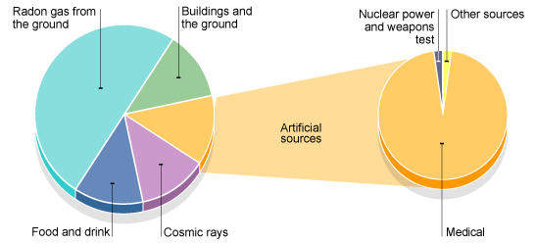
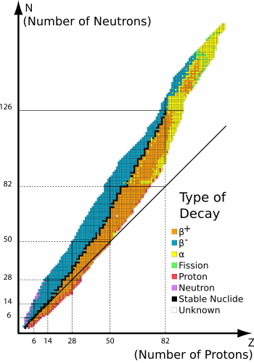
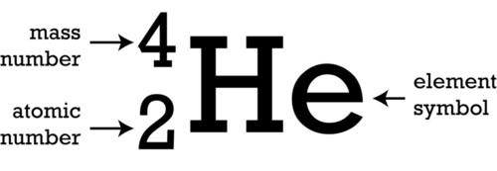
Topic 6: Radioactivity
6 protons
& 6 neutrons
Atoms are very small. A hydrogen atom has a diameter of approximately 1x10⁻¹⁰m
 | mass | charge | Made from
proton | 1 | +1 | Quarks: Up, Up, Down
neutron | 1 | 0 | Quarks: Up, Down, Down
electron | 1/2000 | -1
positron | 1/2000 | +1 | Antimatter Anti electron
Our ideas about the structure of the atom have changed over time
One of the first models was called the plum pudding model by a man called Thompson (below)
The Rutherford alpha scattering experiment (see other side) proved the plum pudding model was wrong. We now use a better model created by Niels Bohr (to the left).
An ion is an electrically charged atom – it has lost or gained electrons. Atoms are usually neutral – they have equal numbers of protons & electrons
Isotopes have the same number of protons but a different number of neutrons. It has a different mass, but reacts the same way chemically. It usually has an unstable nucleus.
Atoms can be made into ions – in other words they can be ionised - if electrons are added or removed
Ionising radiation has enough energy to knock electrons out of their shells
Background radiation is everywhere.
It varies from place to place.
It comes from many sources, but mostly Radon gas
Radon emits Alpha particles
Different isotopes emit different types of radiation. Large isotopes emit alpha, isotopes with too many neutrons emit B- and isotopes with too many protons emit B+.
We can graph all known isotopes and see this pattern (see right)
The atomic number = the number of protons
The mass number = protons + neutrons
People can protect themselves from radiation in 2 ways
1: Using shielding to block the radiation
2: Limiting how much time we spend exposed to it
People can use radiation detectors to make sure they are safe. We can use a Geiger counter, or photographic film to detect radiation
 | What is it | How ionising is it | How can it be blocked | Uses
Alpha | 2 protons + 2 neutrons: Helium nucleus | Very. It has +2 charge | 10cm of air. Paper. Skin | Smoke detectors
Beta - | An electron | Medium | Aluminium | Thickness of materials
Beta + | A positron (an anti-electron) | Medium. It annihilates with an electron which produces gamma | Aluminium | PET scanners – annihilates to produce gamma
Gamma | Electromagnetic wave | Usually low. Depends on frequency and intensity | Lots of lead, concrete, etc. | Sterilisation, Tracers, Radiotherapy (treating cancer)
X-Rays | Electromagnetic wave | Lower than gamma | Lead, concrete | Medical imaging
Neutron |  | Not directly ionising, but can make a stable nucleus become unstable |  | In nuclear reactors

Slide 2
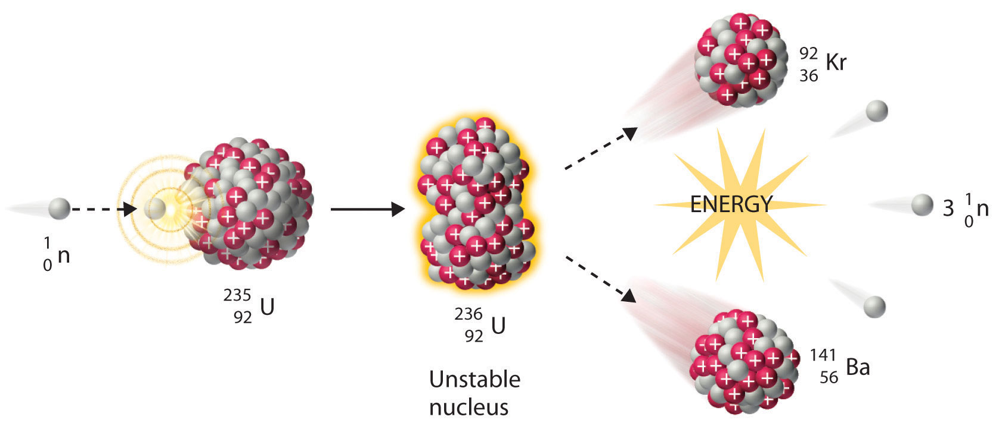
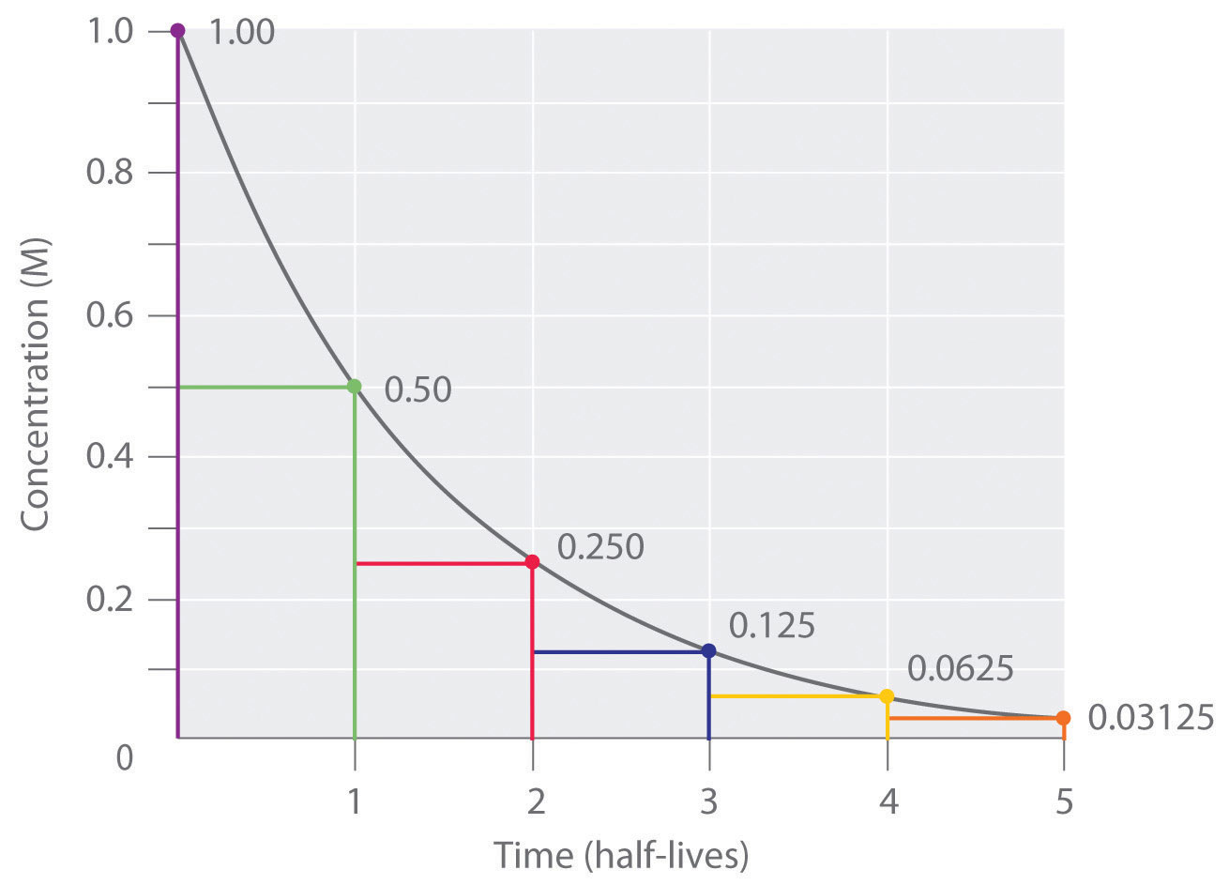
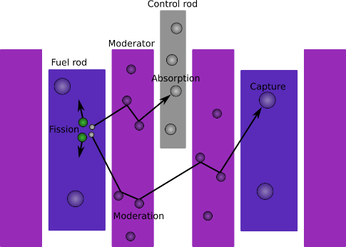
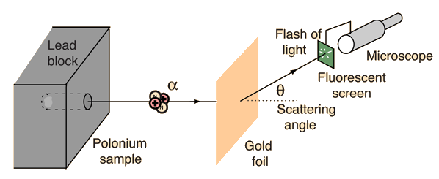
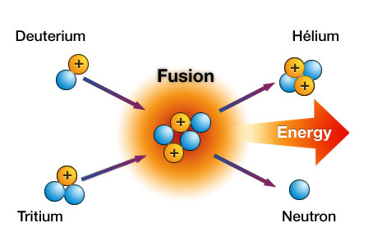
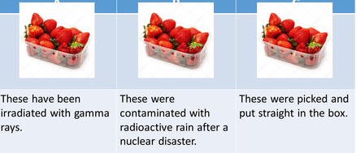
Topic 6: Radioactivity (part 2)
There are several different units for radioactivity, but the important one for you is the Becquerel
Triple Only
We can represent radioactive decay with nuclear equations, which balance just like chemical equations
Carbon-14 decays by a neutron turning into a proton + Beta- radiation.
The carbon now has an extra proton, so it has become nitrogen
Fission is the splitting of large nuclei. They split into 2 (or more) smaller nuclei called daughter nuclei. In the process energy is released as gamma rays. Some extra neutrons are also usually released.
The extra neutrons can be captured by another nucleus, which then becomes unstable, and fissions (splits). This then releases more neutrons which can trigger another nucleus. This sequence is called a chain reaction.
The radioactivity of a source decreases over time, but will take an almost infinite amount of time to reach zero.
We use a measurement called half-life. Half-life is a measurement of time
Half-life tells us how long it takes for the activity of the source to halve. In other words half of the unstable nuclei will decay in 1 half-life. In the next half-life, half of the remaining nuclei will decay. The number will keep halving.
We can use the half-life of radioactive materials to estimate age. For example we use Carbon-14 to date how long ago something died. The half-life of Carbon-14 is 5,700 years.
Radiation is dangerous to us because it is ionising. It can ionise and damage our cells which can cause cell death or cancer
If the damage is done to us from outside our body this is called irradiation
If something emitting radiation gets inside our body and harms us this is called contamination
Neutrons from fission move too fast to be captured, so in a nuclear power station we slow them down with a moderator. Without the moderator the reaction would stop.
We also use controls rods to absorb extra neutrons to stop the chain reaction becoming exponential and getting out of control.
Fusion occurs when small nuclei are joined together to make a larger nucleus.
It is difficult to make nuclei fuse. Fusion requires very high temperatures (over 10 million degrees) and pressures because the positive nuclei repel. Fusion happens in stars. Most fusion involves turning hydrogen into helium. Very large amounts of energy gets released.
Rutherford’s alpha scattering experiment was an experiment where alpha particles were fired at a very thin (1 atom thick) piece of gold leaf. Most of the (positively charged) alpha particles went straight through, but some were deflected (bent) and a very small number bounced back. This was evidence for a small, positive central part of the atom – the nucleus.
Isotopes used inside the body (e.g. in PET scanners) need to have a short half-life to limit the time patients are exposed to radiation. They need to be made near the hospital because of their short half-life.
Sources used to produce gamma rays for radiotherapy may have much longer half-lives. Radiation can be used for both treatment and diagnosis.
The contaminated strawberries could make you ill. The irradiated strawberries are the safest because the radiation will have killed any bacteria.

