Slide 1
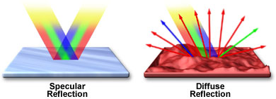
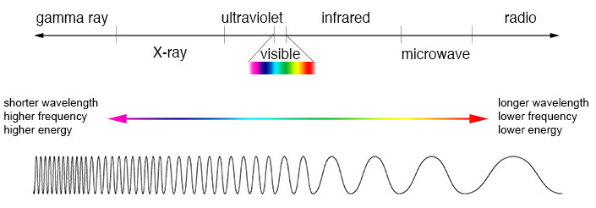
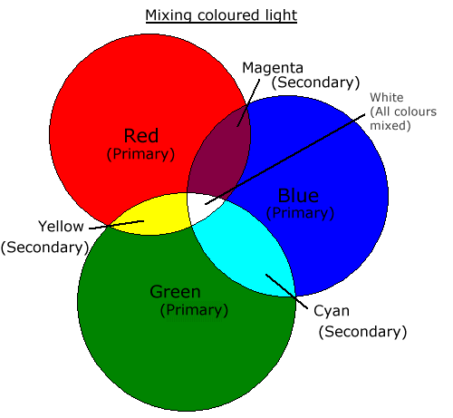
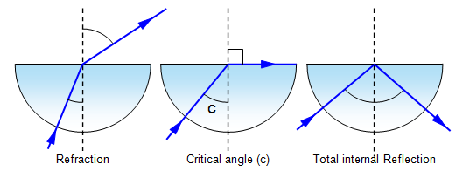
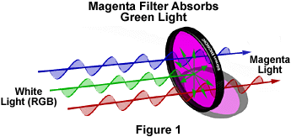
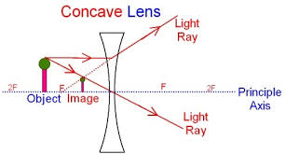
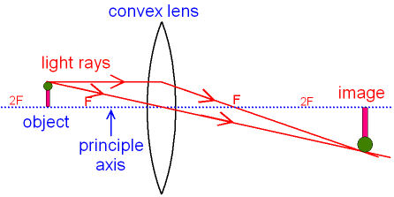
Topic 5: Light & The Electromagnetic Spectrum
Specular reflection is what you see in a mirror – the image is not distorted
Diffuse reflection is what happens from most materials – the light is reflected but the image is not preserved
The primary colours of light are red, blue and green
The primary colours of paints and inks are Cyan, Magenta and Yellow
White light is produced by combining the whole spectrum. Our eye sees white when we see red, green and blue
Filters and paints can absorb parts of the spectrum and change the colour of the light that is transmitted or reflected
A blue filter or blue paint absorb all colours except blue. Only blue reaches our eyes
All parts of the e.m. spectrum behave in very similar ways.
The main differences between them are their wavelength, frequency and energy
They all travel at the same speed in a vacuum: 3x10⁸m/s. Nothing can go faster
They can all reflect and refract
Lenses can be converging (the light is bent inwards to a central point) or diverging (the light is bent outwards)
The more curved the surface of the lens the more powerful it is
The image produced can be real or virtual. Real images appear in front of the lens and can be shown on a screen. Virtual images appear behind the lens and cannot be shown on a screen
The image can also be magnified (larger) or diminished (smaller) and it can be the correct way up or inverted (upside down)
Diverging lens
Waves refract when they cross into a new material at an angle. This is because they change speed
At the critical angle they travel along the surface instead of escaping
Beyond the critical angle they reflect – called total internal reflection
principal
axis
Converging lens
Converging lens
principal
axis

Slide 2
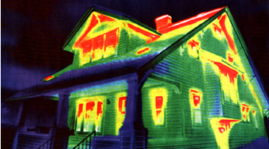
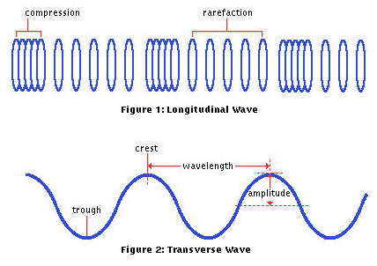
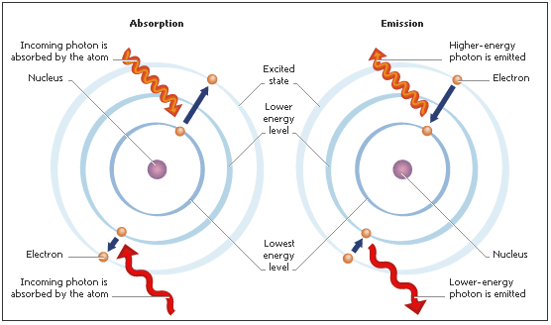
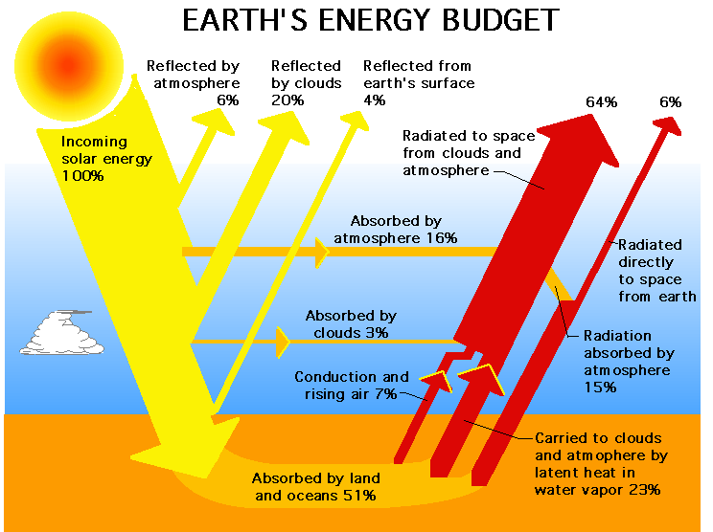
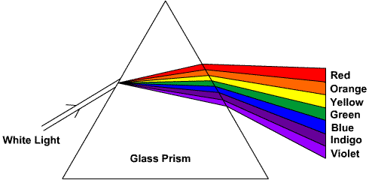
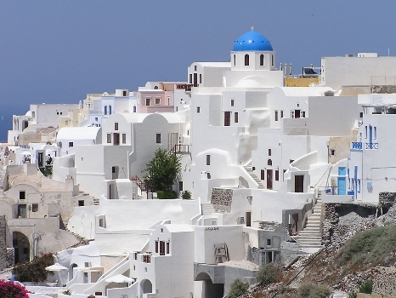
Topic 5: Light & The Electromagnetic Spectrum (part 2)
All objects emit radiation all the time. Most of this is around the infrared range.
Objects emit radiation faster when hot than when cool
Black objects emit radiation faster than white or silver objects. Black objects also absorb radiation faster than white or silver objects.
White and silver objects reflect more radiation. Houses in hot countries are painted white to reflect the radiation from the sun
Objects can absorb one frequency of radiation and then re-emit it at a different frequency.
The greenhouse effect is caused by radiation from the sun being absorbed by the Earth, and reemitted as a frequency that cannot escape the atmosphere
All parts of the e.m. spectrum are transverse waves
Sound is a longitudinal wave
Atoms can absorb and emit electromagnetic radiation. The frequency they absorb is related to the shells of the electrons.
This can produce absorption spectra (astronomy topic)
Type | Use | Danger
radio | Communication | Normally none
microwave | Communication, Cooking | Heating can cause burns
infrared | Heat lamps, Night vision, Remote controls | Skin burns
light | Seeing, lasers, communication | Eye damage
ultraviolet | Security – e.g. with bank notes. Sterilising water | Skin cancer
X-Rays | Imaging bones | Cancer
Gamma | Tracers, treating cancer, Sterilising | Cancer and cell death
The spectrum can be split by refraction.
Red light is refracted less than violet light.
Radio waves are refracted less than gamma rays

