Slide 1
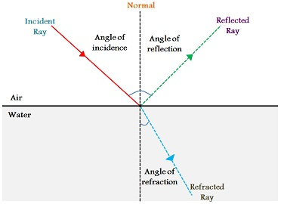
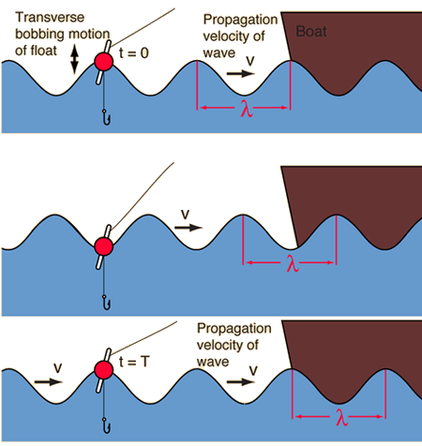
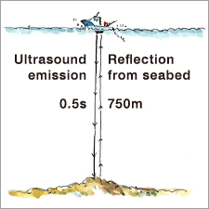
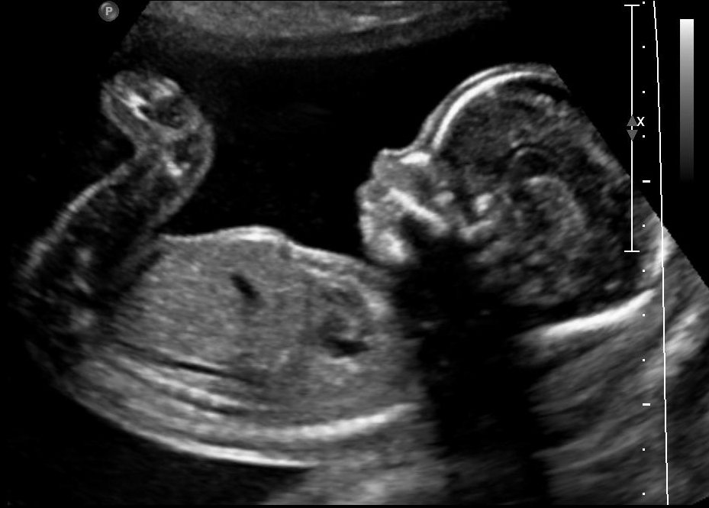
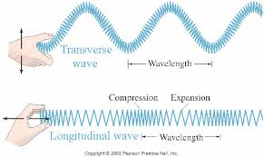
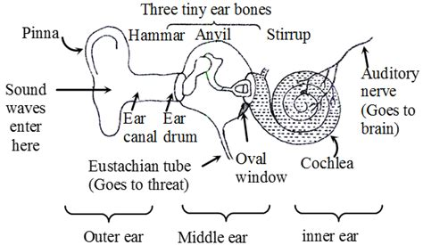
Topic 4: Waves
Waves transmit information (and energy) without transferring any matter. They pass through the medium without taking it with them.
If you are in the sea and a water wave passes you from left to right you will not move left to right. As the wave passes you will go up and down and finish where you started.
Other waves cause movement from side to side, or forwards and backwards.
Triple Only
Waves are reflected when they bounce back from a surface. They can also be refracted (bent) when they pass through material boundaries. Lenses (see topic 5) use refraction to focus light.
The diagram on the right shows incoming light (red) being reflected (green) or refracted (blue)
Humans can hear sounds between 20Hz and 20,000Hz.
Sound below 20Hz is called infrasound.
Sound above 20,000Hz is called ultrasound.
Ships can use ultrasound waves to find the depth of the sea, and also to locate fish and submarines. They use the speed, distance, time equation, because the speed of sound is known in materials like air and water.
Waves can be described by the wavelength, their frequency, their amplitude and their speed.
Speed, frequency and wavelength are related. You must memorise the formula to calculate them.
Infrasound can travel long distances, some animals (e.g. elephants) use it for communicating across many miles.
We also sometimes talk about the ‘period’ of a wave. This is the time it takes for 1 wavelength to pass a fixed point. It is 1 ÷ frequency.
Ultrasound is useful to us as well as to animals. Many animals can hear ultrasound and some (e.g. dolphins, bats) use it for hunting.
We use ultrasound to scan babies. Some of the waves are reflected when they go from a solid material to a liquid. When the waves go from the liquid around the unborn baby and reach the solid skin of the baby some bounce back.
v = λ f | Wave speed = wavelength × frequency
v = d ÷ t | Wave speed = distance ÷ time
Waves can be transverse or longitudinal. The e.m. spectrum (see topic 5) is transverse. Sound waves are longitudinal. Seismic (earthquake) waves come in several types, P-waves (primary) are longitudinal, whilst S-waves (secondary) are transverse.
Sound waves travel faster in denser materials, for example sound travels over 4 times faster in water (1500m/s) compared to in air (340m/s)
Sound waves are longitudinal – there is a compression and rarefaction. The molecules transmitting the sound get closer and further away from each other. The closer the molecules are to each other the faster the sound can travel.
When waves change material they often speed up or slow down. If they cross into the new material at an angle they are bent. This is called refraction. See topic 5 for more information.
Eustachian tube
(Goes to the throat)
Waves can be reflected, refracted, absorbed or transmitted by different materials. What happens depends on the material, and the wavelength.
In the human ear sound waves strike the eardrum which vibrates. The vibrations then travel into the ossicles (ear bones). At high frequencies of human hearing the eardrum and ossicles don't vibrate well. This limits the highest frequency that the human ear can hear.
Waves in the Earth (called seismic waves) are caused by Earthquakes. They can also be used to explore the structure of the Earth. Nuclear tests cause seismic waves which can be detected around the world
We can measure the speed of sound by measuring a distance, and timing the difference between seeing the event and hearing the event, e.g. with lightning.

