Slide 1
Modelling techniques you can do at home for your Art Deco Clock.
On this page are some helpful guides on creative modelling that you can do at home very easily! These are fun things to do so have a go and see if you can do them. Always evaluate you final outcomes! Get the family involved!

Slide 2
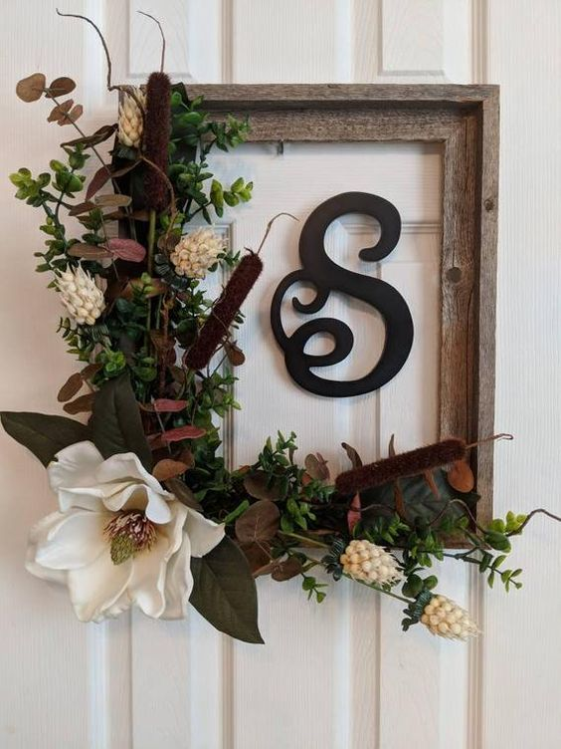
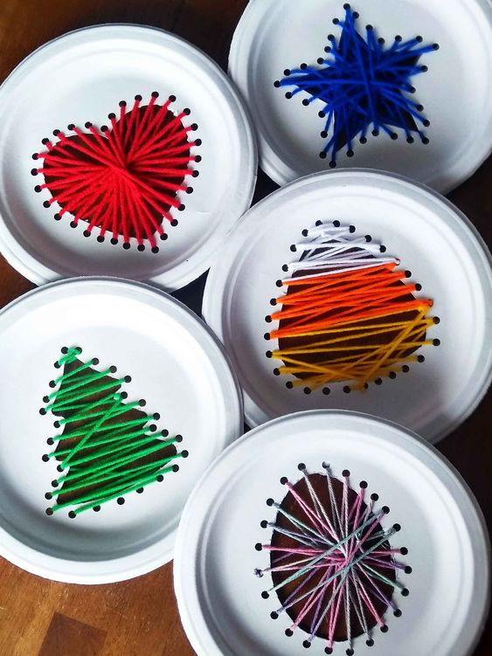
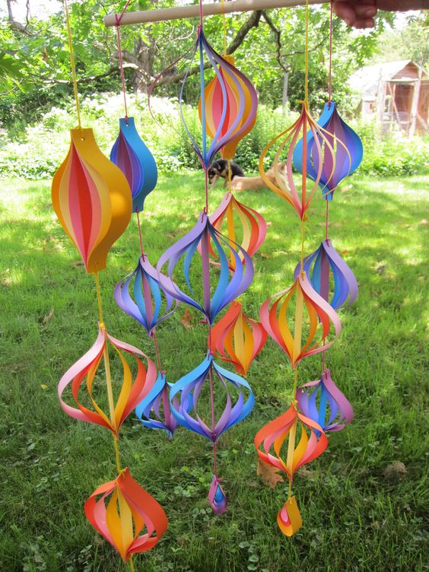
Here are some examples of craft work you could do. They are not necessarily art deco outcomes, but could you use these ideas and change them into art deco clocks or patterns? All the work you do make sure you photograph them so we can put them in your sketch books. Go to Pinterest and type in easy craft to get more ideas!
https://mysillysquirts.com/2019/02/21/kids-paper-plate-string-art-every-holiday/

Slide 3
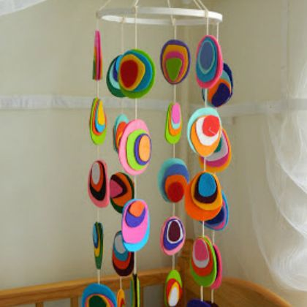
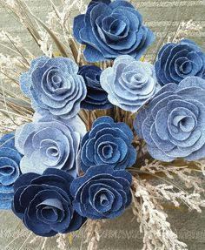
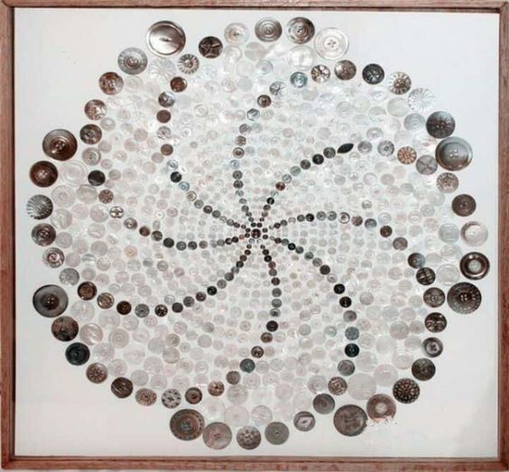
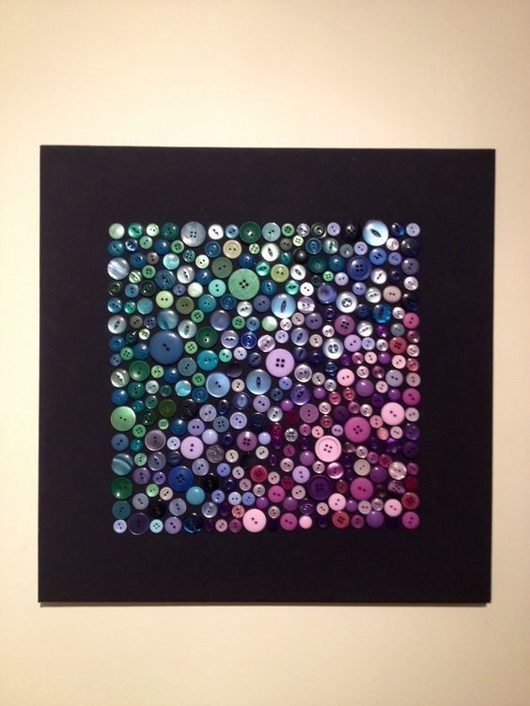
https://www.pinterest.co.uk/pin/617204323919605045/
https://www.pinterest.co.uk/pin/339669996868876729/

Slide 4
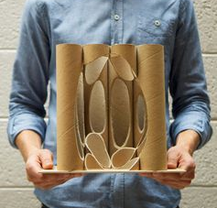
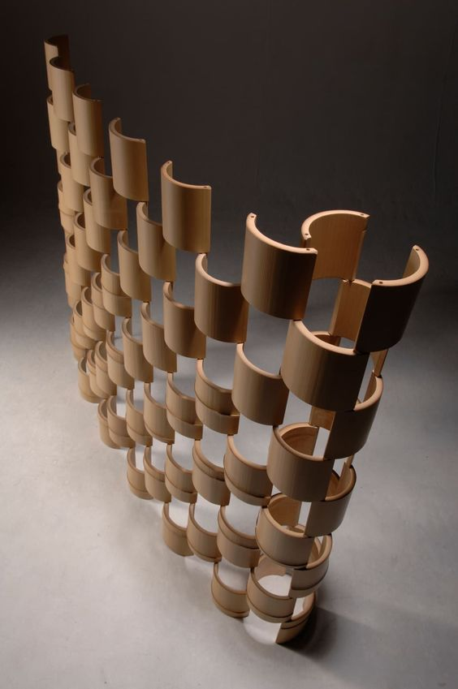
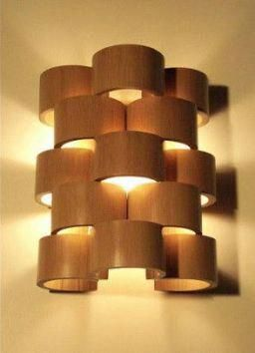
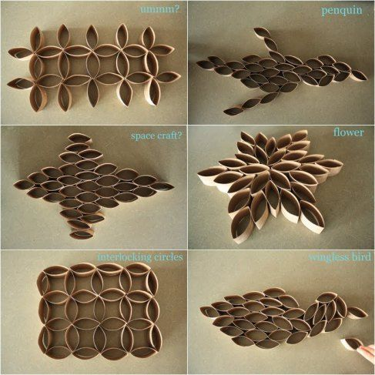
All them empty toilet rolls and kitchen rolls!
https://www.pinterest.co.uk/pin/409053578630727845/
https://www.pinterest.co.uk/pin/509329039111609258/

Slide 5
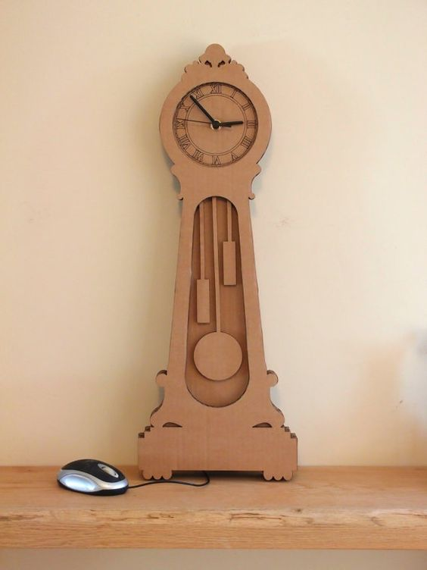
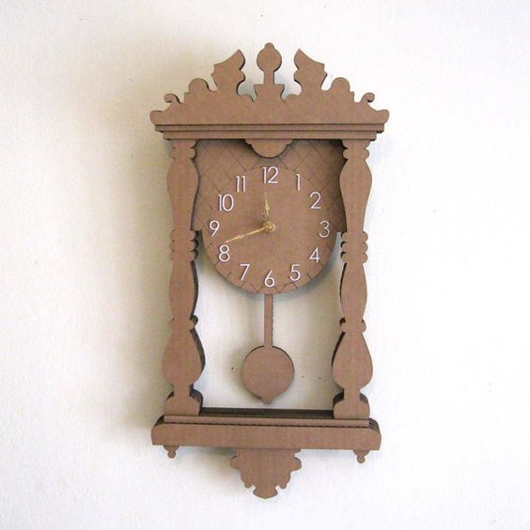
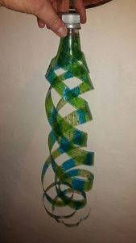
Using simple cardboard from Amazon boxes or other boxes such as cereal boxes, shoe boxes or even plastic bottles!
https://www.pinterest.co.uk/pin/850195235886415442/
https://www.pinterest.co.uk/pin/707417053953199938/

Slide 6
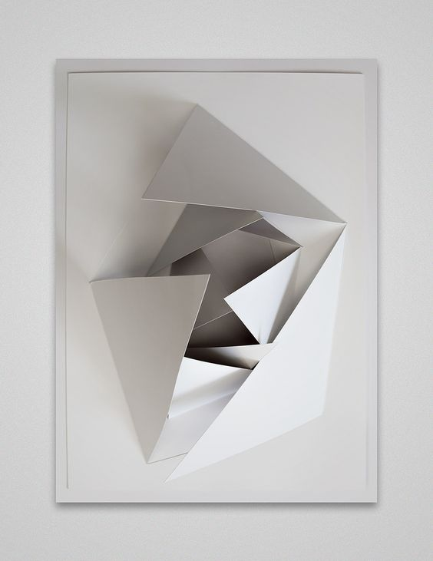
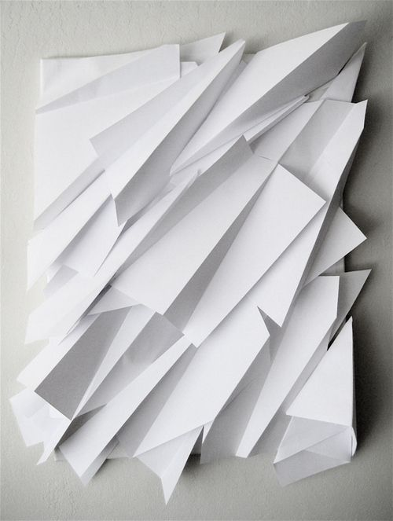
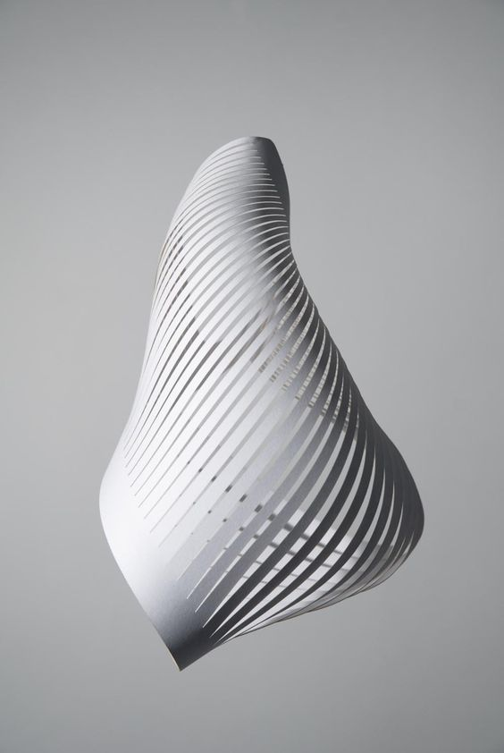
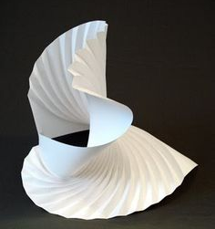
Modelling with paper and using a craft knife and ruler or scissors.
Cut out pieces of paper then folded and glued together to make a collage.
Make a fan and again twist the paper to make a pattern. Then glue together.
Remember making a Chinese lantern. This is the same but instead to gluing straight you twist it into an unusual shape and then glue it.
https://www.pinterest.co.uk/pin/830843831230817171/

Slide 7
Task 1 - Modelling
Using the information shown above create your own models using materials and equipment you have available. You may want to look on YouTube for modelling techniques and how to make them.
Click on the Pinterest examples and try and recreate them into an Art Deco themed model (some of these models are not Art Deco so you will need to think about the Art Deco Patterns/Clock examples you have found previously on your PowerPoint Document. If you have forgotten go to Google/Pinterest and type in Art Deco Clock examples and Art Deco Pattern.
Use the different techniques shown and make your own models and take photographs (keep your models as well!) - don't worry if they go wrong still take photographs of them and on a PowerPoint document add your photographs and annotate by answering the following questions:
1.What you have done and what technique you used?
2. Did you model work if not why?
3. What materials did you use to make your model and these materials work on your final clock or would you need to amend the materials to make your clock durable, stronger, better finished, etc?1

