Slide 1
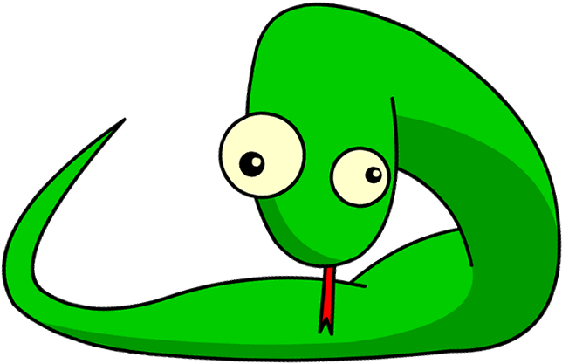

Introduction to Python
Programming
Part 7: Looping

Slide 2
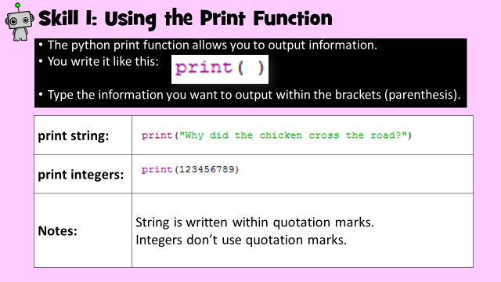
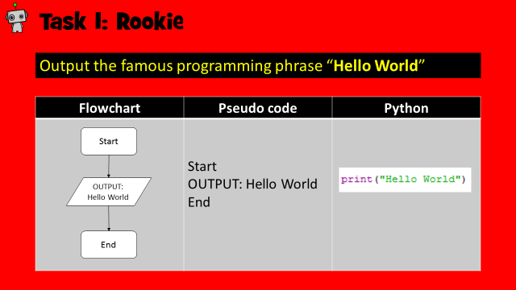
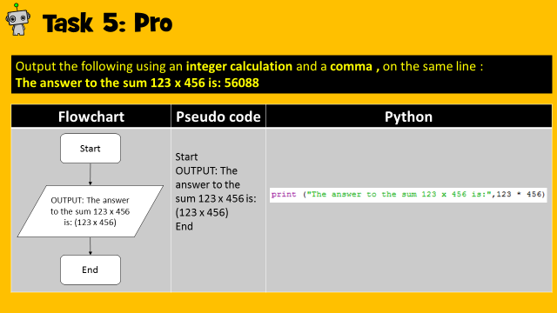
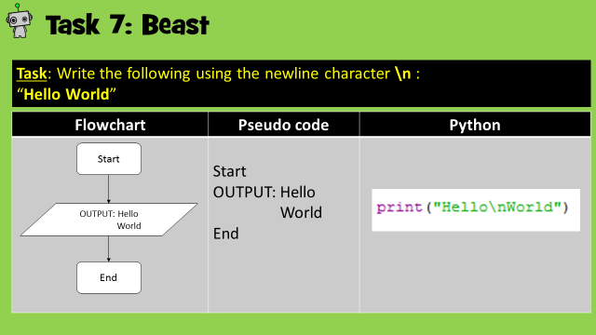
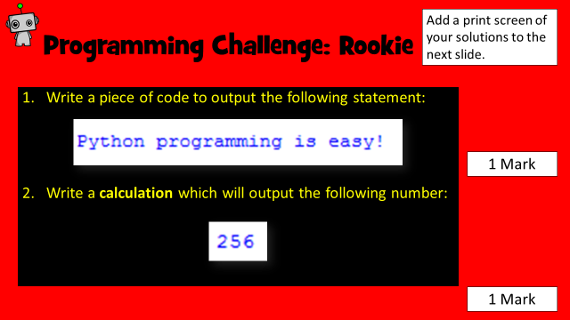
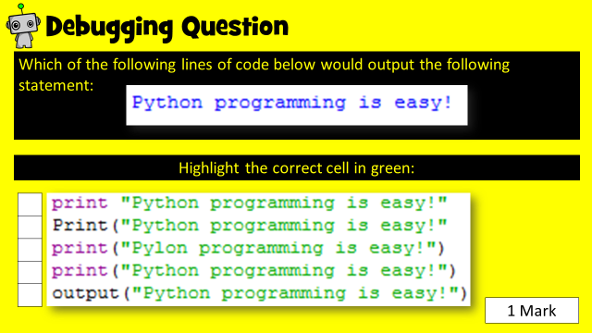
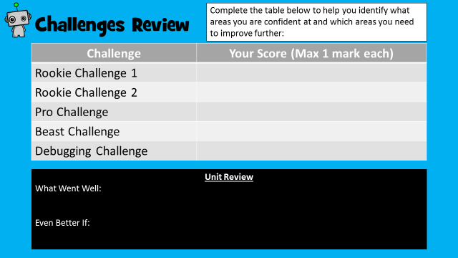
How to use this resource
Within each unit, you will learn how to develop and apply a range of Python programming skills. Skill explanations are in pink.
After reading the explanation of a skill, apply it within the given tasks. The tasks are categorised into Rookie (Easy), Pro (Medium) or Beast (Hard).
Once you have learned how to apply your new skills, demonstrate your ability by completing the given challenges. Don’t forget the debugging task!
Once complete, review your performance!
Skill Explanations: Pink Slides
Tasks: Rookie Pro Beast
Challenges: Rookie Pro Beast

Slide 3
Learning Objectives
Rookie
To be able to write a simple While loop.
To be able to write a simple For loop.
Pro
To use both While and For loops to make coding more efficient.
Beast
To use loops to check for and compare information.

Slide 4
Skill Contents
Once you complete a skill, colour code the box to show your level of confidence. You can always revisit the skill later on to boost your confidence.
Contents | Confidence Level
While loops
For loops
For loops: add a starting number
For loops: increment the number by more than 1
For loops: comparing data
Key | Colour Code
I am very good at this skill and could show a friend how to do it.
I am confident I can perform this skill on my own.
I need to improve my understanding of this skill.

Slide 5
What is Looping (Iteration)?
Why write all this code:
Walk forward one step
Walk forward one step
Walk forward one step
Walk forward one step
Walk forward one step
Walk forward one step
Walk forward one step
Walk forward one step
Walk forward one step
Walk forward one step
When you could simply write this:
Repeat 10 times: Walk forward one step
In programming, Looping, or Iteration, means repeating a set of instructions a certain number of times.
This allows us to create efficient coding structures, which also saves us time!
Within this unit of work we will learn how to write two different types of loops: For Loops and While Loops.

Slide 6
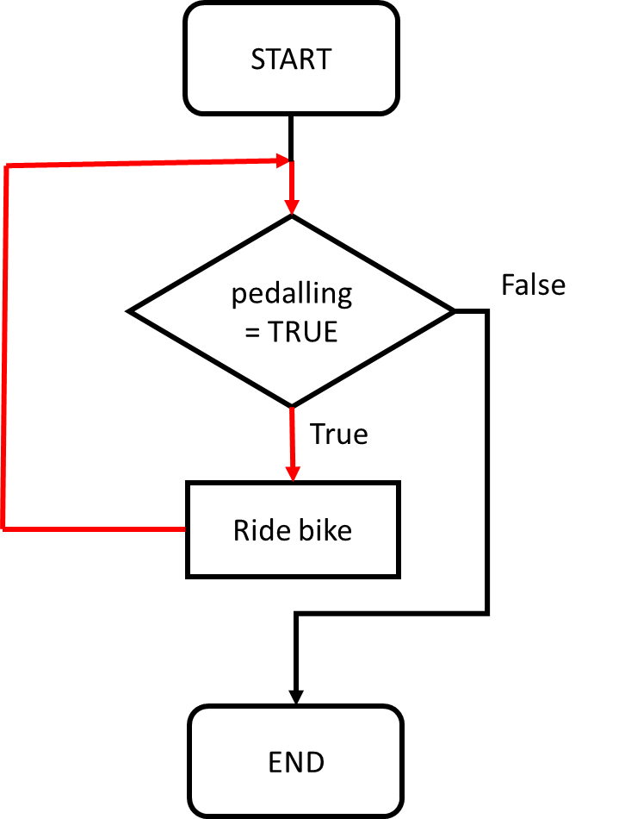
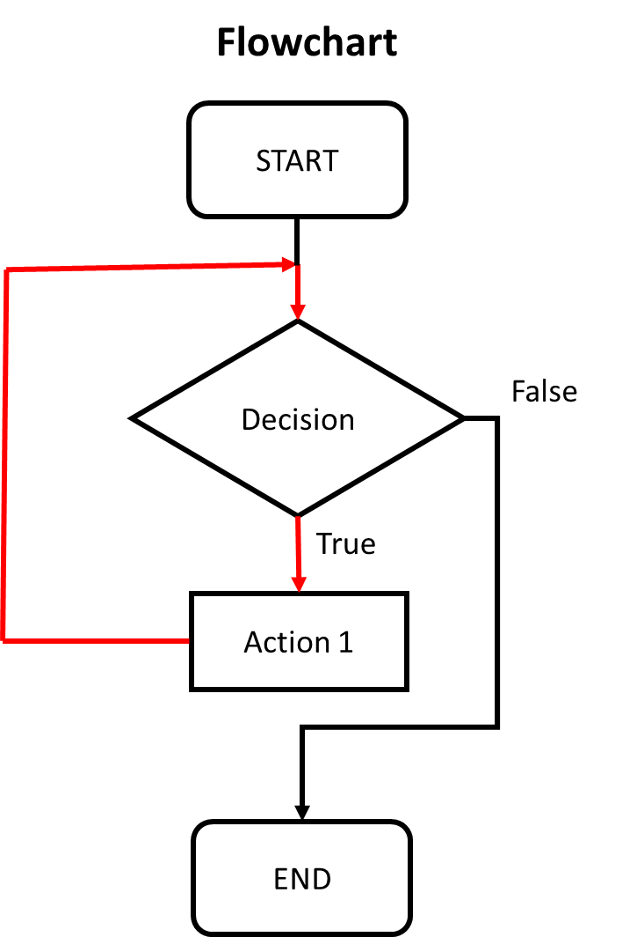
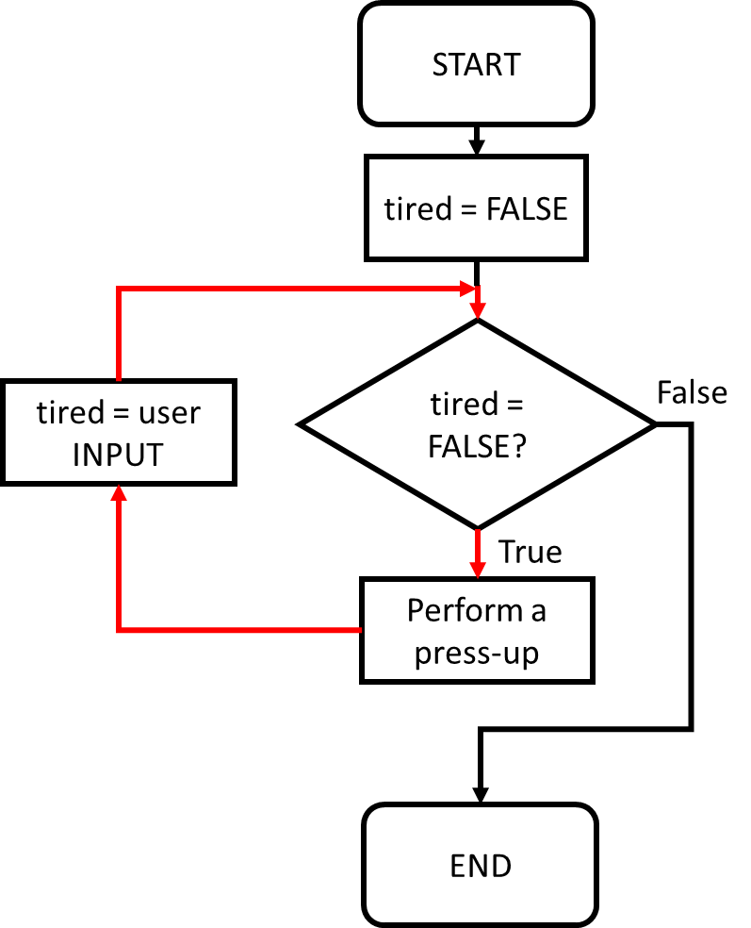
Skill 1: While Loops
Here are some sporting while loop examples!
Riding a bike | START WHILE pedalling = TRUE: ride bike END WHILE END
Do press-ups | START tired = FALSE WHILE tired = FALSE: perform a press-up tired = user INPUT( ) END WHILE END
The first type of loop we will look at is a While Loop.
A While Loop is used to repeat an action or sequence of events while a condition is met.
The structure of the while loop in pseudo code and flowchart is as follows:
Start
WHILE the condition is TRUE:
Perform the task(s)
End
Note how the task to be performed WHILE the condition is TRUE is indented below the while code.

Slide 7
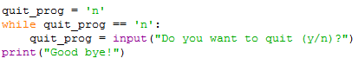
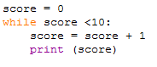
Skill 1: Writing while Loops in Python
In Python, a While loop is structured as follows:
Declare any required variables.
Write the condition.
The indented code will repeat until the while condition becomes FALSE.
Declare any required variables.
While loops can also be used to run code within a numeric range. You will learn how to do this within the following tasks.
Write the condition.
The indented code will repeat until the while condition becomes FALSE.

Slide 8
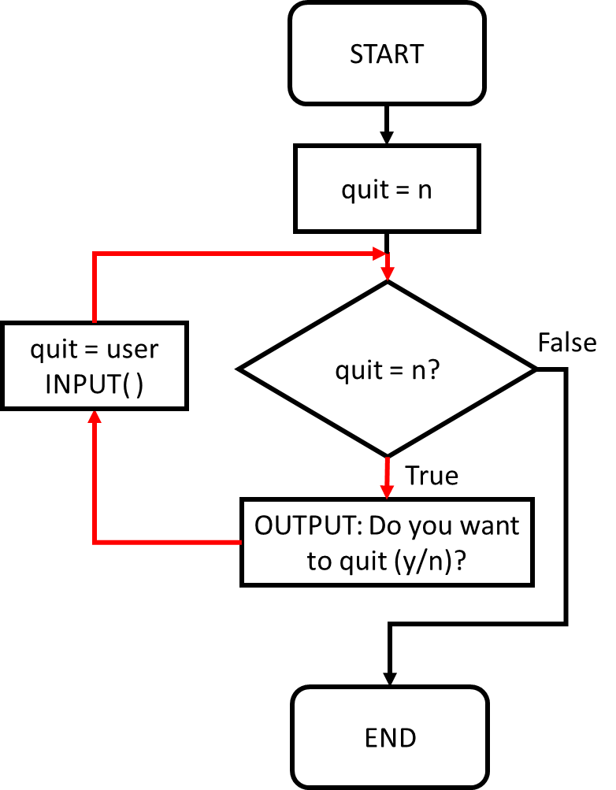
Task 1: Rookie
Create a variable called quit. Assign it the value n.
Using a WHILE loop, while the value of quit is n, ask the user if they want to quit. If a value other than n is input, the while loop and programme ends.
Flowchart | Pseudo code
 | START quit = n WHILE quit = n: OUTPUT: Do you want to quit (y/n)? quit = user INPUT( ) END WHILE END

Slide 9
Task 1: Solution
Add a print screen to show your coding here.
Add a print screen to show your output solution here.

Slide 10
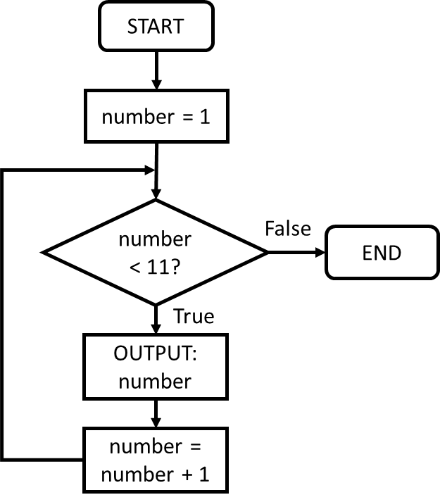
Task 2: Rookie
Create a variable called number and assign it the value 1.
Using a WHILE loop, print out the numbers 1 to 10 by incrementing the value of the variable number.
Flowchart | Pseudo code
 | START number = 1 WHILE number < 11: OUTPUT: number number = number + 1 END WHILE END

Slide 11
Task 2: Solution
Add a print screen to show your coding here.
Add a print screen to show your output solution here.

Slide 12
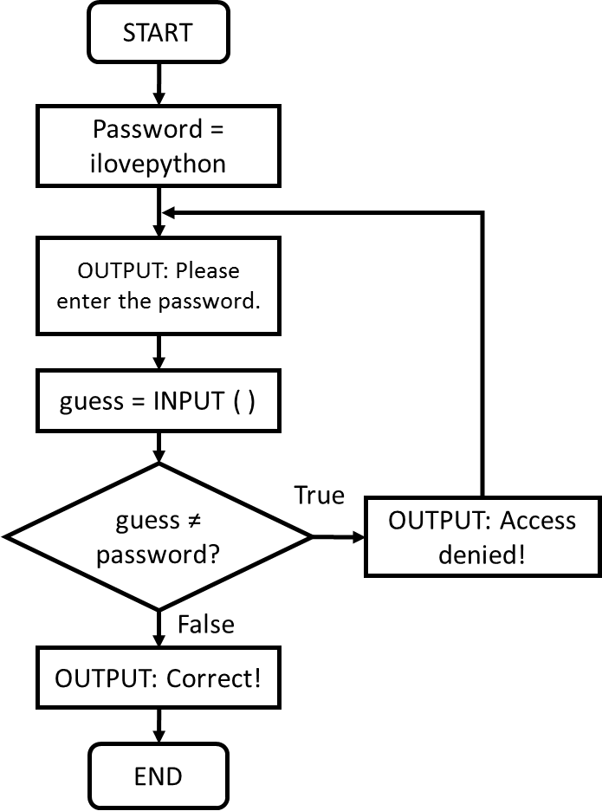
Task 3: Pro
Create a variable called password. Assign it the password ilovepython.
Allow the user to input a password. Use a WHILE loop so that the user is allowed to retype the password until they get it correct.
When the correct password is input, an appropriate success message is displayed and the programme ends.
Flowchart | Pseudo code
 | START password = ilovepython WHILE guess ≠ password: OUTPUT: Please enter the password. guess = INPUT ( ) IF guess ≠ password: OUTPUT: Access denied! ELSE: END IF END WHILE OUTPUT: Password accepted. Welcome back user! END

Slide 13
Task 3: Solution
Add a print screen to show your coding here.
Add a print screen to show your output solution here.

Slide 14
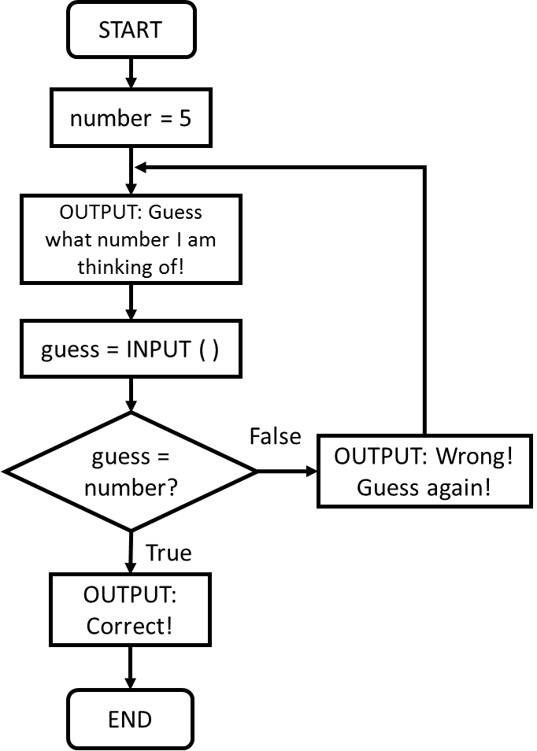
Task 4: Pro
Create a variable called number and store a number between 1 and 10 in it.
Using a While loop, ask the user to guess your number until they get it right.
Make sure you output suitable messages to let the user know if they guessed correctly or not.
EXTENSION: Add an option for the user to quit guessing and end the programme.
Flowchart | Pseudo code
 | START number = [programmers choice] guess = 0 WHILE guess ≠ number: OUTPUT: Guess what number I am thinking of! guess = INPUT ( ) IF guess = number: OUTPUT: Correct! ELSE: OUTPUT: Wrong! Guess again! END IF END WHILE END

Slide 15
Task 4: Solution
Add a print screen to show your coding here.
Add a print screen to show your output solution here.

Slide 16
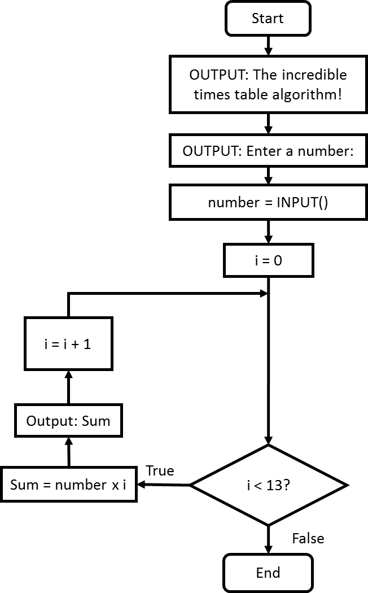
Task 5: Beast
Create a variable called number and assign it the value 1.
Using a FOR loop, print out the numbers 1 to 10 by incrementing the value of the variable number.
Flowchart | Pseudo code
 | START OUTPUT: The incredible times table algorithm! OUTPUT: Enter a number number = user INPUT( ) i = 1 WHILE i < 13 Sum = number x i OUTPUT: Sum i = i + 1 END WHILE END

Slide 17
Task 5: Solution
Add a print screen to show your coding here.
Add a print screen to show your output solution here.

Slide 18
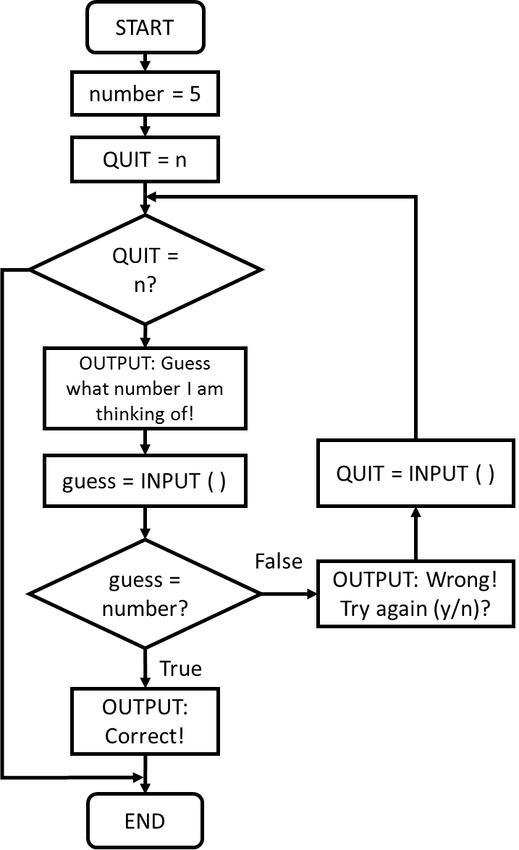
Task 6: Beast
Extend the guess the number algorithm by adding in an option for the user to quit guessing and end the programme.
Flowchart | Pseudo code
 | START number = [programmers choice] QUIT = n guess = 0 WHILE QUIT = n: IF guess ≠ number: OUTPUT: Guess what number I am thinking of! guess = INPUT ( ) IF guess = number: OUTPUT: Correct! ELSE: OUTPUT: Wrong! Do you want to quit(y/n)? QUIT = INPUT ( ) END IF ELSE: END IF END WHILE END

Slide 19
Task 6: Solution
Add a print screen to show your coding here.
Add a print screen to show your output solution here.

Slide 20
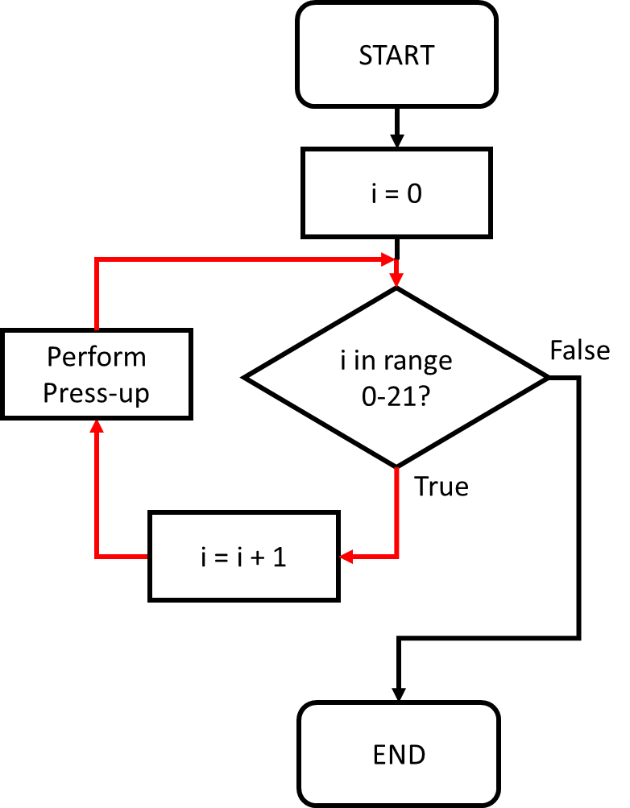
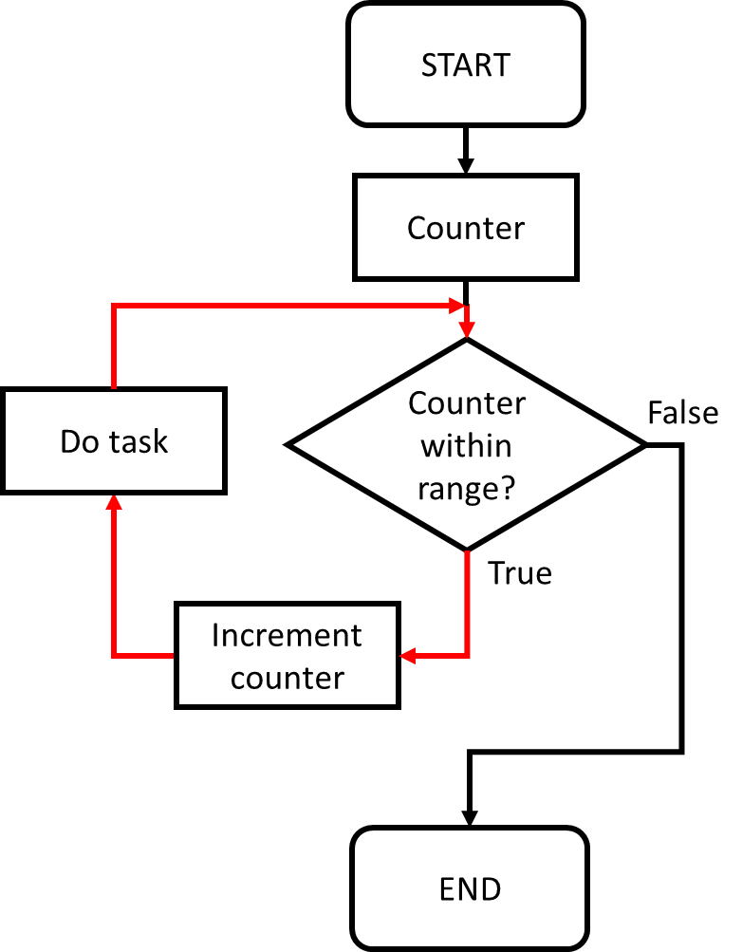
Skill 2: For Loops
Here is a sporting for loop example!
Perform 20 press-ups | START FOR i ← 1 TO 20: Perform a press-up END FOR END
The next type of loop we will look at is a For Loop.
A For Loop is used to repeat a set of instructions a specific number of times.
Start
Repeat for i number of times:
Perform the task(s)
End
Difference between FOR and WHILE loops
FOR loop: Runs for a specific number of times.
WHILE loop: Runs until a condition becomes FALSE.

Slide 21
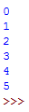
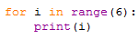
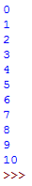
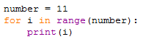
Skill 2: Writing FOR Loops in Python
The number within the bracketed range function (6) refers to the maximum number i can be before the for loop ends i.e.
([up to but not including])
In Python, a FOR loop is structured as follows:
When using a for loop, the i is a type of variable known as a counter. This states how many times to repeat the code for.
By printing i, we can see that the initial value of i is 0 and the final number to be printed is 5.
This bracketed number can also be replaced with a variable as shown below:
In total, a for loop range can take three integer arguments as follows:
We will look at how these are used within the following tasks.
([starting number], [up to but not including], [steps])

Slide 22
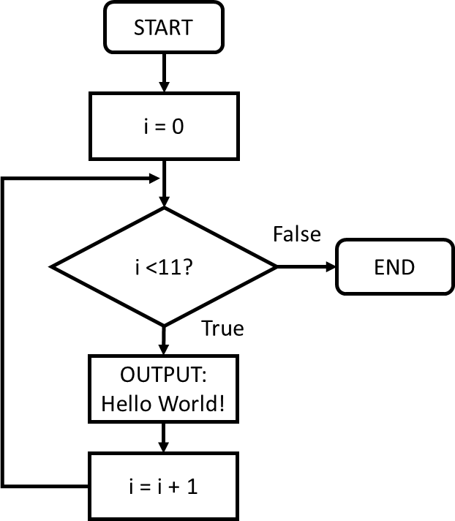
Task 7: Rookie
Use a for loop to print out “Hello World!” 10 times.
Extension: Can you make it repeat 20 times?
Flowchart | Pseudo code
 | START FOR i ← 1 TO 10: OUTPUT: Hello World! END FOR END

Slide 23
Task 7: Solution
Add a print screen to show your coding here.
Add a print screen to show your output solution here.

Slide 24
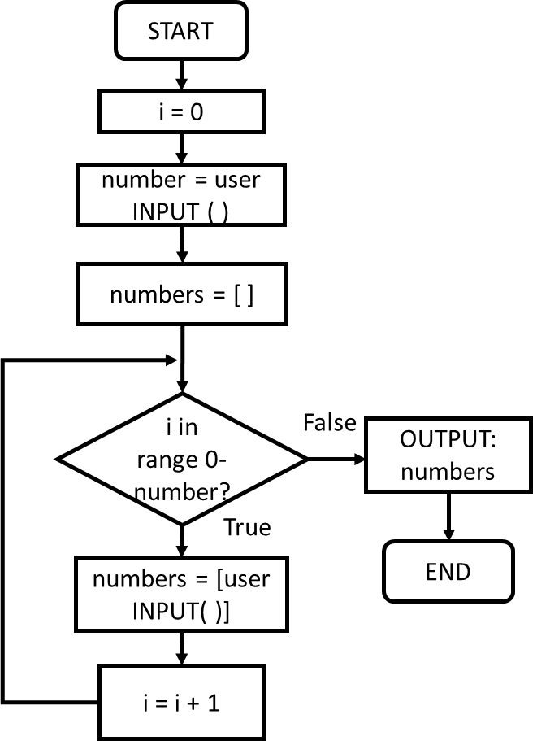
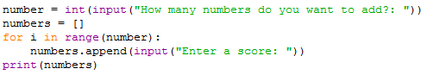
Task 8: Pro
Ask a user how many numbers they want to add to a list.
Use a for loop and the append function to allow a user to enter their chosen number of numbers.
Output the finished list.
Flowchart | Pseudo code | Python
 | START number = user INPUT( ) numbers = [ ] FOR i ← 1 TO number numbers = user INPUT END FOR OUTPUT: numbers END

Slide 25
Task 8: Solution
Add a print screen to show your coding here.
Add a print screen to show your output solution here.

Slide 26
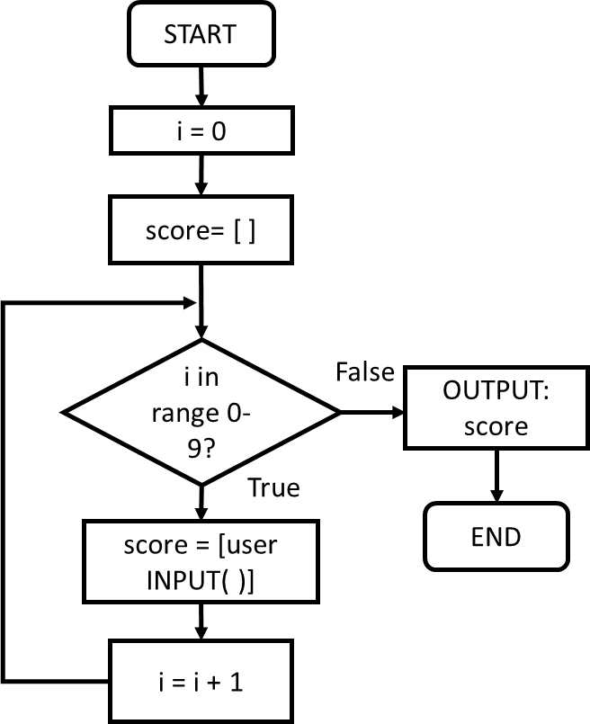
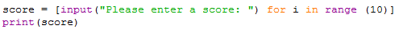
Task 9: Beast
Using a for loop, allow a user to input 10 different scores of their choice into an array.
Once all the scores have been input, OUTPUT the array.
Extension: Ask the user how many scores they wish to enter.
Flowchart | Pseudo code | Python
 | START score = [ ] FOR i ← 1 TO 10 score = user INPUT( ) END FOR OUTPUT: score END

Slide 27
Task 9: Beast
Add a print screen to show your coding here.
Add a print screen to show your output solution here.

Slide 28
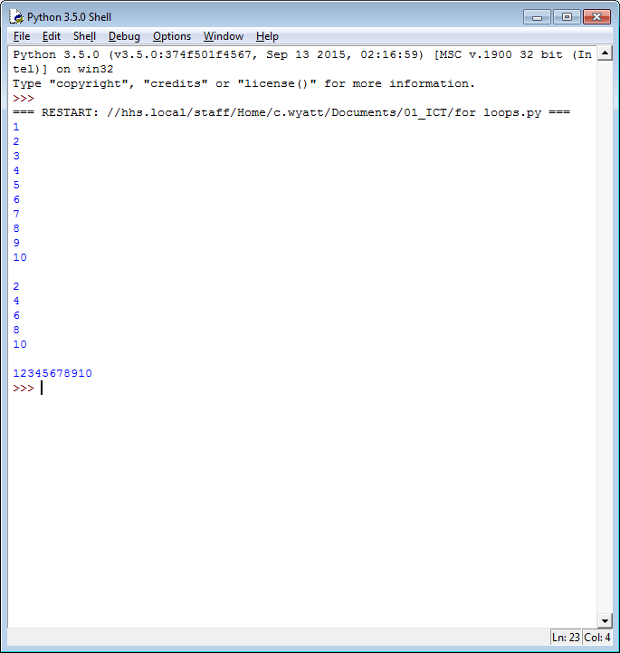
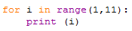
Skill 3: Adding a starting number within a FOR loop
A FOR loop automatically starts at 0 unless otherwise stated within the range arguments.
([starting number], [up to but not including])
The range function allows you to state how many times you wish the code to be repeated by assigning values to the counter variable i.
In the code, (1,11) means i will start with the value 1 and the code will continue to repeat until i becomes 11.
Therefore, in this example, the code will repeat 10 times.
As such, this example code will generate the following output:

Slide 29
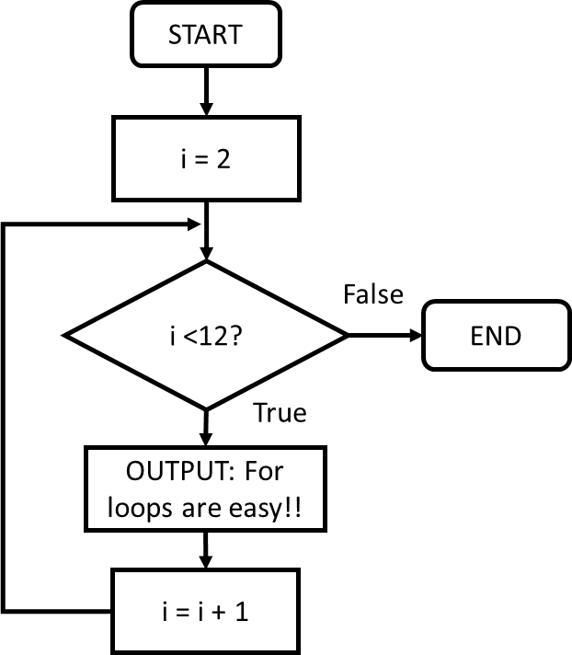
Task 10: Pro
Using a for loop, set the starting count to 2, then output For loops are easy! 10 times.
Extension: Can you make it repeat 20 times with a starting count of 10?
Flowchart | Pseudo code
 | START FOR i ← 2 TO 12: OUTPUT: For loops are easy! END FOR END

Slide 30
Task 10: Solution
Add a print screen to show your coding here.
Add a print screen to show your output solution here.

Slide 31
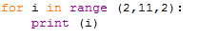
Skill 4: Incrementing the counter by more than 1
A FOR loop counter automatically increments by 1 step unless otherwise stated.
([starting number], [up to but not including], [steps])
In the code, (2,11,2) means i will start with the value 2 and increment each step by the value of 2. The code will continue to repeat while i is less than 11.
In this example, the output shows how i increments by two until it reaches the end of the loop range (11).

Slide 32
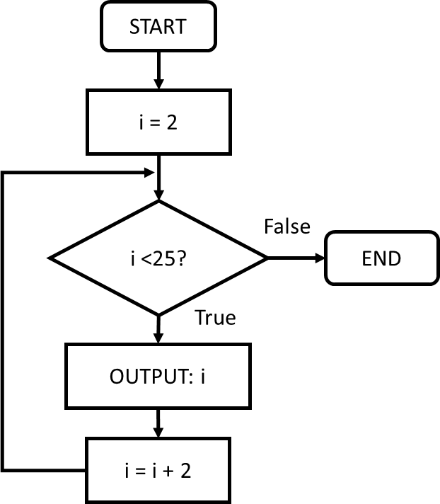
Task 11: Pro
Using a for loop, set the starting count to 2, the range to 25 and the step increment to 2 each step to produce an algorithm to output the 2 times table!
Extension: Can you create an algorithm to output the 10 times table?
Flowchart | Pseudo code
 | START FOR i ← 2 TO 25: OUTPUT: i i = i + 2 END FOR END

Slide 33
Task 11: Solution
Add a print screen to show your coding here.
Add a print screen to show your output solution here.

Slide 34
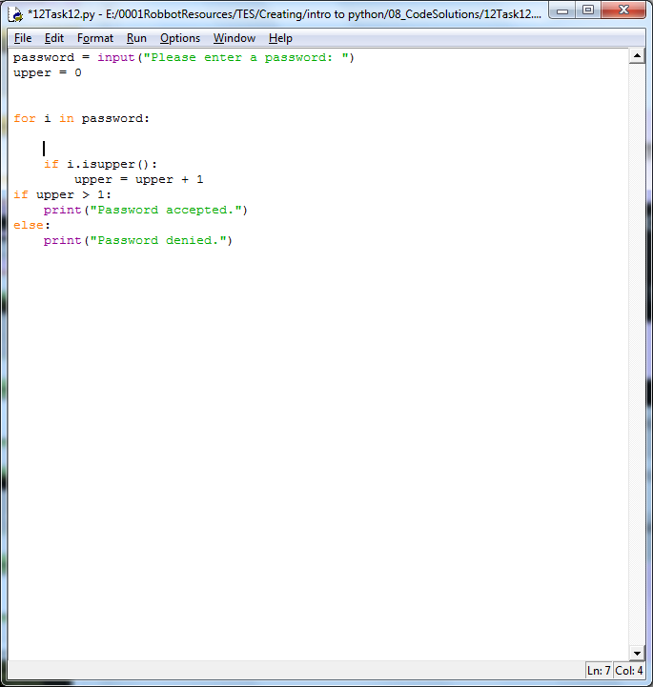
Skill 5: Using for loops to compare data
A for loop can be used to check for specific information within a variable or a list.
To do this, you will need to understand the following functions:
Technique | Explanation | Example
For i in variable: | Rather than use the range function, this will check each index within a given variable or list [i].
.isupper | Conducts a check to see if a variable stores uppercase string
.islower | Conducts a check to see if a variable stores lowercase string
.isnumeric | Conducts a check to see if a variable stores any numbers

Slide 35
Reminder: Understanding Array/List structures
Information stored within data structures such as arrays and variables are given an index value as shown below:
Remember: In Python, the first element of a data structure has an index of zero.
In the example above, the length of the string is 11 characters (note the space is also a character), however the index range is 0 to 10.
This means index 0 stores the character H while index 10 stores the character D.
If we use a FOR loop to check through each index, we need to adjust the FOR loop ranges as follows:
FOR i ← 0 TO LEN(list)-1
Index | 0 | 1 | 2 | 3 | 4 | 5 | 6 | 7 | 8 | 9 | 10
welcome ← | H | E | L | L | O |  | W | O | R | L | D
Final value will be 1 less than the length of the array / string.
First count value will be 0.

Slide 36
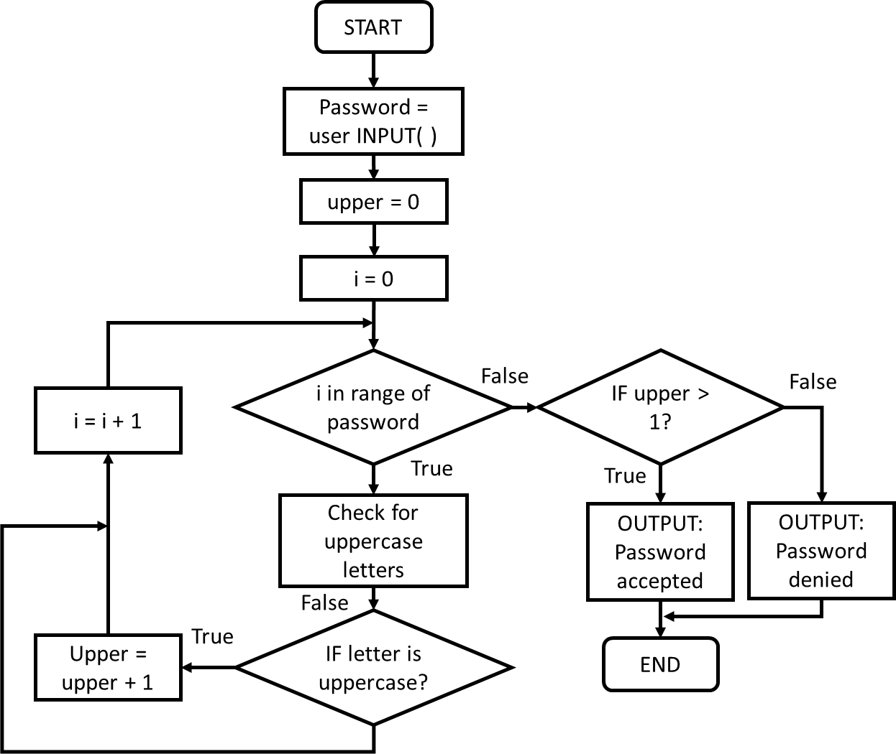
Task 12: Beast
Ask the user to enter a password. Store it in a variable.
Use a for loop and check that it has at least 2 uppercase letters within it.
If it does, let the user know their password was accepted, if not, let them know their password was denied.
Flowchart | Pseudo code
 | START password = user INPUT( ) upper = 0 FOR i ← 0 TO LEN(password)-1 IF password [ i ] is uppercase: upper = upper + 1 ELSE: END IF END FOR IF upper > 1: OUTPUT: Password accepted ELSE: OUTPUT: Password denied END IF END

Slide 37
Task 12: Solution
Add a print screen to show your coding here.
Add a print screen to show your output solution here.

Slide 38
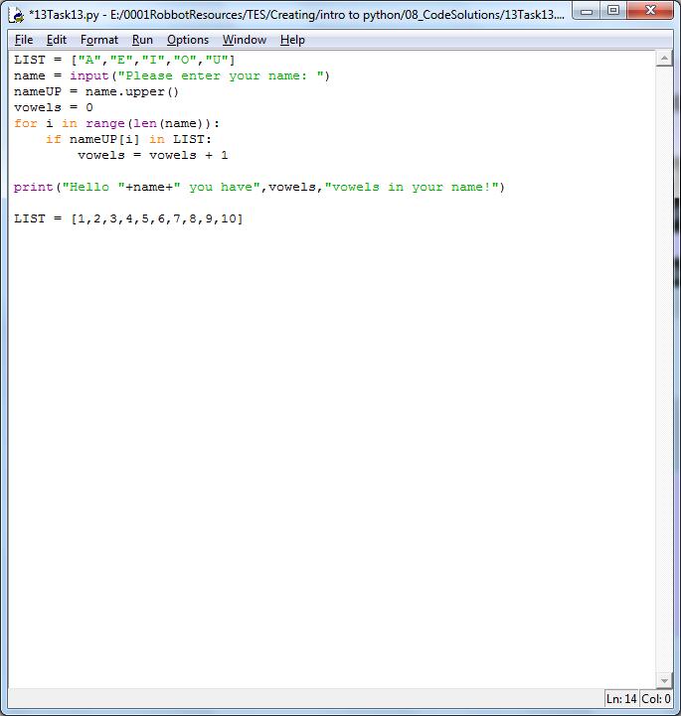
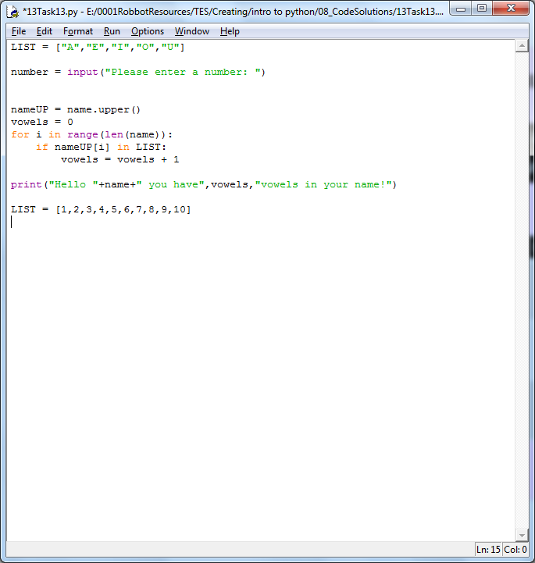
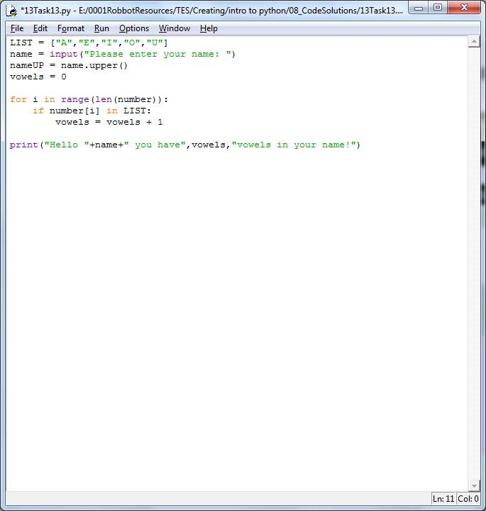
Skill 6: Compare information in a variable to a list
A for loop can be used to compare information against a variable or a list.
To do this, you will need to understand the following functions:
Technique | Explanation | Example
LIST = [1,2,3] | Declare your list and Assign a variable. For example, either enter the data yourself or allow a user to enter a it.
For i in variable length: | Use the range function to repeat the check for as long as the length of the checked word.
Identifying a variable index | This is used to check the value of an indexed location against any value in a list.

Slide 39
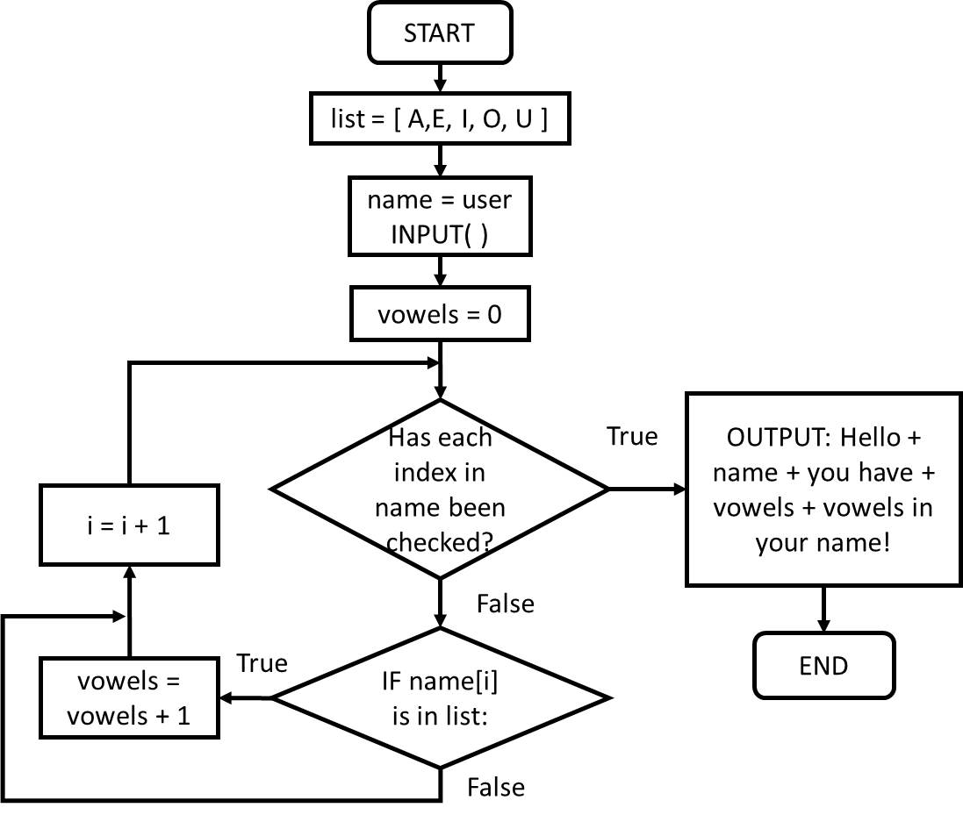
Task 13: Beast
Create a list and store the following letters within it: A E I O U
Ask the user to enter their name. Compare the user name and output the number of vowels within their name in a suitable string sentence.
Flowchart | Pseudo code
 | START list = [ A, E, I, O, U ] name = user INPUT( ) vowels = 0 FOR i ← 0 TO LEN(name)-1: IF name[ i ] is in list: vowels = vowels + 1 ELSE: END IF END FOR OUTPUT: Hello + name + you have + vowels + vowels in your name! END

Slide 40
Task 13: Solution
Add a print screen to show your coding here.
Add a print screen to show your output solution here.

Slide 41
Programming Challenges
Now you have learned some programming skills, it’s time to put them into practice!
Complete the following programming challenges. Start with the Rookie challenge and see how far you can push yourself.
Finally, complete the debugging challenge.
Once you have finished your challenges, complete the review. Look back at the skills you have learned so far to help you solve the challenge.

Slide 42
Programming Challenge: Rookie
Add a print screen of your solutions to the next slide.
Using a loop, output a string phrase of your choice 20 times.
1 Mark

Slide 43
Programming Challenge: Rookie - Answer
Add a print screen to show your coding here.
Add a print screen to show your output solution here.

Slide 44
Programming Challenge: Pro
Add a print screen of your solutions to the next slide.
Create a programme which asks the user to answer the question ‘what is 10 + 10?’
If the user gets the question wrong, they are asked to try again.
If the user gets the question right, the programme outputs a suitable response and ends.
1 Mark

Slide 45
Programming Challenge: Pro - Answer
Add a print screen to show your coding here.
Add a print screen to show your output solution here.

Slide 46
Programming Challenge: Beast
Add a print screen of your solutions to the next slide.
Create a variable which stores the name of your favourite sporting hero.
Ask the user to guess your sporting hero.
If the user guesses the correct name, congratulate them and end the programme. If they guess incorrectly, allow them to have another go if they wish.
If they guess incorrectly, give them a clue; let the user know how many letters in their guess were the same as in your answer.
Give them another clue: let the user know the first letter of your sporting hero’s name, the next guess tell them the first and second, etc.
Make sure your coding is robust.
1 Mark

Slide 47
Programming Challenge: Beast - Answer
Add a print screen to show your coding here.
Add a print screen to show your output solution here.

Slide 48
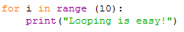

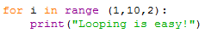
Debugging Question
Which piece of code below would output the phrase below 10 times;
Looping is easy!
1 Mark

Slide 49
Challenges Review
Complete the table below to help you identify what areas you are confident at and which areas you need to improve further:
Challenge | Your Score (Max 1 mark each)
Rookie Challenge
Pro Challenge
Beast Challenge
Debugging Challenge
Unit Review
What Went Well:
Even Better If:

