Slide 1
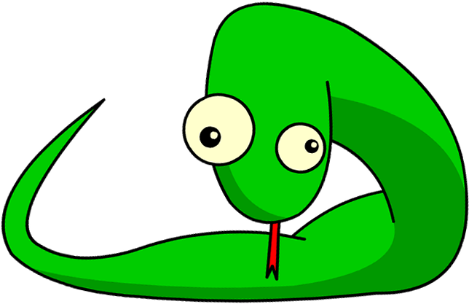
Introduction to Python Programming
Part 6: String Manipulation

Slide 2
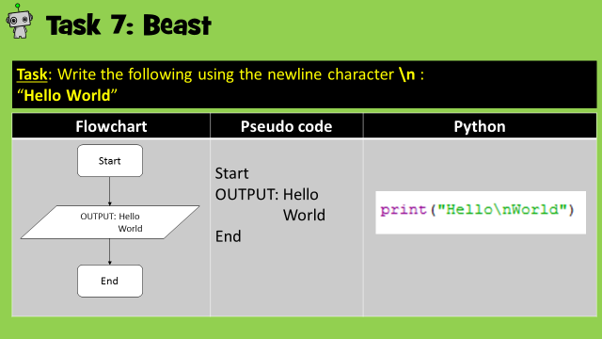
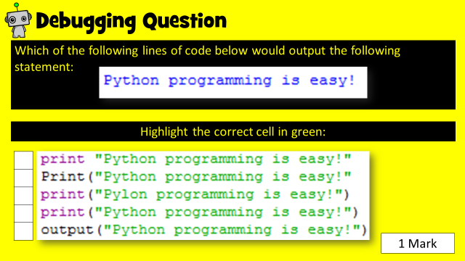
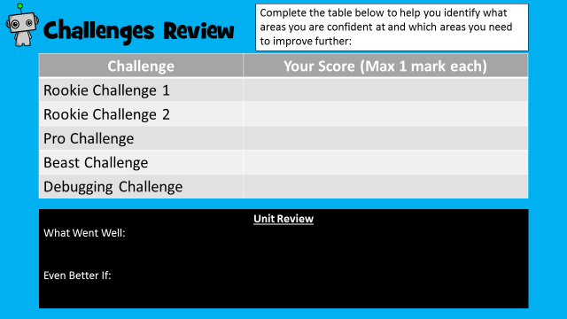
How to use this resource
Within each unit, you will learn how to develop and apply a range of Python programming skills. Skill explanations are in pink.
After reading the explanation of a skill, apply it within the given tasks. The tasks are categorised into Rookie (Easy), Pro (Medium) or Beast (Hard).
Once you have learned how to apply your new skills, demonstrate your ability by completing the given challenges. Don’t forget the debugging task!
Once complete, review your performance!
Skill Explanations: Pink Slides
Tasks: Rookie Pro Beast
Challenges: Rookie Pro Beast

Slide 3
Learning Objectives
Rookie
To be able to use a variety of string manipulation techniques with assistance.
To be able to be able to state what changes have happened to the string.
Pro
To be able to use a variety of string manipulation techniques with some assistance.
To use manipulation techniques to reduce programming logic errors.
Beast
To be confident in applying a variety of techniques with little assistance to make changes to stored string statements.
To use manipulation techniques to improve the robustness of programming.

Slide 4
Skill Contents
Once you complete a skill, colour code the box to show your level of confidence. You can always revisit the skill later on to boost your confidence.
Contents | Confidence Level
Concatenation
Changing the casing (upper & lower)
Find the length of stored string
Title text
Count specific elements of a string
Using the index
Replacing an element of a string
Check string and create a Boolean response
Key | Colour Code
I am very good at this skill and could show a friend how to do it.
I am confident I can perform this skill on my own.
I need to improve my understanding of this skill.

Slide 5
What does string manipulation mean?
String manipulation simply means altering, adjusting or measuring existing string statements.
In Python, string stored within variables can be altered and changed in a variety of ways.
This guide will show you some of the most popular ways to manipulate stored string statements.

Slide 6
Skill 1: Concatenation
Concatenation means to link two or more things together.
With regards to Python, it means to join two or more string variables together.
For example;
Variables a, b, c and d all contain string which is concatenated within variable e.
The output is shown below;
In this code, variable e includes space characters between each variable which means the output is much clearer.

Slide 7
Task 1: Rookie
Create two variables to store the words Hello and World in.
Concatenate the words suitably within a third variable and output it.
Pseudo code | Python
START var1 = Hello var2 = World var3 = var1 + var2 OUTPUT: var3 END

Slide 8
Skill Task 1: Solution
Add a print screen to show your coding here.
Add a print screen to show your output solution here.

Slide 9
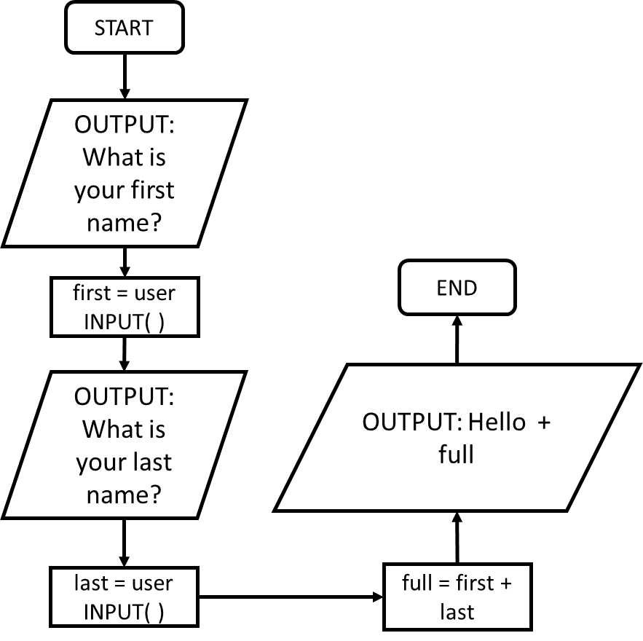
Task 2: Pro
Create two variables called first and last.
Ask for the users first name and last name and store the user input within the appropriate variable.
Concatenate the two variables within a third variable suitably and output the third variable.
Flowchart | Pseudo code
 | START OUTPUT: What is your first name? first = user INPUT( ) OUTPUT: What is your last name? last = user INPUT( ) full = first + last OUTPUT: Hello + full END

Slide 10
Skill Task 2: Solution
Add a print screen to show your coding here.
Add a print screen to show your output solution here.

Slide 11
Skill 2: Change text to upper or lower case
If you were checking if the user input “hello world” was equal to the string statement “Hello World” it would return untrue.
This is because string comparisons are case sensitive.
By manipulating string using the .upper and .lower python functions
Variable a contains the lowercase string “hello world”.
The .upper( ) function converts all lowercase string into uppercase string as shown in the output:
Variable b contains the uppercase string “HELLO WORLD”.
The .lower( ) function converts all uppercase string into lowercase string as shown in the output:

Slide 12
Task 3: Rookie
Create a variable and add your name as string.
Create another variable and change the string to uppercase.
Print the second variable.
Pseudo code
START var1 = Bob var2 = change var1 to UPPERCASE OUTPUT: var2 END

Slide 13
Skill Task 3: Solution
Add a print screen to show your coding here.
Add a print screen to show your output solution here.

Slide 14
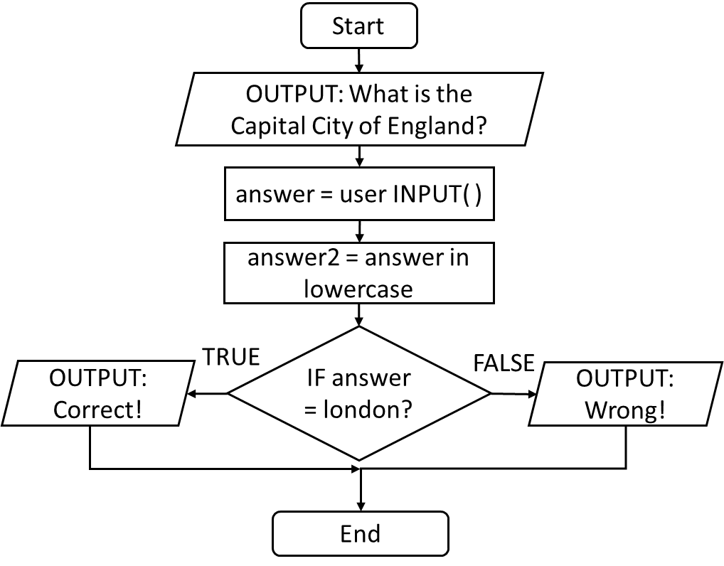
Task 4: Pro
Ask the user what the capitol of England is. Store the response in a variable.
Change the response so that it is all in lowercase.
Using an IF statement, if the user’s answer is equal to london, then let them know they are correct, else let them know they are wrong.
Flowchart | Pseudo code
 | START OUTPUT: What is the capital of England? answer = user INPUT( ) answer2 = answer in lowercase. IF answer = london: OUTPUT: Correct! ELSE: OUTPUT: Wrong! END

Slide 15
Skill Task 4: Solution
Add a print screen to show your coding here.
Add a print screen to show your output solution here.

Slide 16
Skill 3: Find the length of a string
It is possible to count how many characters are included within a string statement.
Variable a contains a string statement. Variable b checks the length of variable a and stores the result as in integer.
As you can see, when variable b is printed, the integer length of a is outputted.

Slide 17
Task 5: Rookie
Create a variable and add your name as string.
Create another variable and store the length of the string in the first variable.
Print the second variable.
Pseudo code | Python
START var1 = Bob var2 = length of Bob OUTPUT: var2 END

Slide 18
Skill Task 5: Solution
Add a print screen to show your coding here.
Add a print screen to show your output solution here.

Slide 19
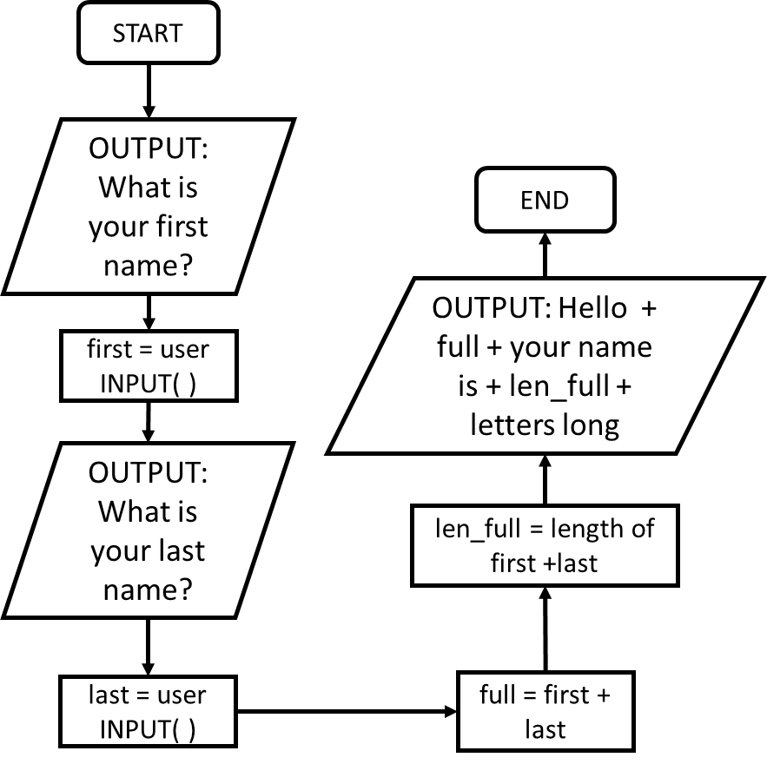
Task 6: Pro
Ask a user to input their first name and last name. Store them in separate variables.
Concatenate the variables within a third variable.
Measure the length of the user’s first and last names and output both the users name and length within a sentence.
Flowchart | Pseudo code
 | START OUTPUT: What is your first name? first = user INPUT( ) OUTPUT: What is your last name? last = user INPUT( ) full = first + last len_full = length of first + length of last OUTPUT: Hello + full + your name is + len_full + characters long! END

Slide 20
Skill Task 6: Solution
Add a print screen to show your coding here.
Add a print screen to show your output solution here.

Slide 21
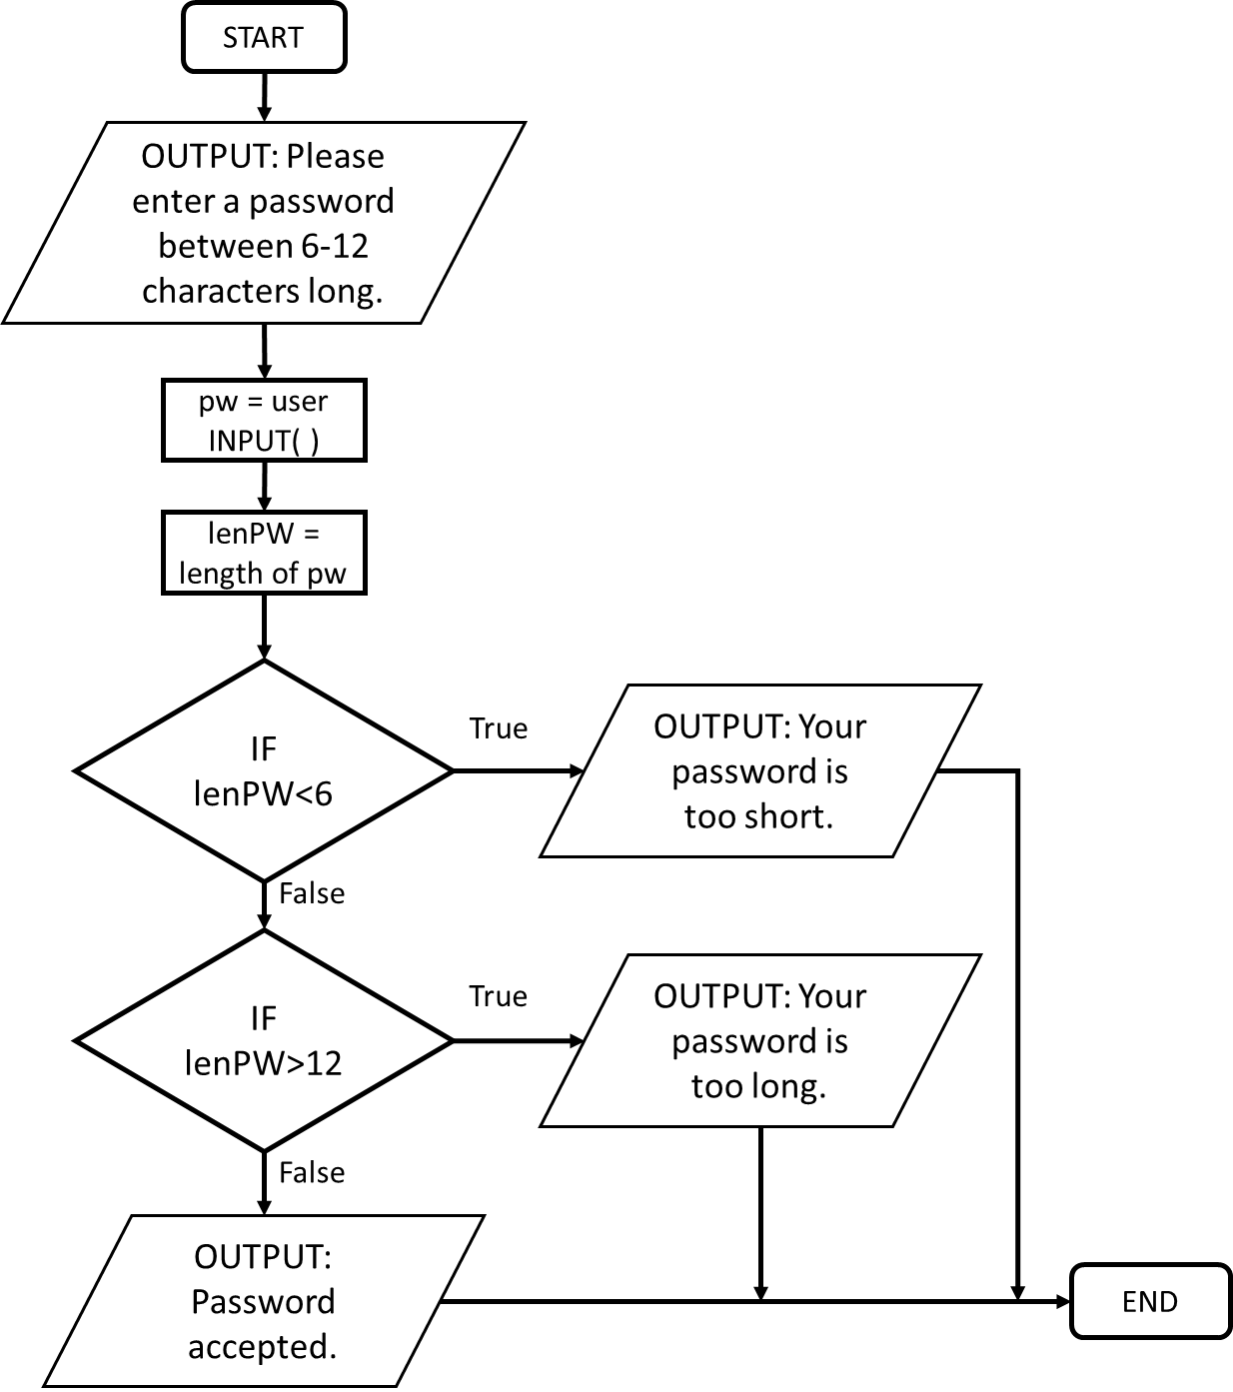
Task 7: Beast
Ask the user to input a password between 6 – 12 characters in length. Store the password in a variable.
Store the length of the password in another variable.
If the password is too short or too long, output a suitable message.
Otherwise, let the user know their password has been accepted.
Flowchart | Pseudo code
 | START OUTPUT: Please enter a password between 6-12 characters long. pw = user INPUT( ) lenPW = length of pw IF lenPW <6: OUTPUT: Your password is too short. ELSE IF lenPW >12: OUTPUT: Your password is too long. ELSE: OUTPUT: Password accepted. END IF END

Slide 22
Skill Task 7: Solution
Add a print screen to show your coding here.
Add a print screen to show your output solution here.

Slide 23
Skill 4: Title text
The function .title( ) can be used to convert each word of a string statement so that the first letter is placed in uppercase and the rest of the string into lowercase.
See the examples below:
Variable a contains the lowercase string “hello world”.
The .title( ) function will convert the first letter of each word to uppercase and the rest to lowercase as shown in the output:
In contrast, variable b contains the uppercase string “HELLO WORLD”. The .title( ) function will again convert the string as it did to variable a;

Slide 24
Task 8: Rookie
Create a variable and add your name as string.
Create a second variable, use the title function and store the string in the first variable in it.
Print the second variable.
Pseudo code | Python
START var1 = bob var2 = title string in var1 OUTPUT: var2 END

Slide 25
Skill Task 8: Solution
Add a print screen to show your coding here.
Add a print screen to show your output solution here.

Slide 26
Task 9: Rookie
Create a variable and add your full name as string.
Create a second variable, use the title function and store the string in the first variable in it.
Print the second variable.
Pseudo code | Python
START var1 = david beckham var2 = title string in var1 OUTPUT: var2 END

Slide 27
Skill Task 9: Solution
Add a print screen to show your coding here.
Add a print screen to show your output solution here.

Slide 28
Task 10: Pro
Create two variables and store a user’s first and last names within them.
Create a third variable, use the title function and concatenate the previous two variable in it.
Print the second variable within a suitable string output.
Flowchart | Pseudo code
 | START OUTPUT: What is your first name? var1 = user INPUT( ) OUTPUT: What is your last name? var2 = user INPUT( ) var3 = title (var1 + var2) OUTPUT: Hello + var3 +, pleased to meet you! END

Slide 29
Skill Task 10: Solution
Add a print screen to show your coding here.
Add a print screen to show your output solution here.

Slide 30
Skill 5: Count elements of a string
The .count( ) function can be used to find a specific string element, or elements, within a variable.
The examples below show how it can be used;
Variables a, contains the string statement “hello world”. Variable b contains the count of the letter “l”. As you can see, when variable b is printed, the number 3 is outputted.
The .count( ) function can also be used to find sequences of string, as shown in the following example;

Slide 31
Task 11: Rookie
Create a variable and add your name as string.
Create another variable and add a count of a specific letter, for example ‘a’.
Print the second variable.
Pseudo code
START var1 = kelly holmes var2 = count of the letter “m” OUTPUT: var2 END

Slide 32
Skill Task 11: Solution
Add a print screen to show your coding here.
Add a print screen to show your output solution here.

Slide 33
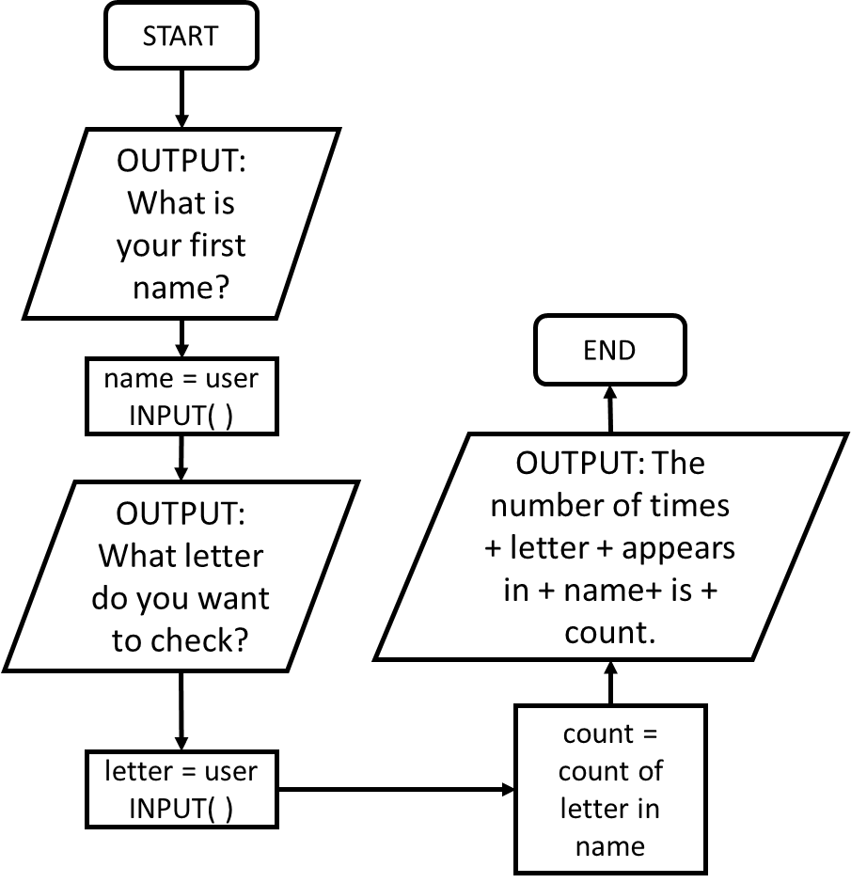
Task 12: Pro
Ask the user to input their name. Store this in a variable.
Ask them which letter they want to count. Store this in a variable.
Conduct the count using the user variable and output the answer in a sting sentence.
Flowchart | Pseudo code
 | START OUTPUT: What is your first name? name = user INPUT( ) OUTPUT: Which letter do you want to check? letter = user INPUT( ) count = count of number of times letter appears in name OUTPUT: The number of times + letter + appears in + name + is + count END

Slide 34
Skill Task 12: Solution
Add a print screen to show your coding here.
Add a print screen to show your output solution here.

Slide 35
Task 13: Beast
Ask a user to input their first name. Store it in a variable. Convert the name to lower case in another variable.
Take a count of each vowel (a, e, i, o and u) and store each count in a separate variable. Also take a count of the total vowels.
Output the information in suitable string statements, showing the user how many individual and total vowels their name contains.
Pseudo code
SSTART OUTPUT: What is your first name? name = user INPUT( ) lower = convert name into lower case count1 = count of the letter a in lower count2 = count of the letter e in lower count3 = count of the letter i in lower count4 = count of the letter o in lower count5 = count of the letter u in lower total = total of Count1 to Count5 OUTPUT: Your name contains the following vowels: OUTPUT: a: + Count1 (repeat for Count2 to Count5). OUTPUT: In total your name contains + total + vowels. END

Slide 36
Skill Task 13: Solution
Add a print screen to show your coding here.
Add a print screen to show your output solution here.

Slide 37
Skill 6: Using the Index
When data is allocated to a variable, each piece of data is given a numbered index.
For example, if the text “Hello World” was assigned to a variable, each string would be allocated the following index locations:
Index | 0 | 1 | 2 | 3 | 4 | 5 | 6 | 7 | 8 | 9 | 10
Variable a | H | e | l | l | o |  | W | o | r | l | d
In this code, variable a is allocated the string “Hello World”. To select an item within a specific indexed location, the square brackets [ ] are used as shown within the example;
Note from the examples how indexing begins at 0.
Also not that space characters are also allocated an index place.

Slide 38
Task 14: Rookie
Create a variable and add your name as string.
Create another variable and store the first index value of the first variable.
Output the second variable.
Pseudo code | Python
START var1 = Sharon var2 = var1 index[0] OUTPUT var2 END

Slide 39
Skill Task 14: Solution
Add a print screen to show your coding here.
Add a print screen to show your output solution here.

Slide 40
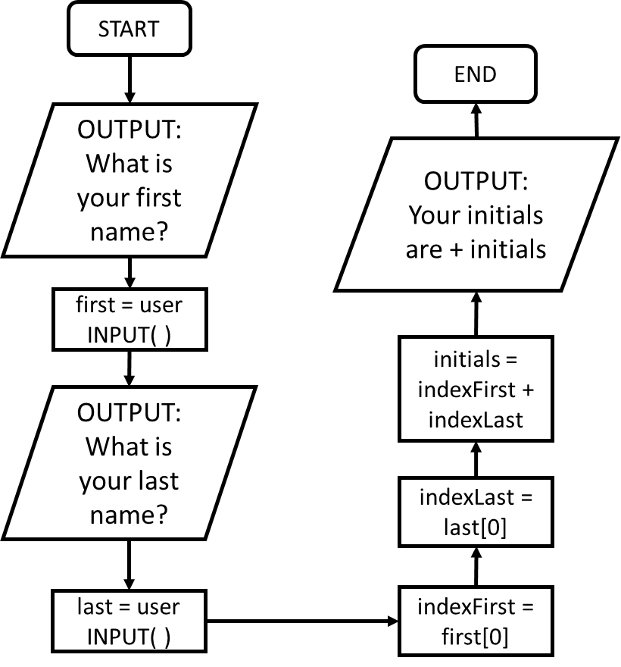
Task 15: Pro
Ask the user to input their first name and last name. Store these in separate variables, converting both to titled string.
Use indexing to identify the first letter of both the user’s first name and last name. This will identify their initials.
Output the user’s initials in a suitable sting sentence.
Flowchart | Pseudo code
 | START OUTPUT: What is your first name? first = user INPUT( ) OUTPUT: What is your last name? last = user INPUT( ) indexFirst = first index[0] indexLast = last index[0] initials = indexFirst + indexLast OUTPUT: Your initials are + initials END

Slide 41
Skill Task 15: Solution
Add a print screen to show your coding here.
Add a print screen to show your output solution here.

Slide 42
Skill 7: Replacing string
The .replace( , ) function allows you to replace one string character with another. It works as follows;
variable.replace(old string , new string)
In the first example, you can see how the first letter within the replace function is replaced with the second letter;
The second example shows how data within a variable can be used to replace a string character;

Slide 43
Task 16: Rookie
Create a variable and add your name as string.
Replace a letter of your choice with another of your choice. Store this in a new variable.
Output the result.
Pseudo code | Python
START var1 = Bob var2 = within var1 replace “b” with “p” OUTPUT: var2 END

Slide 44
Skill Task 16: Solution
Add a print screen to show your coding here.
Add a print screen to show your output solution here.

Slide 45
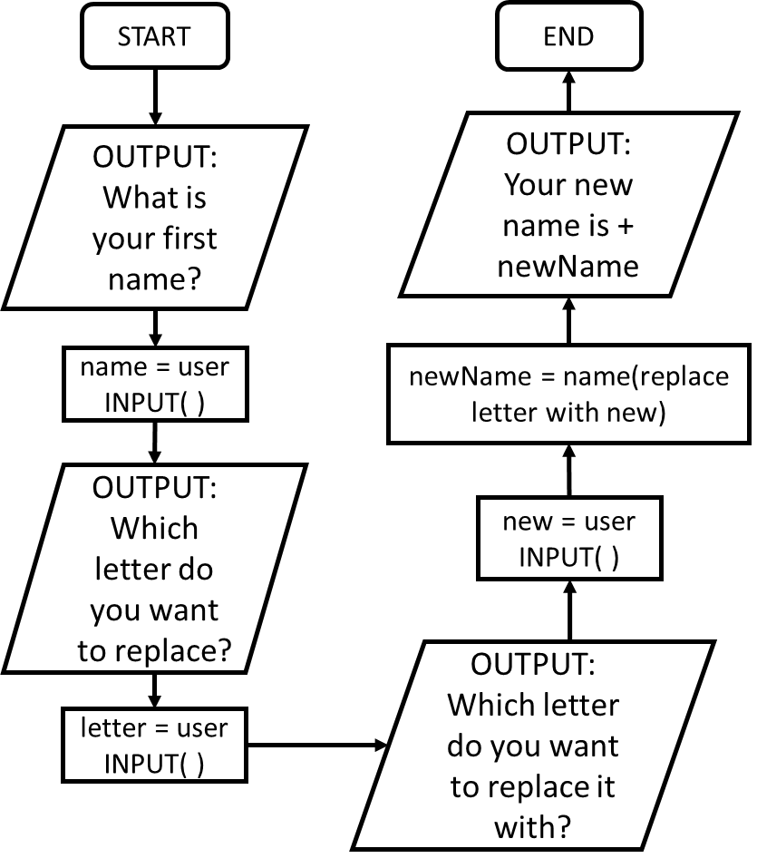
Task 17: Pro
Ask the user to input their name. Store this in a variable.
Ask them which letter they want to replace. Store this in a variable.
Ask them which letter they want to replace it with. Store this in a variable.
Replace the letters and store the resultant name in a separate variable. Output the new name within a sentence.
Flowchart | Pseudo code
 | START OUTPUT: What is your name? name = user INPUT( ) OUTPUT: Which letter do you want to replace? letter = user INPUT( ) OUTPUT: Which letter do you want to replace it with? new = user INPUT( ) newName = within name replace letter with new OUTPUT: Your new name is + newName END

Slide 46
Skill Task 17: Solution
Add a print screen to show your coding here.
Add a print screen to show your output solution here.

Slide 47
Skill 8: Create a Boolean response if a string character is present
Assume you had to create a password which had to contain a specific character, this check could do just that.
In this example, variable b stores the response to the check for the letter “l” within the variable a. As there are three l’s, the result of the check is true.
The second example shows how data within a variable can also be checked against the string;

Slide 48
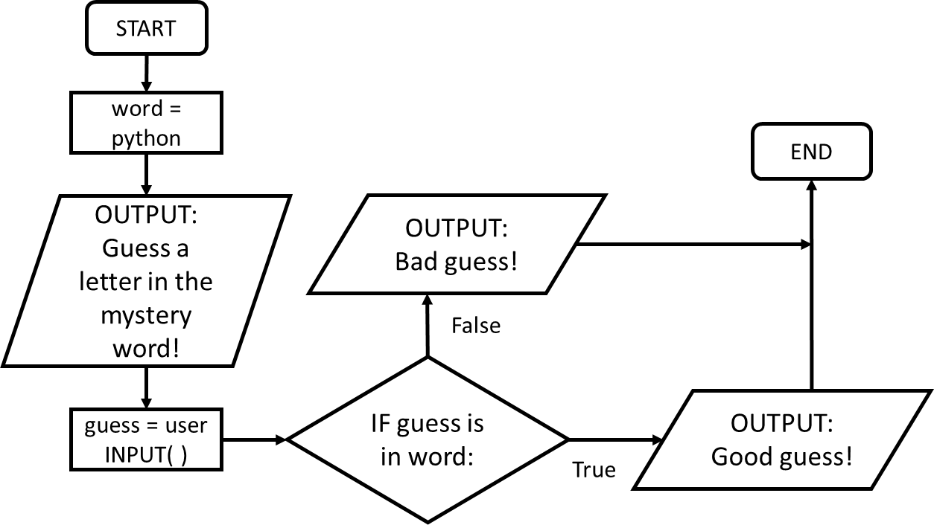
Task 18: Pro
Store a random word in a variable.
Ask the user to guess a letter in the mystery word.
Check if the user input is in the mystery word. Using an if statement, output a suitable response depending on if the letter is present or not.
Flowchart | Pseudo code
 | START word = python OUTPUT: Guess a letter in the mystery word! guess = user INPUT( ) IF guessed letter is in word: OUTPUT: Good guess! ELSE: OUTPUT: Bad guess! END IF END

Slide 49
Skill Task 18: Solution
Add a print screen to show your coding here.
Add a print screen to show your output solution here.

Slide 50
Programming Challenges
Now you have learned some programming skills, it’s time to put them into practice!
Complete the following programming challenges. Start with the Rookie challenge and see how far you can push yourself.
Finally, complete the debugging challenge.
Once you have finished your challenges, complete the review. Look back at the skills you have learned so far to help you solve the challenge.

Slide 51
Programming Challenge: Rookie
Add a print screen of your solutions to the next slide.
Write a piece of code that asks a user for their first name and last name then titles and concatenates it within another variable.
Count the number of letters in the users name and store it in another variable.
Once done, output the gathered information in a sentence like this;
1 Mark
Bonus mark for adding comments!

Slide 52
Programming Challenge: Rookie - Answer
Add a print screen to show your coding here.
Add a print screen to show your output solution here.

Slide 53
Programming Challenge: Pro
Add a print screen of your solutions to the next slide.
Write a piece of code that asks for the user’s first and last names. Output the following information within a suitable format;
Full name titled
Number of letters within their name (excluding spaces)
Their initials
1 Mark
Bonus mark for adding comments!

Slide 54
Programming Challenge: Pro - Answer
Add a print screen to show your coding here.
Add a print screen to show your output solution here.

Slide 55
Programming Challenge: Beast
Add a print screen of your solutions to the next slide.
Write a piece of code that asks for the user’s first and last names. Output the following information within a suitable format;
Full name titled
Number of letters within their name (excluding spaces)
Their initials
Number of individual and total vowels within their name.
1 Mark
Bonus mark for adding comments!

Slide 56
Programming Challenge: Beast - Answer
Add a print screen to show your coding here.
Add a print screen to show your output solution here.

Slide 57
Debugging Question
Which of the following lines of code below would output the letter B:
Highlight the correct cell in green:
1 Mark

Slide 58
Challenges Review
Complete the table below to help you identify what areas you are confident at and which areas you need to improve further:
Challenge | Your Score (Max 1 mark each)
Rookie Challenge
Pro Challenge
Beast Challenge
Debugging Challenge
Unit Review
What Went Well:
Even Better If:

